Slide 1
Expected Outcomes
Upon completing this session, attendees can expect to be familiar with:
Gradebook Dashboard
Creating Gradebooks
Gradebook Setup and Configuration: Options, Categories, Final Marks
Manage Students (Add/Drop)
Adding/Editing Assignments and attaching Standards to Assignments
Entering Scores
Accessing Gradebook Reports
Submitting Gradebook Grades to Report Cards
Accessing Support Resources

Slide 2
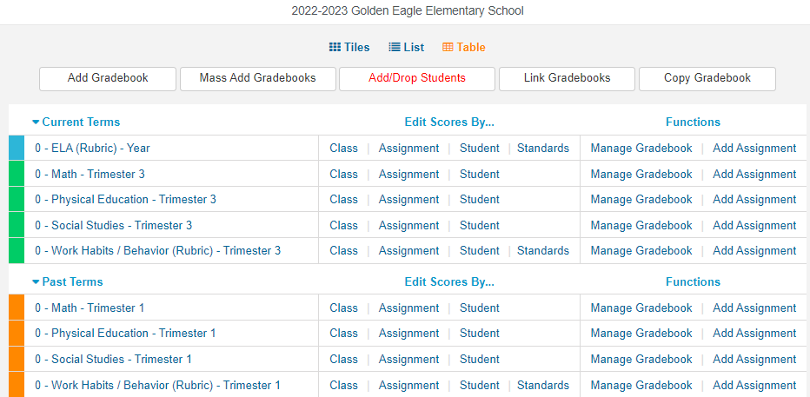
Gradebook Dashboard
Views: Tiles, List, or Table
Add, Mass Add, Copy Gradebooks
Add/Drop Students (if needed)
Link Gradebooks (if needed)
Focus on Current Terms, but Future and Past Terms will be available
3 Ways to Edit Scores: by Class, by Assignment, by Student (plus by Standards if applicable)
Direct access to Manage Gradebook and Add Assignment

Slide 3
Creating New Gradebook(s)
Add Gradebook
Mass Add Gradebooks
Copy Gradebook
Link Gradebooks
1. Configure a Gradebook with Terms, Section(s), and Gradebook Name
Mass Add may be used for teachers who teach more than one section each day. Select sections and terms and then it will configure one Gradebook shell for each section.
Copy allows you to copy:
Your own or another teacher’s Gradebook from current or past year
Include as desired: Final Marks, Options, Categories Assignments
Linking Gradebooks is used in schools with Master Schedules for teachers who teach multiple periods of the same subject.
NOTE: Gradebooks must be linked when the Gradebooks are created, before Categories and Assignments are added. Gradebooks should not be linked after Assignments have been added.

Slide 4
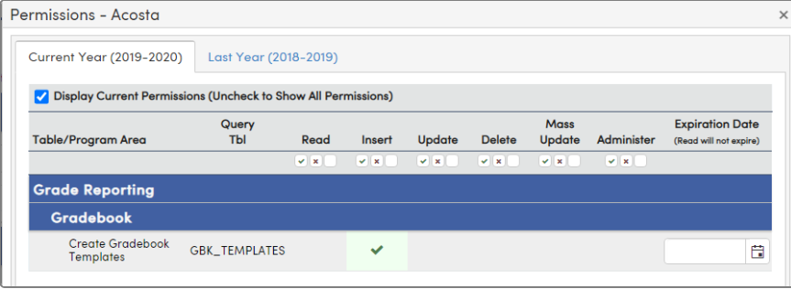
Templates
1.
2.
3.
4.
Security permission (GBK) for teacher(s) to create a template
The teacher with GBK_ Templates permissions will see the School Template option when adding a Gradebook. If checked, they will see the Multi-School Template option
When templates are available, other teachers see the Use Existing Template checkbox
Use of a template can be required on Portal Options > Gradebook tab. Lock options are also available.

Slide 5
Manage Gradebook
BLUE NAVIGATION BAR
TABS
BLUE NAVIGATION BAR (available on most pages other than Dashboard)
Use drop-down arrow to switch to another Gradebook
Easy access back to Dashboard
Direct link to methods of entering scores: By Class, Assignments, Students, Standards
Reports
TABS
Set up/Configure Gradebook using Edit, Options, Categories, Final Marks, Narrative Grades, Rules
Manage Students
Assignment details
Backup & Restore

Slide 6
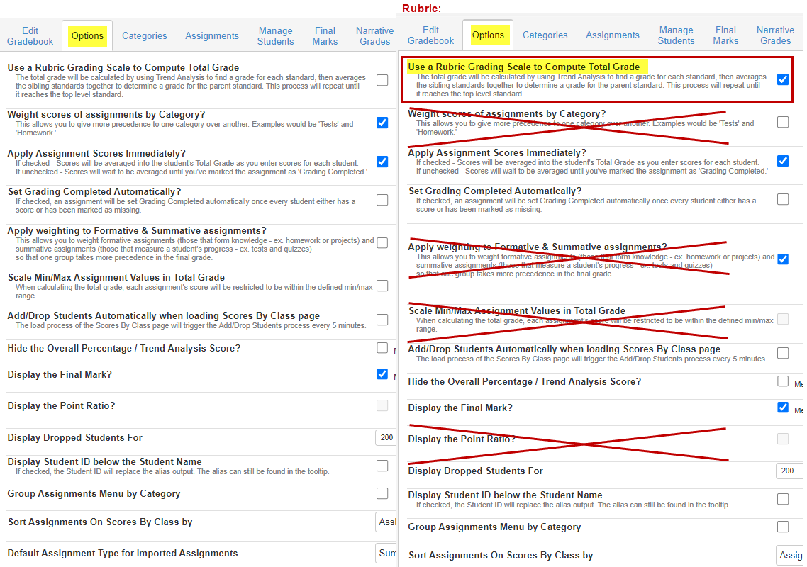
Gradebook Options
Variety of set up options to choose from
Some are personal preference
Others are required to perform assignment score functions
If the Gradebook is Rubric, some setup Options will not apply.

Slide 7
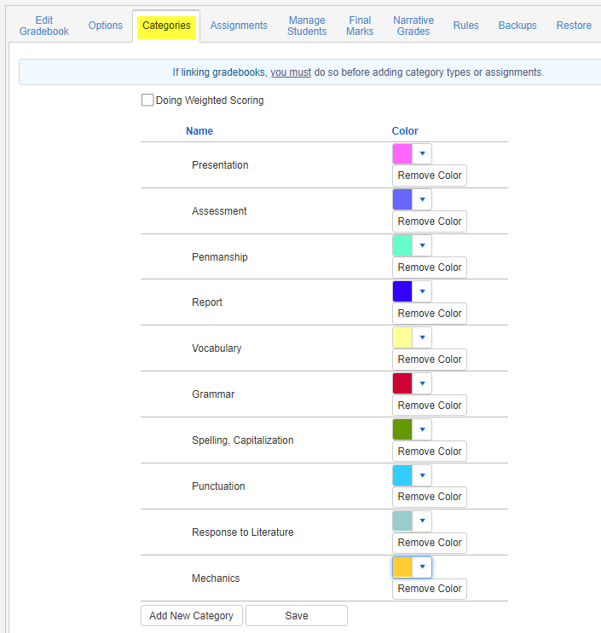
Categories
Each Gradebook must have at least one Category
Doing Weighted Scoring does NOT apply to Rubric
Each Category can be color-coded

Slide 8
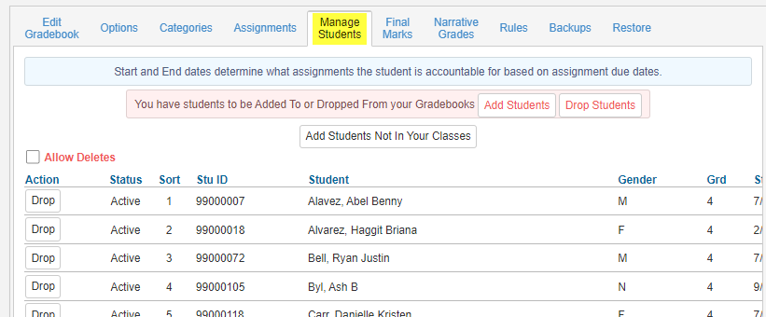
Manage Students
Three locations:
Manage Students tab
Options tab
Dashboard

Slide 9
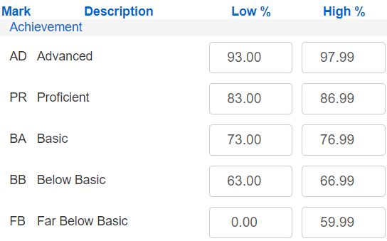
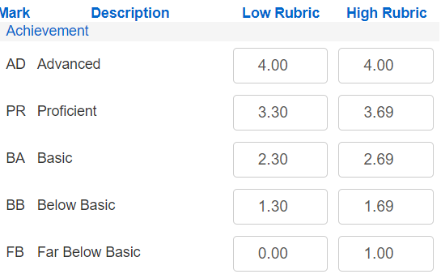
Final Marks
Restore School Recommended Defaults: Marks are set up by the school’s Aeries Admin for SBG marks or GRD marks
The Low %/ High % or Low Rubric / High Rubric can be modified by the teacher

Slide 10
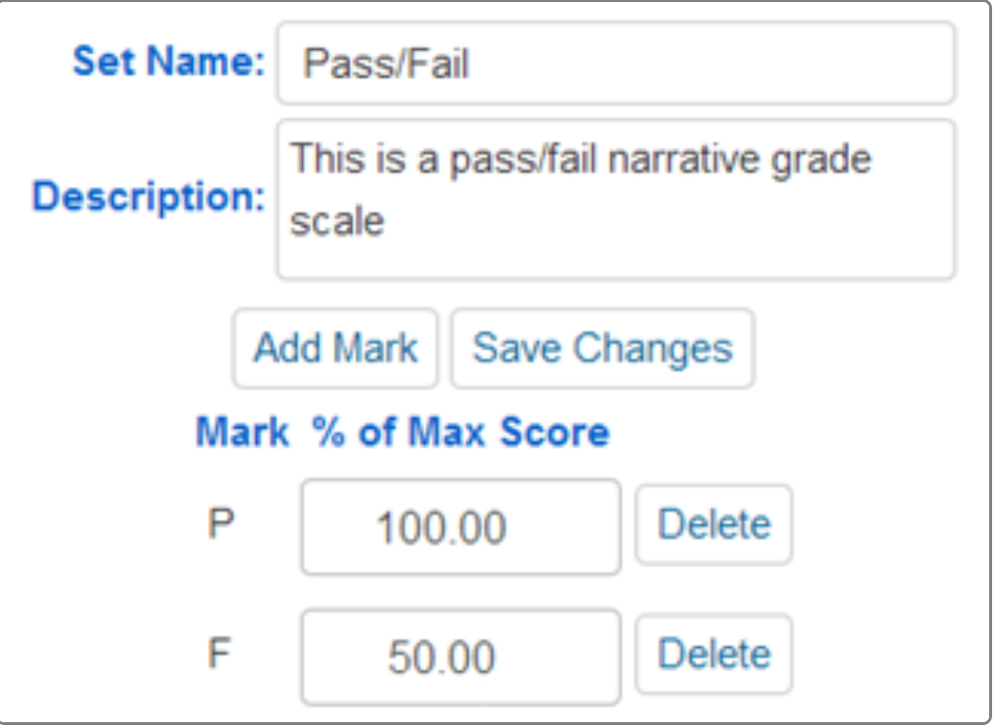
Narrative Grades
A Percentage of the Max Score is entered for each valid mark
Only alpha Narrative Marks are supported
When adding a new assignment, the Narrative Grade Set will be available from the dropdown of the Narrative Grading field

Slide 11
Rules
Does not apply to Rubric scoring
Meant to drop lowest specified number of assignment scores and optionally replace with average or top score in subject area

Slide 12
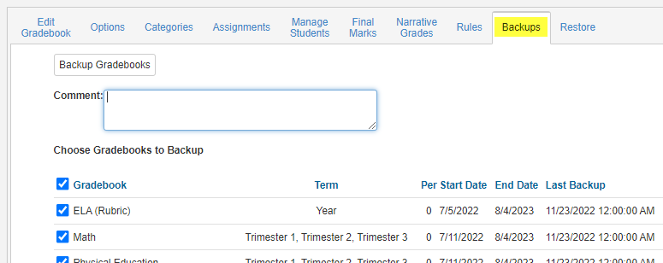
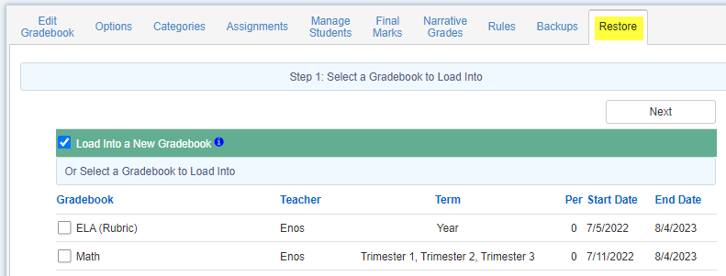
Backups / Restore
Allows Teacher to backup their Gradebooks.
Restore allows teachers to restore their own Gradebook or other teacher’s Gradebooks
Restore has 3 steps:
1. Load INTO a New Gradebook or Existing Gradebook
2. Restore FROM
3. Select Items/Tables to restore

Slide 13
Adding Scores
Scores by Class
Scores by Assignments
Scores by Student
Scores by Standards

Slide 14
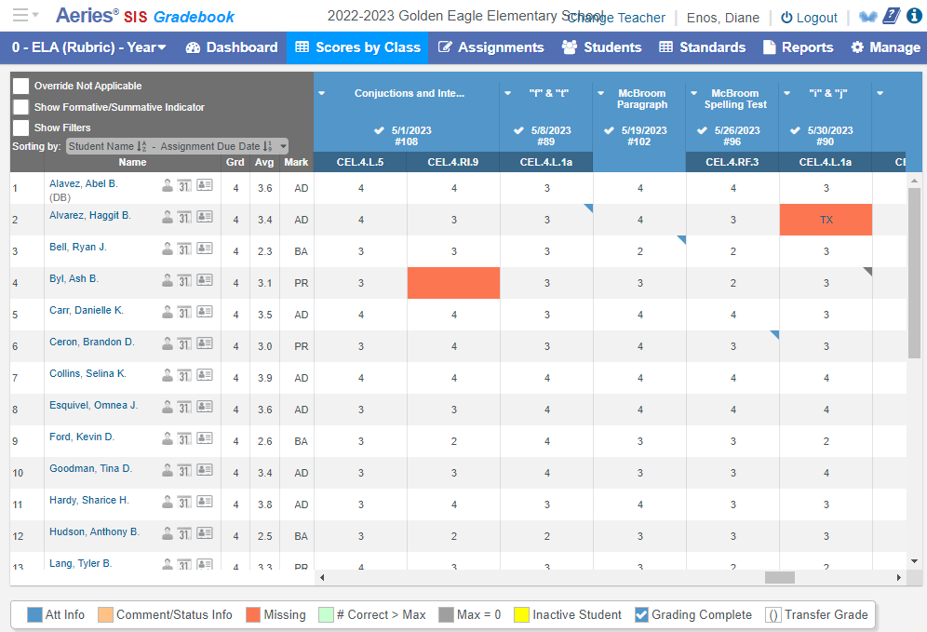
Scores by Class
All the assignments; all the students
Legend at the bottom

Slide 15
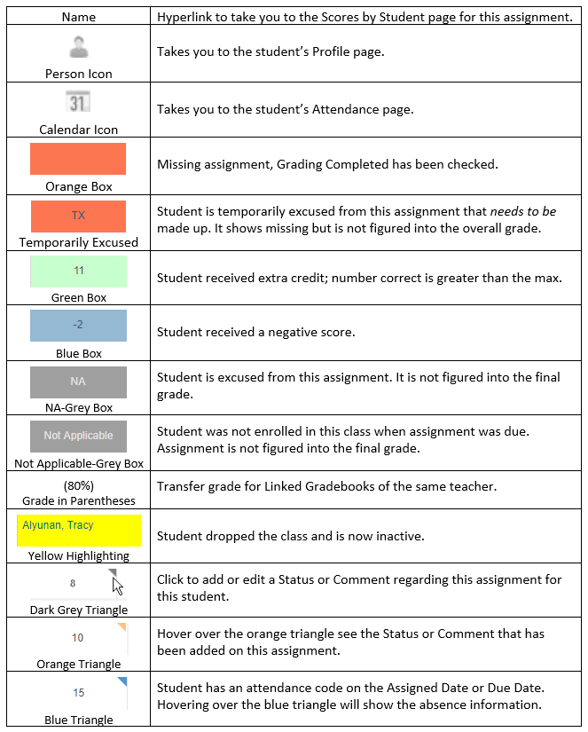
Legend for Scores pages
On Scores by Class and (mostly) on Scores by Assignment

Slide 16
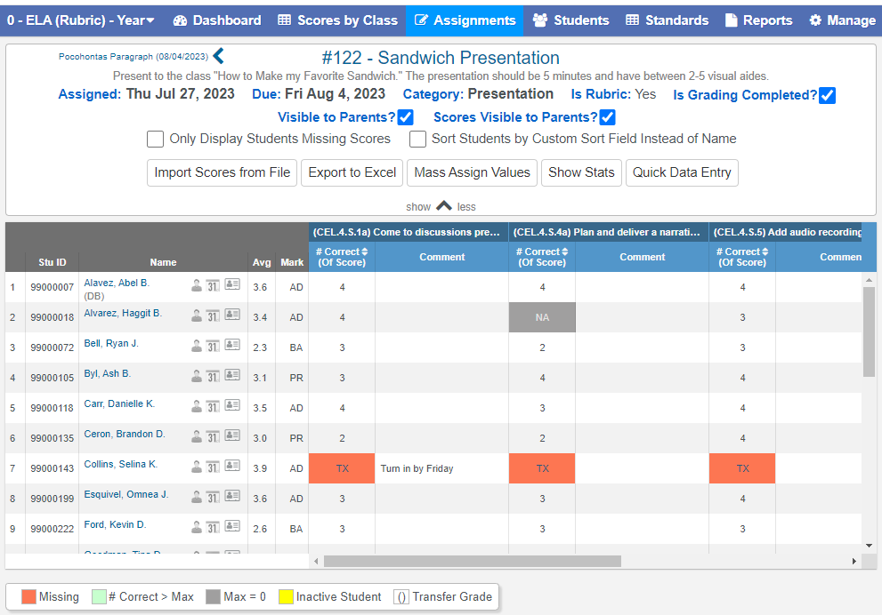
Scores by Assignment
One assignment at a time
Show More:
Mass Assign Values
Import Scores

Slide 17
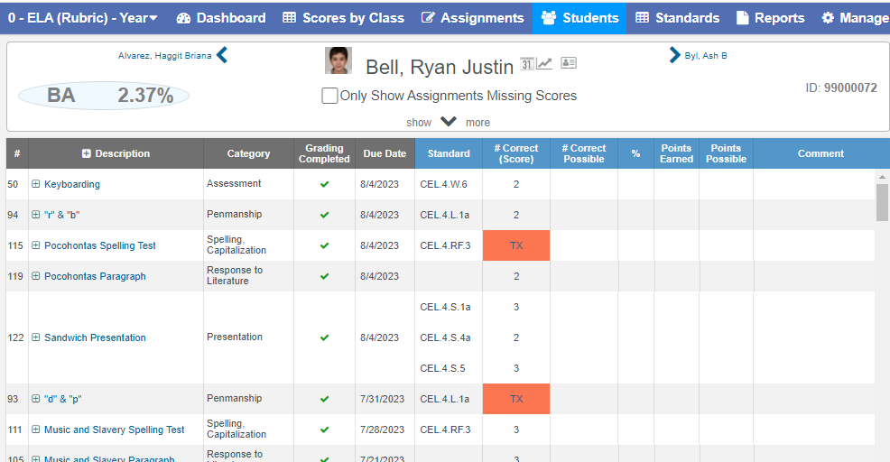
Scores by Students
One student at a time
Show More displays a summary by Category and Total

Slide 18
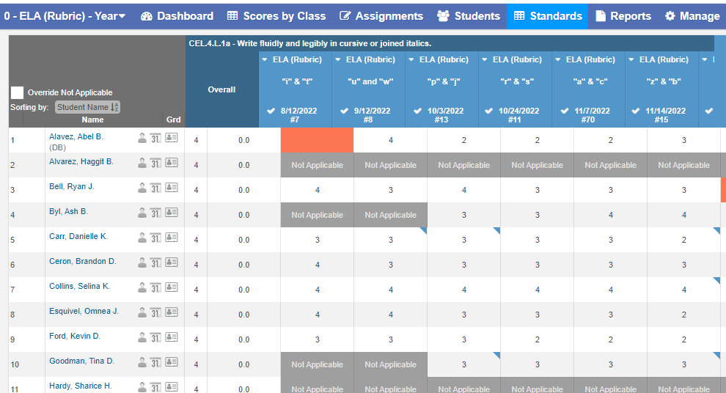
Scores by Standards
Can view all or selected Standards

Slide 19
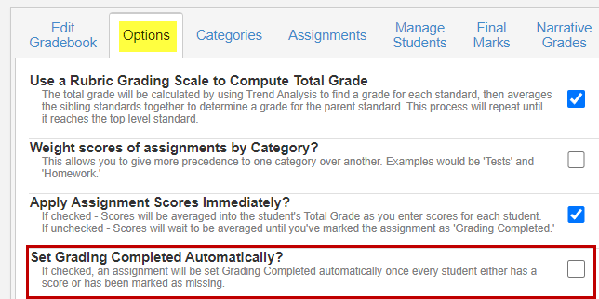
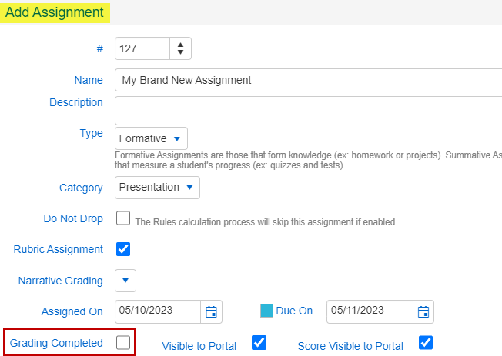
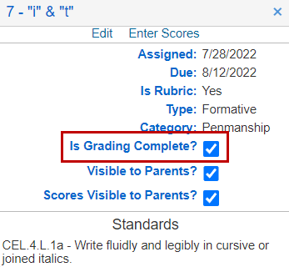
Grading Completed
Can be set in multiple places

Slide 20
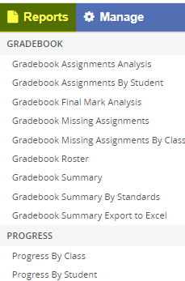
Gradebook Reports
Gradebook:
Gradebook Assignments Analysis
Gradebook Assignments By Student
Gradebook Final Mark Analysis
Gradebook Missing Assignments
Gradebook Missing Assignments By Class
Gradebook Roster
Gradebook Summary
Gradebook Summary By Standards
Gradebook Summary Export to Excel
Progress:
Progress By Class
Progress By Student

Slide 21
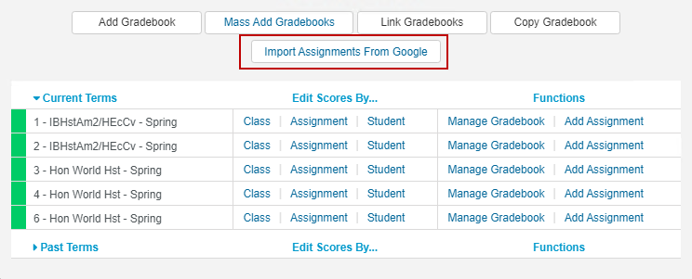
Google Classroom
Not applicable to Rubric scoring
If configured, available from Dashboard or Scores by Assignment
See Gradebook – Scores by Assignment documentation: https://support.aeries.com/support/solutions/articles/14000067734-gradebook-scores-by-assignment

Slide 22
Gradebook Documentation folder: https://support.aeries.com/support/solutions/folders/14000115568
Gradebook Videos:
https://support.aeries.com/support/solutions/folders/14000116602
Remember the Book of Knowledge link within Aeries:
Gradebook documentation on support.aeries.com:

Slide 23
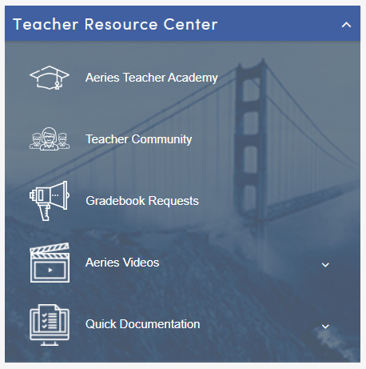
More help: the Teacher Resource Center

Slide 24
More Help is Available:
Aeries Academy: https://www.aeries.com/academy
Free, self-paced training on lots of topics, including scheduling
Good Morning Aeries! Free 30-45 minute webinars on specific topics
Previous GMAs here: https://support.aeries.com/support/solutions/folders/14000128556
Upcoming GMAs here: https://www.aeries.com/events/
Demo data is available all the time here: https://www.aeries.com/solutions/demo

Slide 25
Questions?

Slide 26
We value your feedback!
Please take a few minutes to complete our survey and let us know how we can better serve you in the future!
http://surveys.aeries.com/s3/training

Slide 27
THANK YOU!

