Slide 1
AERIES Scheduling Workshop Day #2 – AM Session
WELCOME!
This workshop will start about 8:00 PST/10:00 CST.
Sam Defeo - Aeries Trainer

Slide 2
AERIES Scheduling Workshop Day #2 – AM Session
8:00 – 11:30 PST/10:00 – 1:30 CST - Master Schedule Building
AM Break about 9:45 PST/11:45 CST
12:30 – 4:00 PST/2:30 – 6:00 CST - Flex Periods & Class Calendars
PM Break about 2:15 PST/4:15 CST
Sam Defeo - Aeries Trainer

Slide 3
DOCUMENTATION
The documentation for this workshop:
https://support.aeries.com/support/solutions/articles/14000126743

Slide 4
DOCUMENTS USED FOR THIS WORKSHOP
The documents that will be used in this workshop:
SW D2 AM Doc1 Master Schedule Building.pptx SW D2 AM Doc2 Master Schedule Building Cells.docx SW D2 AM Doc3 Course Request Tally.pdf
SW D2 AM Doc4 Class Load Averages with Details .pdf
SW D2 AM Doc5 Class Load Averages with Totals.pdf
Flex SMS Board
--------------------------------------------------------------------------
SW D2 PM Doc1 Flex Periods & Class Calendars.pptx
Finals Day.docx

Slide 5
COLOR CODING OF CHIPS
Chips may be color coded by:
Department: English, History, Science, etc.
Grade: Multiple grades, 12th grade, 11th grade, 10th grade, 9th grade.
Frequency of Offering: Singletons, doubletons, tripletons, etc.

Slide 6
REQUIREMENTS
Any section that is locked into a specific period, term and teacher is a requirement. These may also be called constraints.
Know the rational for the requirement.
Accept or reject the requirement – Gottabe vs. Wannabe.
The more requirements that you accept, the more difficult it is to build the rest of the master schedule.

Slide 7
SINGLETONS
Singletons are sorted most requests to fewest. Choose your primary sort order:
All Courses
Grade Level: Cross grade level courses, 12th grade, 11th grade, etc.
Department: English, History, Science, etc.
Level of Instruction: Special Ed, AP, Honors, etc.
Place singletons to reduce the number of conflicts by using the Conflict matrix.

Slide 8
DOUBLETONS
Doubletons are sorted most requests to fewest, Use the same primary sort order that was used for placing singletons:
All Courses
Grade Level: Cross grade level courses, 12th grade, 11th grade, etc.
Department: English, History, Science, etc.
Level of Instruction: Special Ed, AP, Honors, etc.
Place doubletons to reduce the number of conflicts by using the Conflict matrix.

Slide 9
TRIPLETONS
Tripletons are sorted most requests to fewest, Use the same primary sort order that was used for placing singletons:
All Courses
Grade Level: Cross grade level courses, 12th grade, 11th grade, etc.
Department: English, History, Science, etc.
Level of Instruction: Special Ed, AP, Honors, etc.
Place tripletons to start the balancing of the average number of students by period, grade level, and term.

Slide 10
REMEMBER
RULES FOR SINGLETONS & DOUBLETONS
Use the Conflict Matrix
Run the Singleton or Doubleton through every period
TOTAL SEATS
Total the average number of seats by Period, Grade Level, and Term

Slide 11
INTERMISSION – AM BREAK

Slide 12
REMEMBER
RULES FOR SINGLETONS & DOUBLETONS
Use the Conflict Matrix
Run the Singleton or Doubleton through every period
USE THE SMS BUILDER

Slide 13
USE THE SMS BUILDER
C.2. SMS Board
Select: SMS BUILDER.
Select a Course. Displays Course Request by Grade.
Scheduling Conflict Matrix.
Sections to Add.
Complete the data for each section.
Select: Add Sections

Slide 14
REMEMBER
TOTAL SEATS
Total the average number of seats by Period, Grade Level, and Term
SCHEDULING CLASS LOAD AVERAGES

Slide 15
TOTAL SEATS
D.6. Scheduling Class Load Averages – prints the class load averages by Term, Period, and Grade. This report is commonly referred to as the “Seat Count” report.
Select Term to Print: Y – (includes F, S, Y)
Select Print Options: Skip Inactive Students
Select Print Options: Display Only Totals

Slide 16
ANY QUESTIONS?

Slide 17
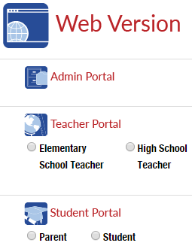
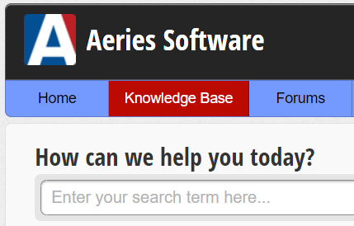
MANY SUPPORT RESOURCES
demo.aeries.net
Demo Database
Great for more practice!
learn.aeries.com
Aeries Teacher Academy
FREE online courses!
support.aeries.com
Aeries Documentation
& Video Library
Targeted support at your fingertips!

Slide 18
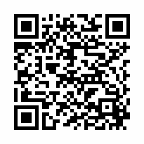
We value your feedback!
Please take a few minutes to complete our survey and let us know how we can better serve you in the future!
You will be enrolled in our monthly drawing for a gift card.
https://survey.alchemer.com/s3/7443595/Aeries-Training-Survey

Slide 19
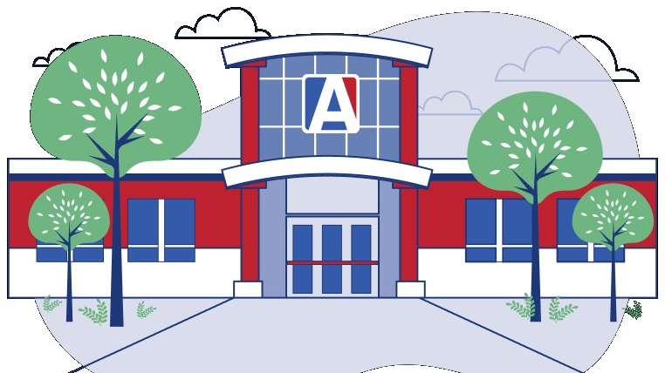
THANK YOU!

Slide 20
INTERMISSION – LUNCH

