Slide 1
Good morning, Aeries!
Standards Based Grade Report Card Templates

Slide 2
Speaking today:
Presenter - Arlene Suval | Aeries Trainer
arlene@aeries.com
Moderator – Leeni Mitchell | Aeries Trainer

Slide 3
Good morning, Aeries!
Short & sweet… only 30-40 minutes
Show & Tell
Casual Setting
Time for Q&A
Power Point and Recordings Posted to Aeries Support Home Page

Slide 4
Is this a new SBG report card or is it an existing SBG report being modified?
SBG Standards (Common Core, CA, Local) need to be identified for each grade level
Standards Based Options need to be selected prior to creating a Template
Need
To
Know
Only 2-column report card templates are supported at this time

Slide 5
Current SBG report cards can be imported into Templates
Designing the template can be on-going before actual setup is finalized
Existing templates can be copied to other grade levels, and many templates for the same grade level can be created before finalizing
Nice
To
Know
Print preview option is available after a template has been saved

Slide 6
Standards
Standard Based Report Card Template Overview
Standard Based Report Card – Creating a New Template
Standard Based Report Card – Building a New Template
Standard Based Report Card – Saving and Opening a Template
Standard Based Report Card – Push to SBE
Where To
Go

Slide 7
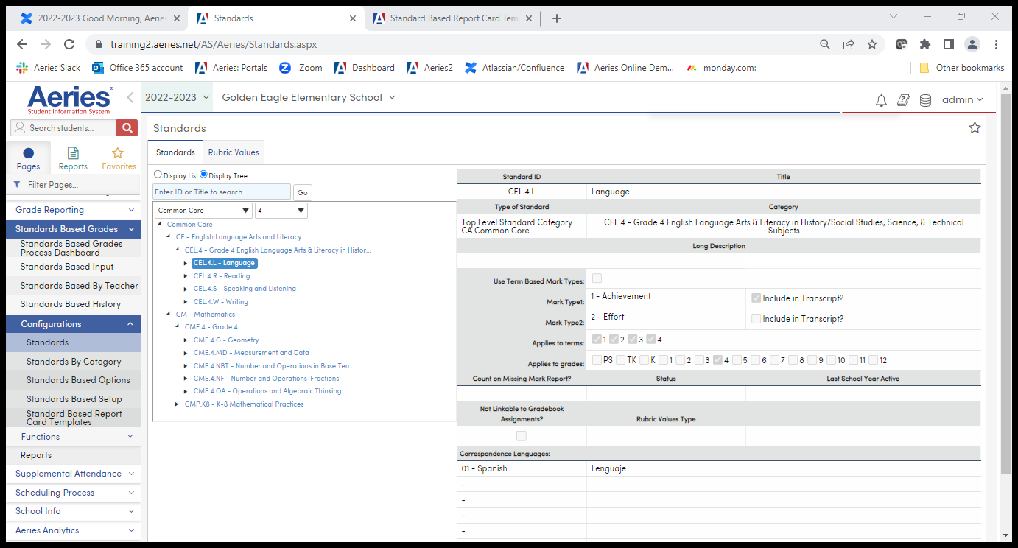
Identify and confirm the Standards that your District will use for each Grade Level

Slide 8
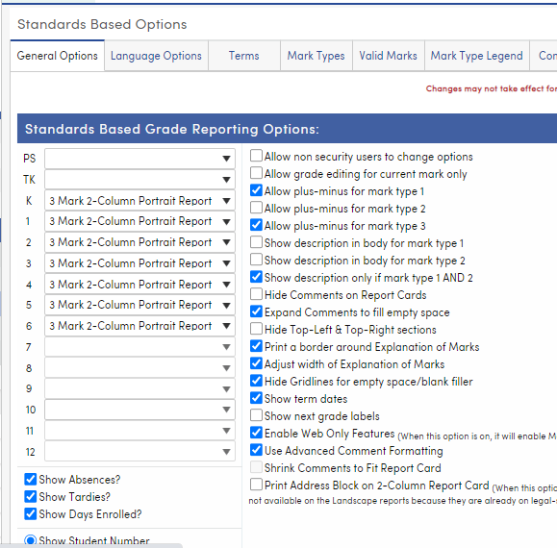
Standard Based Options – General Options tab, has choices that will determine how the report card looks

Slide 9
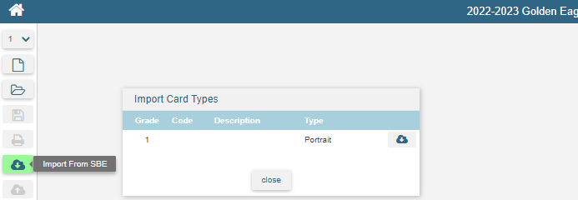
There are two options when setting up a new Template (there is a 3rd option we’ll talk about later)
1. Import from SBE – brings a copy of an existing report card into Template, so it can be modified
2. Create New Template – creates a blank template that incorporates any SBG Options that have been selected prior to this step

Slide 10
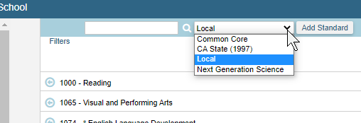
After opening a template, begin selecting the main Standard. Left arrow adds all sub-standards Right arrow drills down to each sub-standard

Slide 11
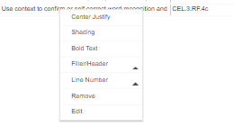
After adding your standards, begin “designing” by highlighting each Standard to either “drag & drop” in another location, or highlighting and using rt click to open format options

Slide 12
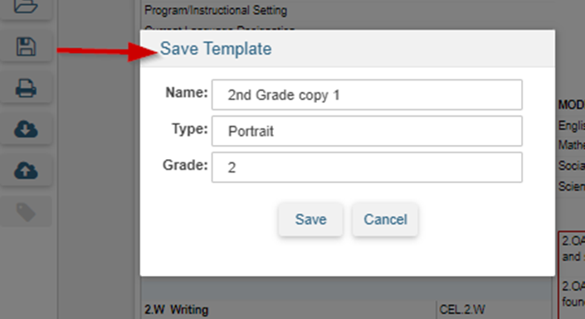
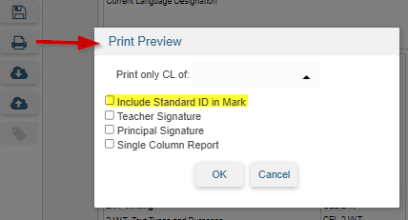
Save your template and use Print Preview, including Standard ID This begins the work of finalizing the template before Pushing it to SBE
Add a Title in the Name field – will help you identify which to keep

Slide 13
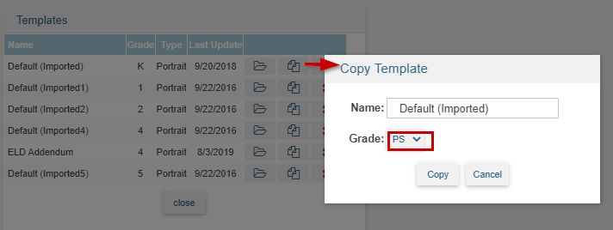
The 3rd way to create a template….Copy one template and re-assign the grade level or name to create a new template

Slide 14
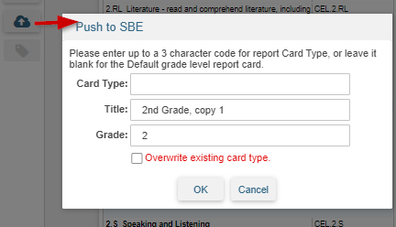
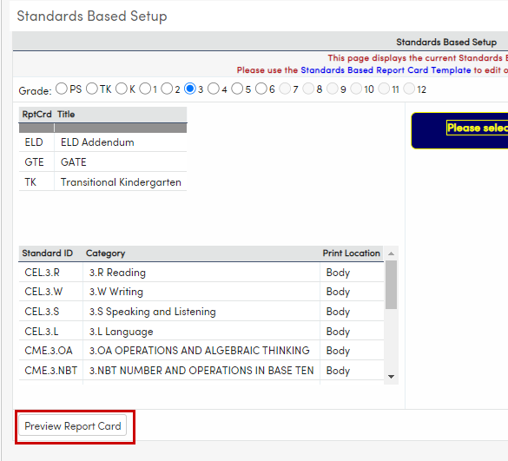
When the template is finalized, push it to the SBE table In the Standards Based Setup (SBE) page, you can print out a blank report card NO Changes to SBG report cards after grading begins!!

Slide 15
Thanks for Joining Us!
Watch for future GMAs (9am PST/11am CST)
https://www.aeries.com/events/
CALPADS EOY - Dual Enrollment Students, 5/31
Calpads EOY/Where Does Data Go?, 6/1
Transcripts - Mass Update Grad Status
& Print to Colleges, 6/6
End of Year Wrap Up/Queries, 6/8
New Year Rollover - Non-Hosted, 6/13

Slide 16
We Value Your Feedback…
Please take a few minutes to complete our survey; let us know how we can better serve you in the future. Have a great rest of your day!
Good-Morning-Aeries-Survey

