Slide 1
Good morning, Aeries!
Discipline Dashboard

Slide 2
Speaking today:
SUSAN PROW | Implementation Coordinator
susan@aeries.com
DESIREE GUERRERO | Training Specialist
desireeg@aeries.com

Slide 3
Discipline Dashboard
A resource for monitoring discipline.
Supports data driven decision making.
Ready for use!

Slide 4
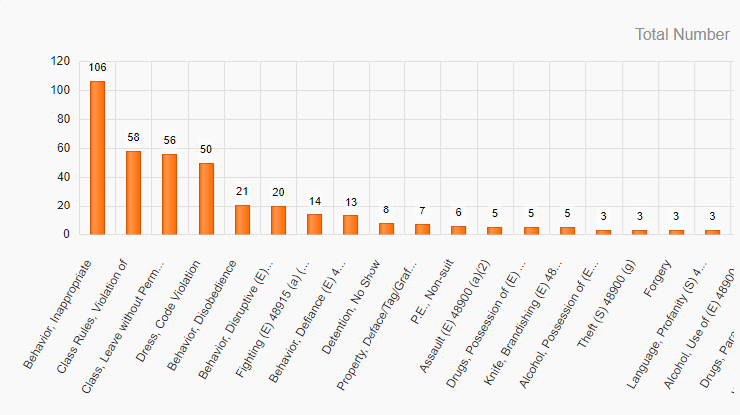
The Discipline Dashboard displays analytic data of
Assertive Discipline (ADS) incidents
for the current academic year.
Why use the Discipline Dashboard?

Slide 5
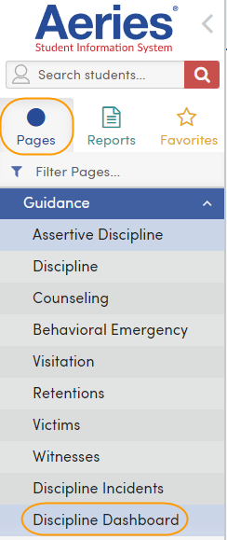
Accessing the Discipline Dashboard
Permissions/Pages Tab
Read Rights to Assertive Discipline (ADS)
Student Data Node
Guidance Sub-Node
Discipline Dashboard

Slide 6
Options for viewing discipline data include:
Year to Date
Date Range
Assertive Discipline (ADS) Codes
Code selection options
Show Total # of Referrals
Referrals filtering options
Incidents for all Violation Codes
Incident filtering options
Downloading Details
Exports to Excel
Export as an Image
Exports to a png
Click graphic to view associated students
Navigating the
Discipline Dashboard

Slide 7
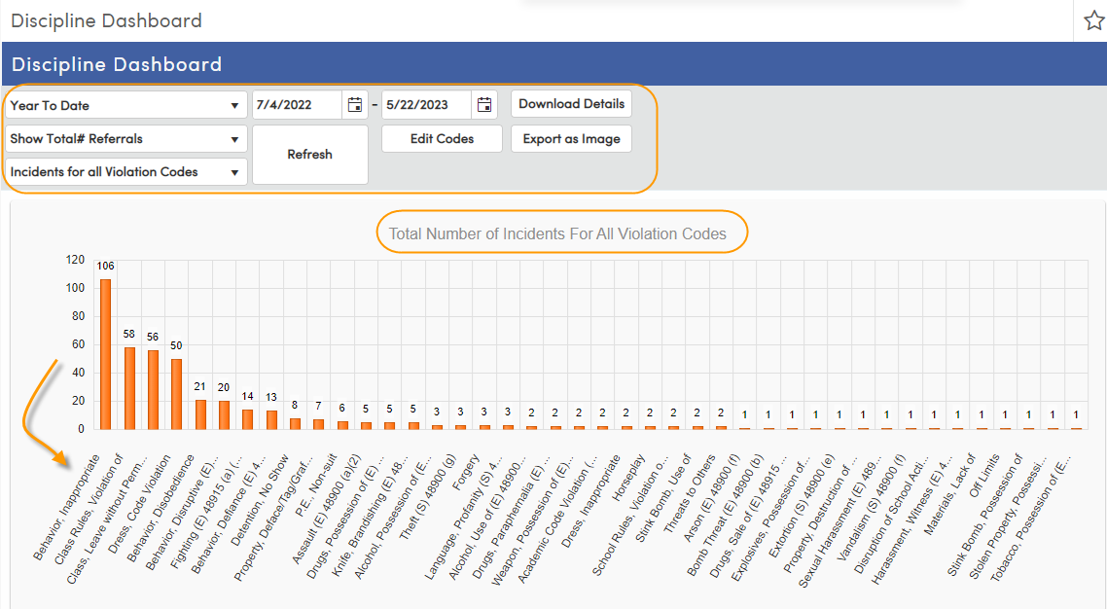
Discipline Dashboard Display

Slide 8
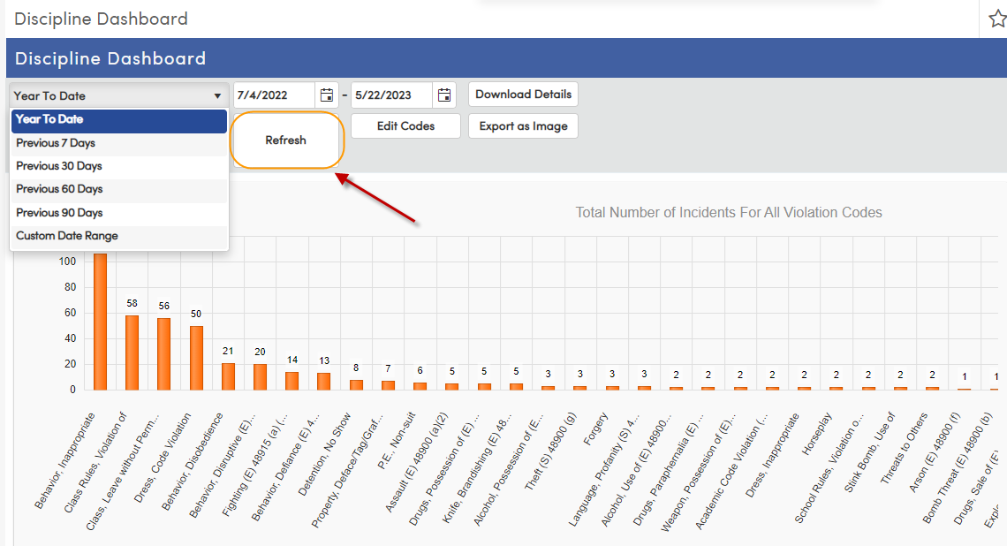
Year to Date Options
Range Options:
Year to Date
Previous 7 Days
Previous 30 Days
Previous 60 Days
Previous 90 Days
Custom Date Range
Refresh

Slide 9
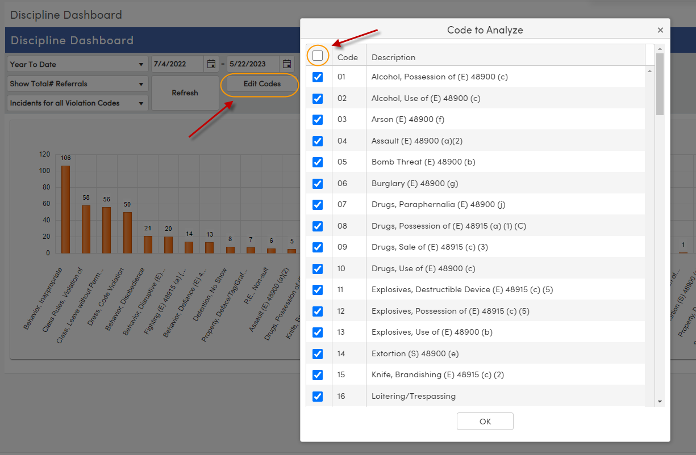
Assertive Discipline Codes
Displays all codes available in Assertive Discipline table (ADS)
Select All/None available
Refresh

Slide 10
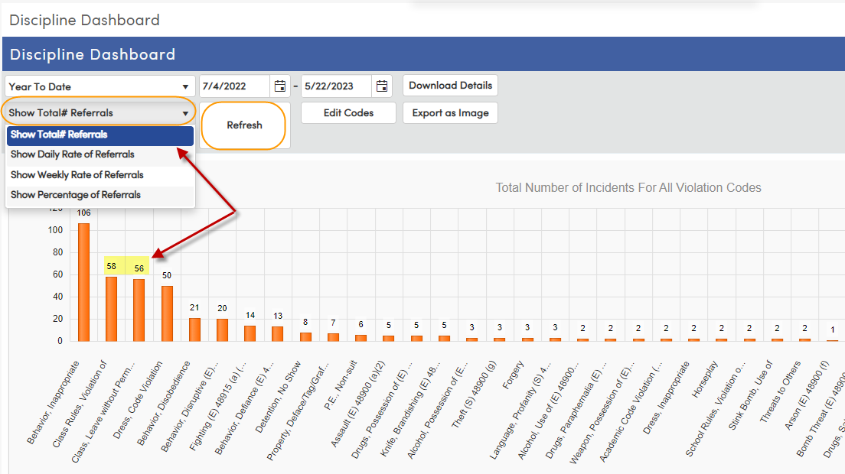
Show Total # of Referrals
Referral Options:
Show Total #
Show Daily Rate
Show Weekly Rate
Show Percentage
Refresh

Slide 11
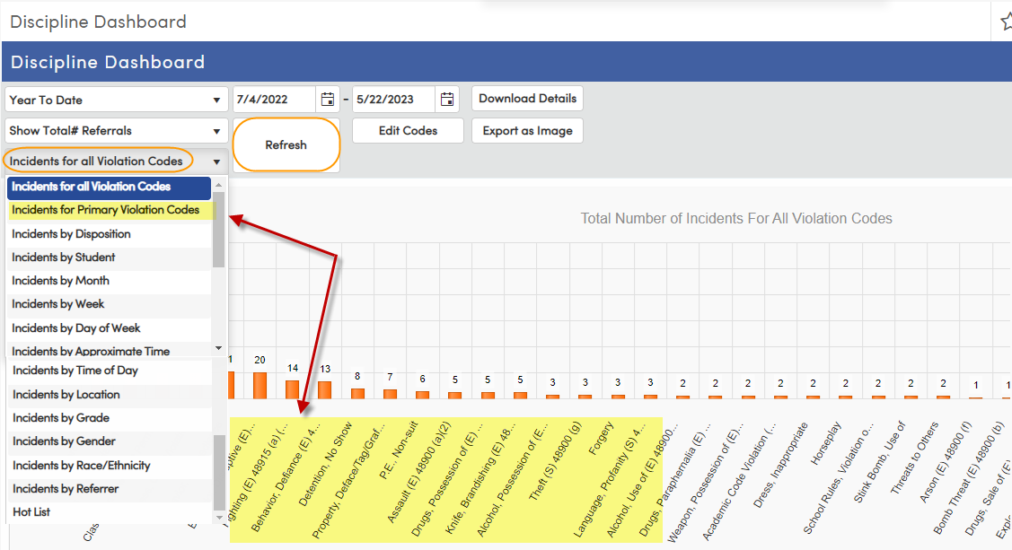
Incident Types of Referrals
Incidents Options:
Primary Violation Codes
Disposition
Student
Month
Week
Day of the Week
Approximate Time
Time of Day
Location
Grade
Gender
Race/Ethnicity
Referrer
Hot List
Refresh

Slide 12
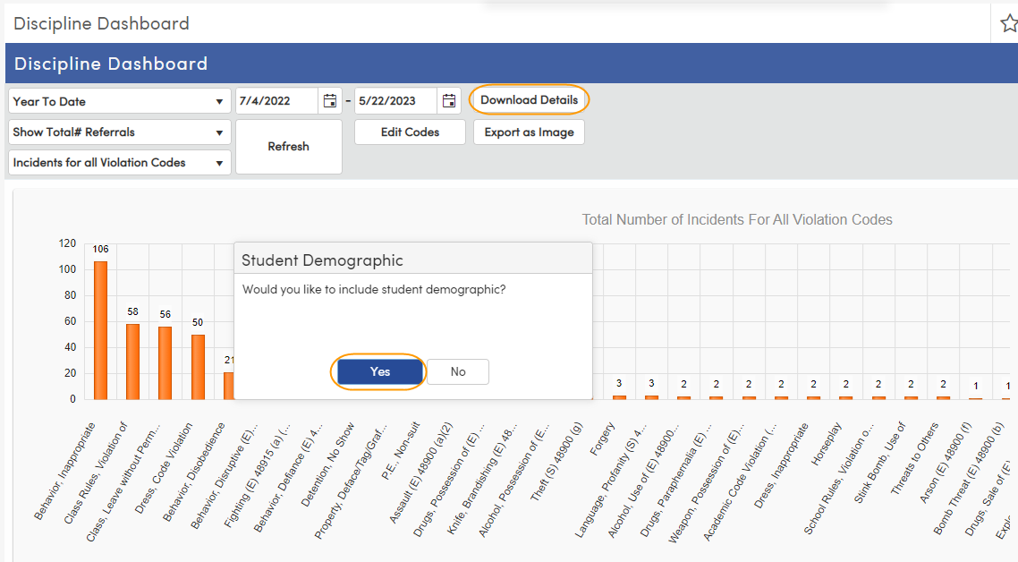
Download Details
Provides an Excel spreadsheet of the displayed data
Option to include Student Demographics (STU)

Slide 13
Download Details

Slide 14
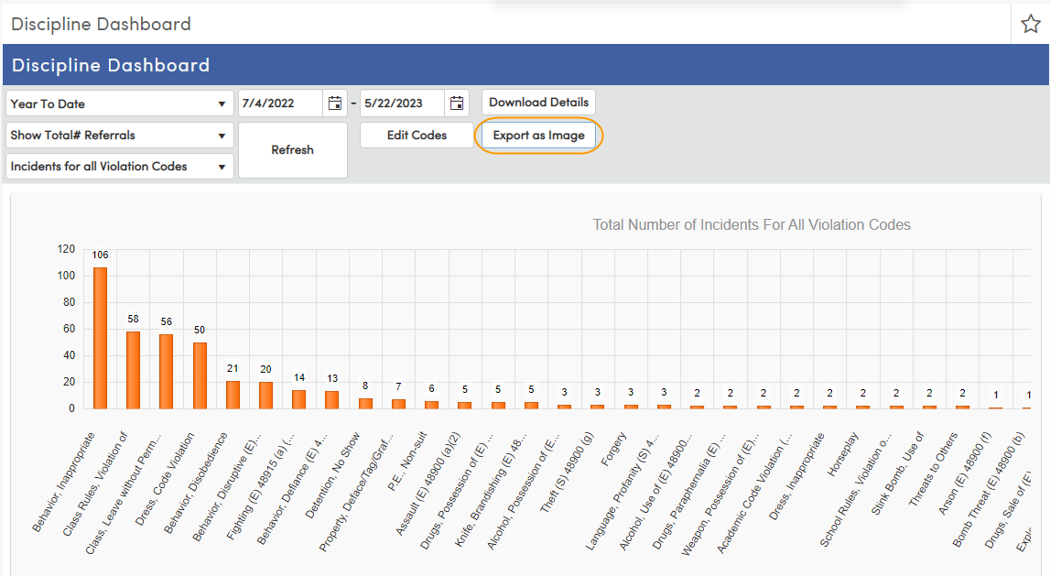
Export as an Image
Provides a PNG of Image

Slide 15
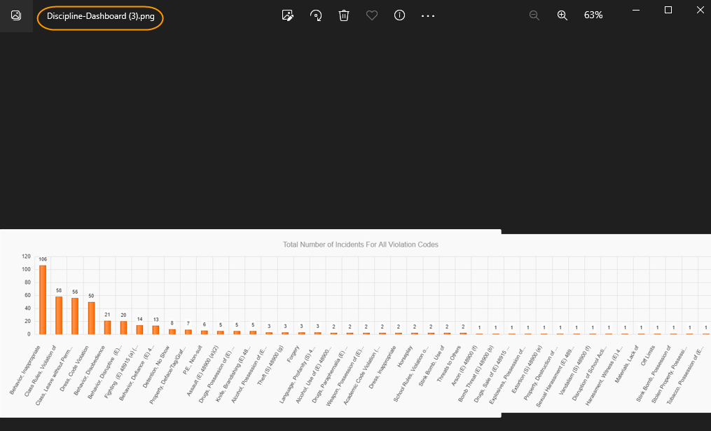
Png Image

Slide 16
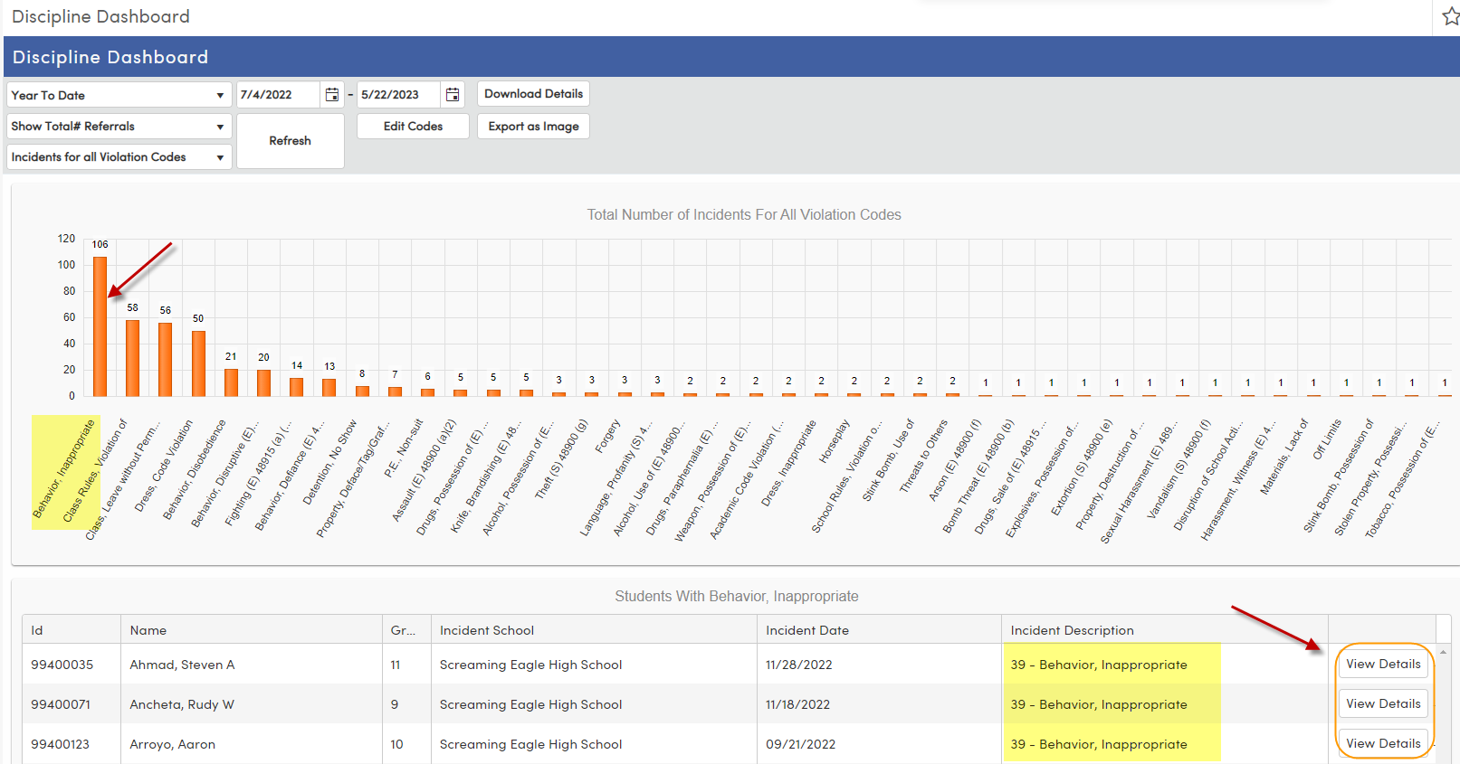
Viewing Associated Students
Click a Column
Students Display below
Click the View Details button to view the corresponding Assertive Discipline record in ADS

Slide 17
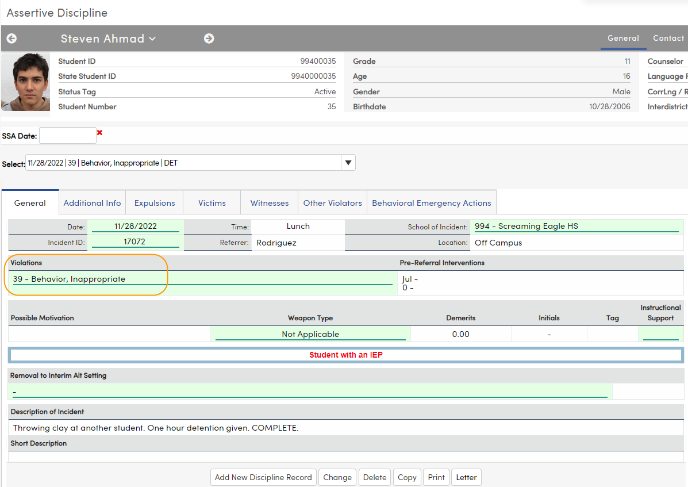
View Details

Slide 18
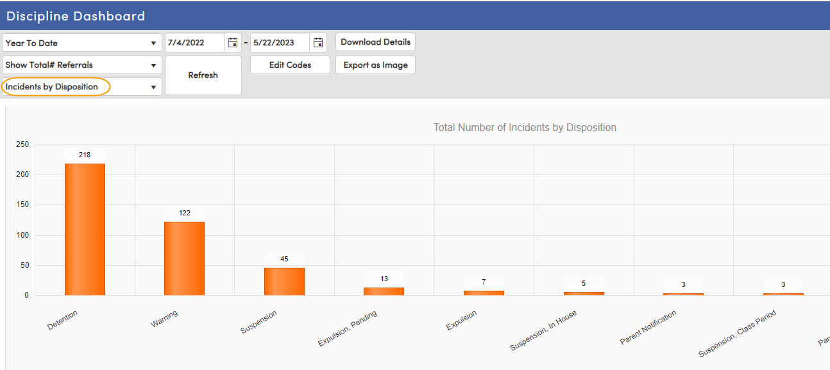
Various Views – By Disposition

Slide 19
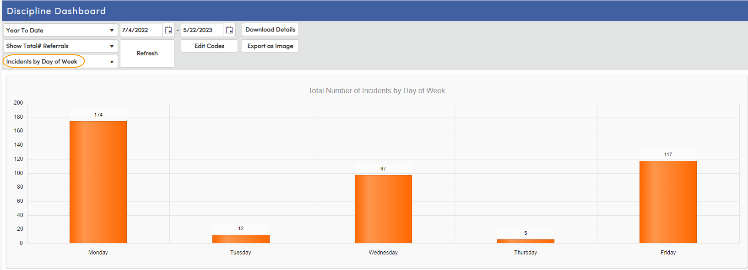
Various Views – Day of the Week

Slide 20
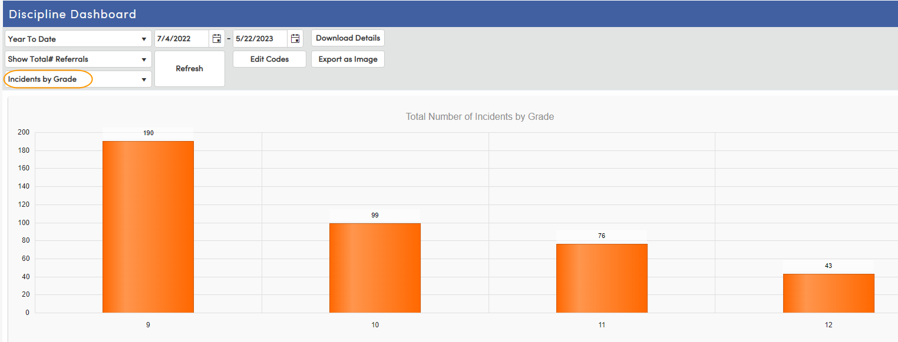
Various Views – By Grade Level

Slide 21
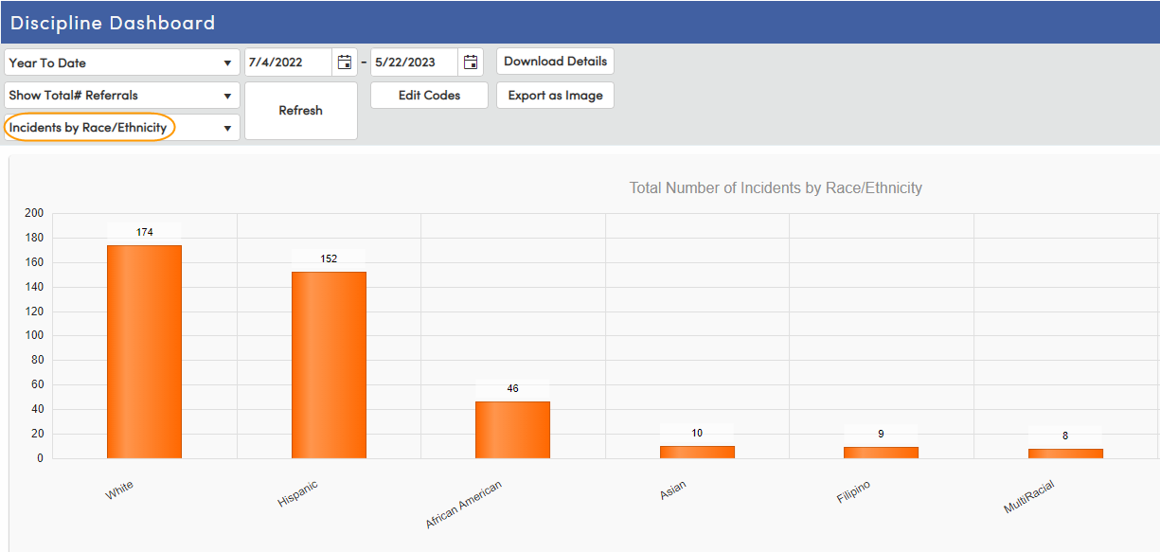
Various Views – By Race/Ethnicity

Slide 22
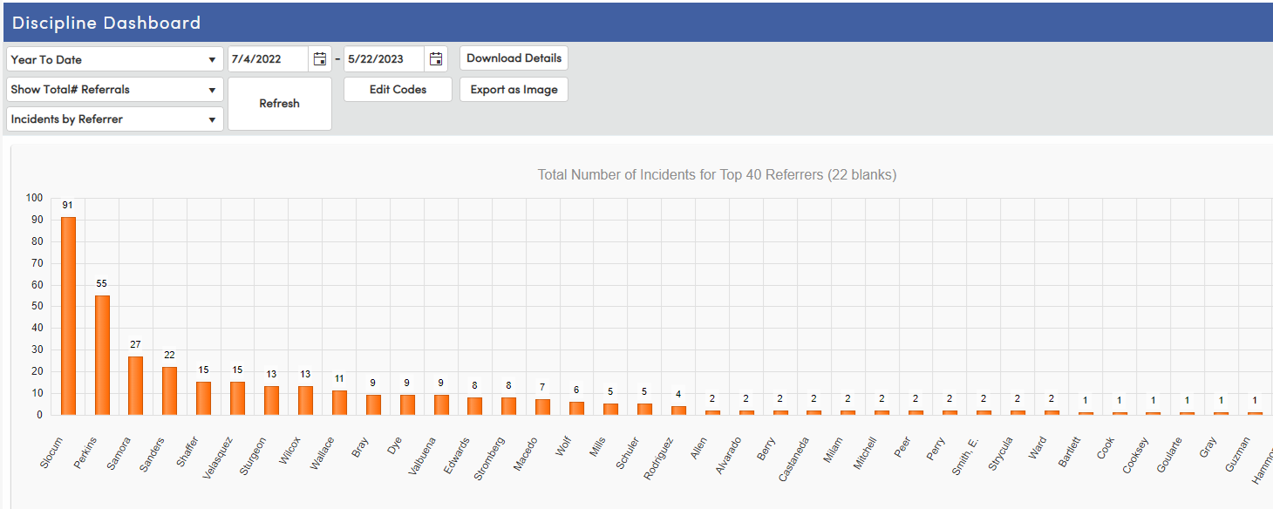
Various Views – By Referrer

Slide 23
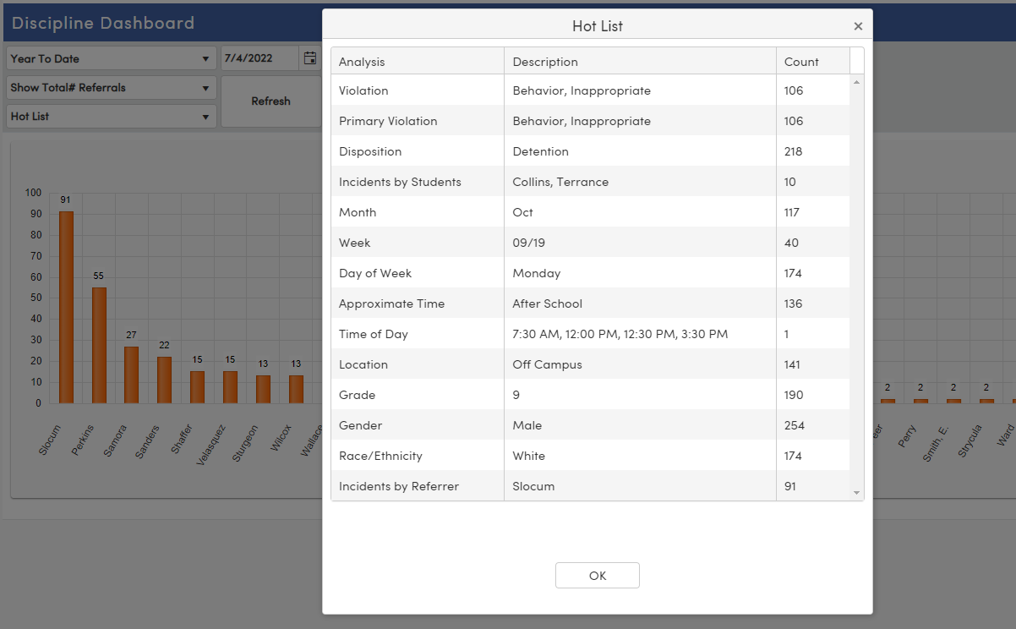
Various Views – Hot List
So Many Options!

Slide 24
Thanks for joining us!
Info and links
Discipline FAQs
Discipline Videos
Discipline Dashboard
Discipline Documentation

