Slide 1
AERIES 5-part Scheduling Workshop
Part 1 of 5 – Setup Tables & Course Requests
WELCOME!
The AM Session starts at 9:00, the PM session starts at 1:00.
While you are waiting, please complete the 3 questions in the poll.
Sam Defeo - Aeries Trainer
Leeni Mitchell or Colin Baxter– Aeries Trainer & Today’s Moderator
Aeries SIS
Scheduling Workshop

Slide 2
Part 1 of 5 – Setup Tables & Course Requests
AM Session – 9:00 – 12:00
AM Break about 10:30
PM Session – 1:00 – 4:00
PM Break about 2:30
Sam Defeo - Aeries Trainer
Leeni Mitchell or Colin Baxter – Aeries Trainer & Today’s Moderator
Aeries SIS
Scheduling Workshop

Slide 3
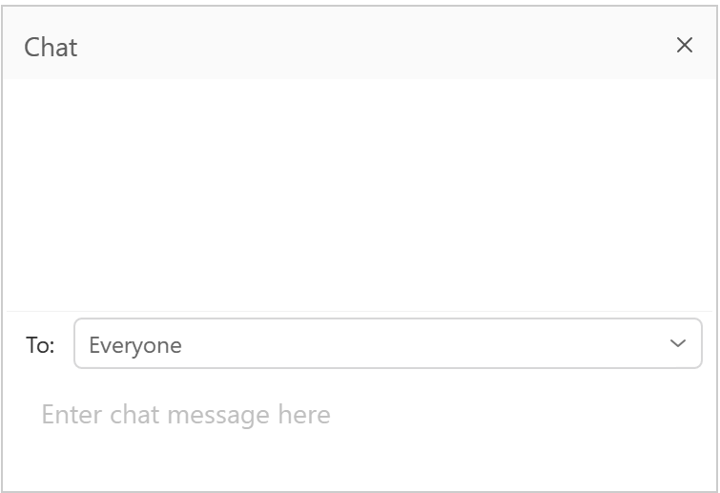
Zoom Tips
Mute Your Audio
Address your questions to Everyone
The Moderator will answer questions
PHOTO CAPTION

Slide 4
DOCUMENTATION
The documentation for this workshop:
https://support.aeries.com/support/solutions/articles/14000140141

Slide 5
DOCUMENTS USED FOR THIS WORKSHOP
The documents that will be used in this workshop:
SW 1 of 5 Doc1 Setup Tables & Course Requests.pptx Aeries Simple New Tables Diagram.pdf Aeries New Tables Diagram.pdf
Master Schedule CO.docx

Slide 6
BASIC STEPS FOR SCHEDULING
Collect & Enter Course Requests
Print Reports (Tally, Conflict Matrix, Reverse Verification Listing)
Build & Enter the Scheduling Master Schedule
Print Scheduling Master Schedule Report by Teacher/Course/Period/Room
Schedule Students
Print Scheduling Analysis Reports (Course Request Analysis, Class Load Analysis, Class Load Averages)
Repeat Steps 1-6 as needed

Slide 7
SECURITY SETTINGS - TABLES USED
Scheduling for next year (2023-24) Scheduling in the current
while still in current year (2022-23). year (2022-23).
SSS – Course Requests SEC – Current sections
SMS – Scheduling Master Schedule MST – Master Schedule
SSM – Section Staff Members SSE – Section Staff Members
STF – Staff Data STF – Staff Data
CRS – Courses CRS - Courses
FTF – Flex Periods FTF – Flex Periods
FTT – Flex Period Times FTT – Flex Period Times
CCL – Class Calendar CCL – Class Calendar
CCD – Class Calendar Dates CCD – Class Calendar Dates

Slide 8
Additional Aeries Tables
ALTERNATE COURSE REQUESTS PORTAL COURSES
ACA – Alternate Course Request Association CRQ – Course Request Sheet Table
ACR - Alternate Course Requests
COURSE REQUEST SECTION PACKETS
BACKUPS SPK – Section Packets
BAA – Alternate Course Request Association Backup SMP – SMS Sections
BAC – Alternate Course Requests Backup MSP – MST Sections
SBU – Scheduling Backups
SMB – Scheduling Master Schedule Backup SCHEDULING EXCLUSIONS
SSB – Student Scheduling Schedules Backup SED – Scheduling Exclusions
COURSE REQUEST PACKETS STAFF DATA
CRD – Course Request Packets SSI – Staff Scheduling Info
CRP – Course Request Packet Courses STJ – Staff Job Assignments

Slide 9
FORMS AFFECTING SCHEDULING
School Options (LOC table)
Staff (STF table)
Scheduling Info (SSI table)
Job Assignments (STJ table)
Course (CRS table)
Student (STU table)

Slide 10
STUDENT DATA TABLE
HIGH SCHOOL
GRADE (GR) NEXT GRADE (NG) STATUS TAG
12 13
11 12
10 11
9 10
8 9 * (Asterisk = Pre-enrolled)
JUNIOR HIGH
GRADE (GR) NEXT GRADE (NG)
8 9
7 8
6 7

Slide 11
STUDENT DATA TABLE
JUNIOR HIGH SCHOOL
GRADE (GR) NEXT GRADE (NG) STATUS TAG
8 9
7 8
6 7
5 6 * (Asterisk = Pre-enrolled)
ELEMENTARY SCHOOL
GRADE (GR) NEXT GRADE (NG)
5 6
4 5
3 4
2 3
1 2
0 1
0 0 * (Asterisk = Pre-enrolled)

Slide 12
INITIALIZE SCHEDULING TABLES
A.1. Scheduling Setup:
Must have “Administer” security for the SSS & SMS tables to access this page.
Scheduling Status – Use Flex Scheduling for Next Year
Scheduling Options – Use Staff-Section Association instead of Teacher Numbers (TN) with SMS sections
Course Requests – Blank out the SSS Table
Scheduling Master Schedule – Blank out the SMS Table
Select Initialize Scheduling
If using Flex Scheduling for the current year (2022-23), decide if the Flex Periods for 2022-23 will be copied to next year. If so, then after initializing (blanking out) the SMS table, select Do Nothing with the SMS Table but Copy Flex Periods (FTF).
Decide if the MST table will be copied to the SMS table. If so, then this may be done after initializing (blanking out) the SMS table.

Slide 13
ADDITIONAL SETUP TABLES
A3. Course Request Packets – CRD & CRP tables
A.4. Course Request Section Packets – SPK & SMP tables can be created after the SMS table has been created.
A.5. Update Course Request Options – CRQ table is used to identify the courses that students will be allowed to select as their course requests in the Student Portal.
A.6. Portal Options – Scheduling Tab – For each grade level, enter the start & end dates that allow students to use the portal. Additional options may also be set.

Slide 14
BACKUP & RESTORE
Available on the Scheduling Dashboard in multiple locations (A, B, C, & D).
Backups are identified with date and time.
This will backup or restore both the SSS & SMS tables.
Backup frequently. Restore carefully!

Slide 15
ENTER COURSE REQUESTS
PORTAL – Uses the CRQ Table. Enter start/end dates for each grade level. Alternate Course Requests may be entered, sorted, and linked to primary course requests.
IMPORT from ACADEMIC PLAN – Select term and grade level to import. Query KEEP & SKIP may be used.
MASS CHANGE or ADD COURSE REQUESTS – Select courses to mass add, change, or delete. Select grade level. May use Course Request Packets. Query KEEP & SKIP may be used.
MANUAL ENTRY – Individual student. May add one course or many courses. May use Course Request Packets. Query KEEP & SKIP may be used. Alternate Course Requests may be entered, sorted, and linked to primary course requests. Scheduling Exclusions may be entered.

Slide 16
INTERMISSION – BREAK

Slide 17
ENTER COURSE REQUESTS – PORTAL SETUP
A.5. Update Course Request Options:
Initialize New Course Request Options Table or Recreate Course Request Options Table (CRQ) Select the Sort Option for the CRQ table. For each grade level, determine the courses that students are allowed to select from the portal.
A.6. Portal Options – Scheduling Tab:
Select Course Requests options at the top.
Enter Start Date & End Date for each grade level.
Select Scheduling Options.
Don’t forget to Save. This is at the bottom of the page.

Slide 18
ENTER COURSE REQUESTS – ACADEMIC PLAN
B.1. Import Course Requests from Academic plan
Select term(s) to Import
Select Location(s) to Import
Change Students in the Following Grades
Additional Options
Delete Existing Course Requests?
Limit with a Query KEEP or SKIP
Preview Only
Update SSS

Slide 19
ENTER COURSE REQUESTS – MASS CHANGE or ADD
B.2. Mass Change or Add Course Requests
Change students with these course requests (drop)
To now have these course requests (add)
Only change students in the following grades
Only change for gender
Students are being Scheduled Using Next Year’s Grade Levels!
Limit with a Query KEEP or SKIP
Preview Only
Update
Reset

Slide 20
ENTER COURSE REQUESTS – MANUAL ENTRY
B.3. Student Course Requests
Change: Time Range or Scheduling Group
Display Options: Show Available Periods
New Edit View / Old Edit View
Add New Record
Add Many New Records
Course Request Packet
Alternate Course Requests
Scheduling Exclusions
Limit with a Query KEEP or SKIP

Slide 21
AVAILABLE REPORTS: COURSE REQUESTS
B.9. Scheduling Course Request Tally
C.3. Scheduling Conflict Matrix Preferred Report Variations: Scheduling Conflict Matrix/A/NoBreak Scheduling Conflict Matrix/Chart
B.7. Scheduling Reverse Verification Listing

Slide 22
ANY QUESTIONS?

Slide 23
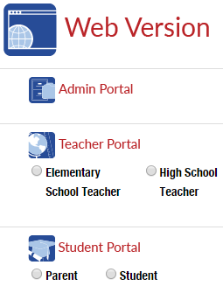
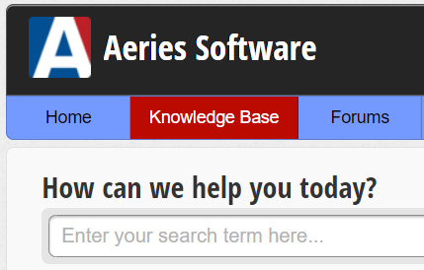
MANY SUPPORT RESOURCES
demo.aeries.net
Demo Database
Great for more practice!
learn.aeries.com
Aeries Teacher Academy
FREE online courses!
support.aeries.com
Aeries Documentation
& Video Library
Targeted support at your fingertips!

