Slide 1
Aeries Data Validation System
James Lancaster, Second Level Support
Kevin Praeger, Core Product Manager
Jason Miles, Programmer Analyst, Irvine USD

Slide 2
Discussion Topics
Data input validation
Post-input validation

Slide 3
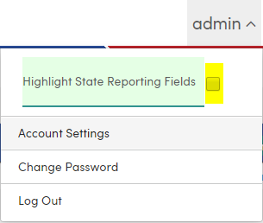
Data Input Validation
CALPADS Required Fields
Are my users entering data correctly?
Define Required Fields
How much data do we have at once?
What about district-defined rules?

Slide 4
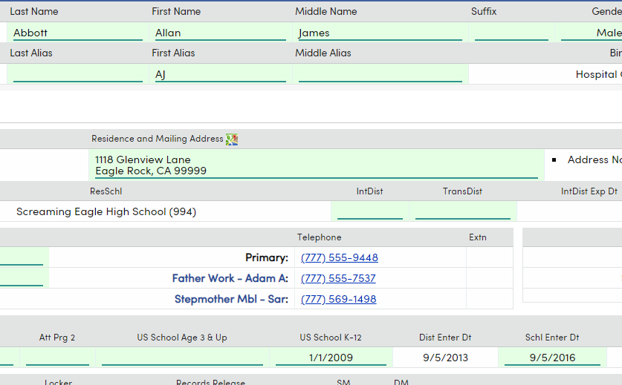
Data Input Validation
Highlight CALPADS Reporting Fields
Highlights all possible fields, not immediately necessary fields

Slide 5
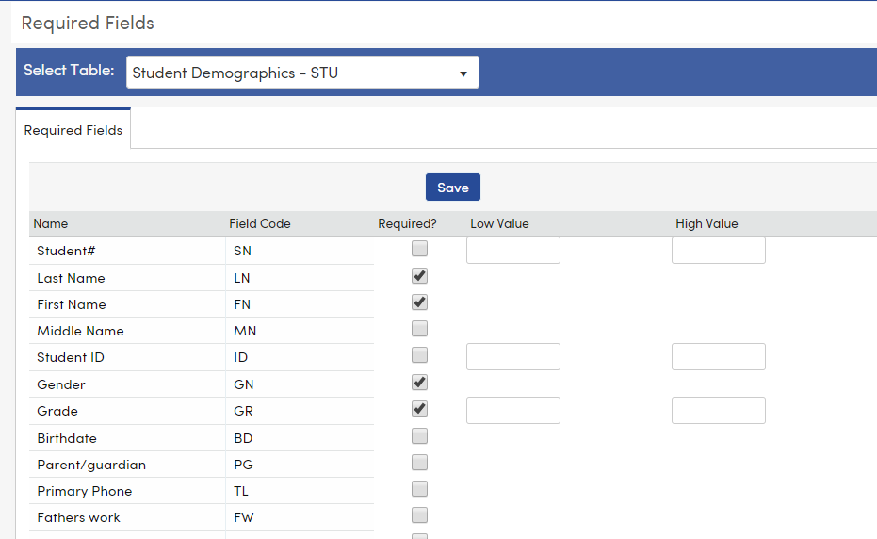
Data Input Validation
Define Required Fields
Mandate fields be populated
State reporting tables are supported
Limited to 20 tables

Slide 6
Data Input Validation
What about district-defined rules?
Aeries Communications
Security
Automation/Integration (Third-parties)

Slide 7
Post-Input Validation
Some data is not available at time of initial input
Concerns are wider than State Reporting needs
Accountability requires visibility

Slide 8
Post-Input Validation
Data Validations

Slide 9
Data Validation
Let’s start with the “Defaults,” shall we?

Slide 10
Free Add-Ons
Wait… Where can I download those free definitions?
https://aeries.link/cetpa-dv

Slide 11
ANY QUESTIONS?
Aeries® SIS
Data Validation

