Slide 1
Using Aeries to Maximize
Assessment Analysis
Camden Iliff
Director of Product Development
Aeries SIS
EADMS

Slide 2
PUSHING TESTS TO AERIES
A BRIEF OVERVIEW
PUSH TEST RESULTS
ANALYZE RESULTS
READY AERIES
Use EADMS to assess your students
Aeries Analytics™
Testing Control Table
Identify Test ID and Test Parts
ASSESS STUDENTS
Utilities > Managers > Push Test to Aeries
ADD DASHBOARD
Compare and contrast
Aeries SIS
EADMS

Slide 3
READY AERIES
TESTING CONTROL TABLE
Create a Test ID. Part “0” should always be the “Overall Score” for the assessment. Add additional parts if the assessment you are administering has “Strands or Skill Areas” in EADMS.
Aeries SIS
EADMS

Slide 4
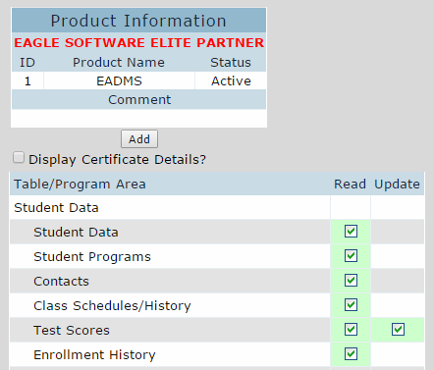
READY AERIES
Security Permissions – API Security
Make sure you grant EADMS permission to Update your “Test Scores” table.
Aeries SIS
EADMS

Slide 5
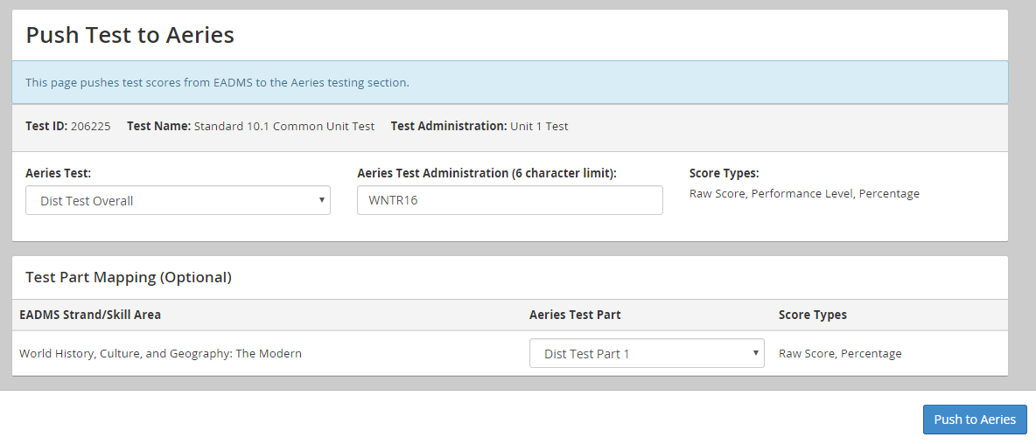
PUSH TEST RESULTS
EADMS > Utilities > Managers > Push Test to Aeries
In EADMS, go to the “Push Test to Aeries” page. Choose your EADMS Test and fill in the rest of the page.
Aeries SIS
EADMS

Slide 6
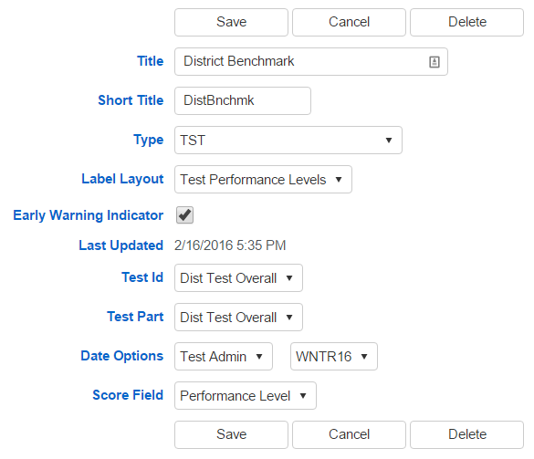
ADD DASHBOARD
Add Analytics Item
Aeries SIS
EADMS

Slide 7
ADD DASHBOARD
Process Current Indicator
Don’t forget to go to the “Summary Data” tab and click the “Process Current Indicator” button. This should be fast.
Aeries SIS
EADMS

Slide 8
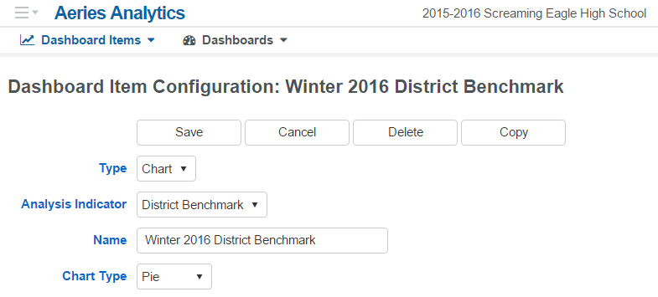
ADD DASHBOARD
Add Dashboard Item
On the “Analytics Dashboard Config” page, add a new Dashboard Item and setup the options.
Aeries SIS
EADMS

Slide 9
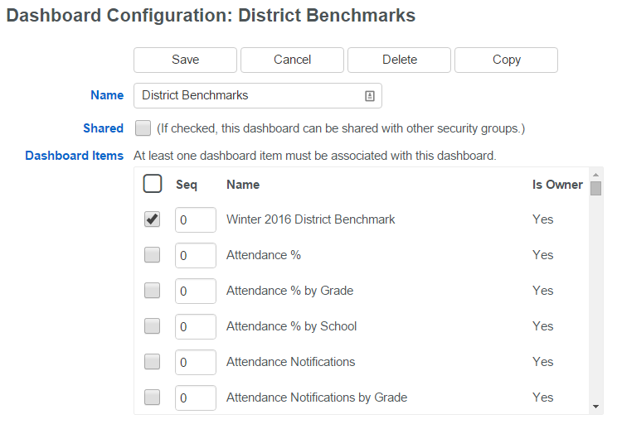
ADD DASHBOARD
Add Dashboard For Your Benchmarks
On the “Analytics Dashboard Config” page, add a new Dashboard and add your newly created Item.
Aeries SIS
EADMS

Slide 10
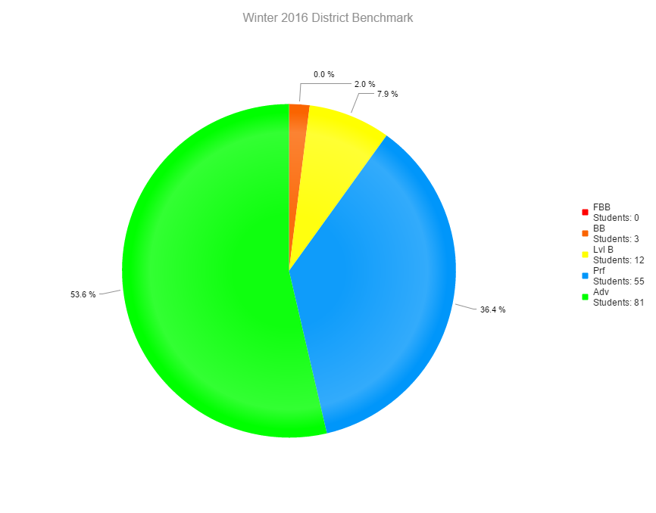
ANALYZE RESULTS
Use Aeries Analytics™ features to slice and dice.
Aeries SIS
EADMS

