Slide 1
310-1 Student Scheduling for Next Year
Building the Scheduling Master Schedule
Presenter: Carole Williams

Slide 2
Related AeriesCon Sessions
Course Requests:
305-1: Managing Student Scheduling Course Requests
305-2: Student Scheduling Course Requests Using the Aeries Student Portal
Flex Scheduling:
325-1: Flex Scheduling - Traditional Bell Schedule
328: Elementary w/Primary Class (CA Only)
Scheduling:
310-1: Student Scheduling for Next Year: Building the Scheduling Master Schedule
310-2: Student Scheduling for Next Year: Scheduling Students
320: Master Schedule Building Theory
330: Scheduling Master Schedule Board (including the SMS Builder)
340: Student Scheduling – Scheduling Groups and Teams
Scheduling related:
456: Alternative School Scheduling
610: Individualized Academic Plan for Students
You
Are
Here
If you have never scheduled before, this session may help you get the concepts (did you go in Period 1?)
If you’re building the Scheduling Master Schedule, be sure to watch this session to learn more about the SMS Board (today P5; tomorrow P1)

Slide 3
Key Topics
Overview of Student Scheduling for Next Year
Terminology
Timeline
Scheduling Process Dashboard
Scheduling Setup page
Reports:
Scheduling Course Request Tally
Scheduling Conflict Matrix
Build a Scheduling Master Schedule (SMS):
Scheduling Setup page: copy current MST to SMS
SMS Board > SMS Builder
Scheduling Master page
Student Scheduling for Next Year: Background
Building the Scheduling Master Schedule

Slide 4
Student Scheduling for Next Year: Overview
What is “scheduling for next year”?
The planning process for, and the creation of, the Master Schedule for the next school year.
There are three major steps in the process:
1. Gather Course Requests | Find out what courses next year’s students will take. Recorded in the SSS table (Course Requests). | Sessions 305-1 and 305-2
2. Build the Scheduling Master Schedule | Create a planning schedule (the Scheduling Master Schedule or SMS), which contains all the sections for the Courses that students will take next year. Recorded in the SMS table. | Sessions 310-1
3. Schedule Students | Let Aeries schedule the students into the sections (run the Scheduler) and/or hand schedule students into sections. | Session 310-2
Are you scheduling for an elementary school that uses (mostly) self-contained classes?
Typically, traditional elementaries create a Master Schedule and assign the students to sections using class lists (instead of gathering Course Requests and mass scheduling students). For more information, see slides 28-31, starting with “Quick start for traditional elementaries with Master Schedules.”

Slide 5
Student Scheduling for Next Year: Terminology
 | In use this year | For use next year
School | Master Schedule (MST): the sections (classes) in the current year at your school | Scheduling Master Schedule (SMS): the sections (classes) that will be in the Master Schedule next year Max (SMS.MX): the maximum number of students in a section (note: SMS.MX = 0 means no students will schedule into the section)
Student | Classes (SEC): the list of sections a student is taking during the current year | Course Requests (SSS): the list of Courses each student will take next year. When a Course Request is “scheduled,” that means a specific SMS section is recorded for the Course Reject: if a student does not schedule into a section (plus why)
 | Grade Level: STU.GR | Grade Level Next Year: STU.NG
Curriculum; subject; what is being taught | Courses (CRS): used by all schools in the district

Slide 6
Scheduling Timeline
January | February | March | April | May | June | July | August | September
Start planning for next year. Will there be any adjustments to curriculum? Will you change any existing Courses? Will you offer new Courses?
Copy feeder schools’ student records as Pre-Enrolled (STU.TG = *)
Gather Course Requests; analyze Course Request reports
Run the Scheduler; analyze scheduling reports; adjust the SMS to increase the percentage of students scheduled by the Scheduler
New Year Rollover
Re-run the Scheduler; continue adjusting the SMS to increase the percentage of students scheduled by the Scheduler
Print Locator Cards; make any changes to the schedule in the Master Schedule (MST)
Scheduling Setup; Flex Periods setup;
Class Calendars setup
Create Scheduling Master Schedule (SMS); analyze SMS reports
Copy SMS to MST
Hand schedule; manage rejects
Summer Break
Also see the Master Schedule timeline article:
https://support.aeries.com/support/solutions/articles/14000133635-master-schedule-timeline

Slide 7
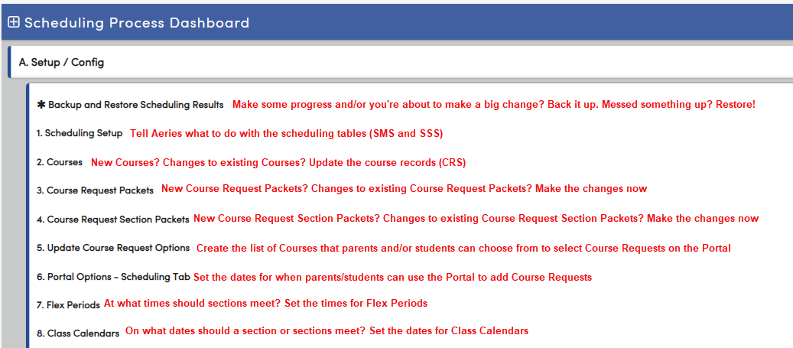
Flex Scheduling Process Dashboard
Also, make sure that:
STU.NG (Next Grade) and STU.NS (Next School) are correct for your students and your feeder school students
Pre-enrolled records are created in your school, for the students who are matriculating from your feeder schools

Slide 8
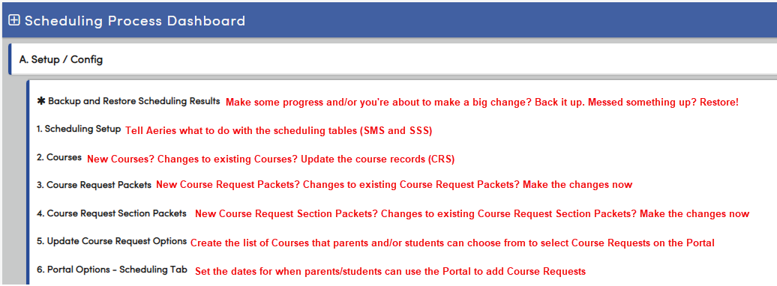
Non-Flex Scheduling Process Dashboard
Also, make sure that:
STU.NG (Next Grade) and STU.NS (Next School) are correct for your students and your feeder school students
Pre-enrolled records are created in your school, for the students who are matriculating from your feeder schools

Slide 9
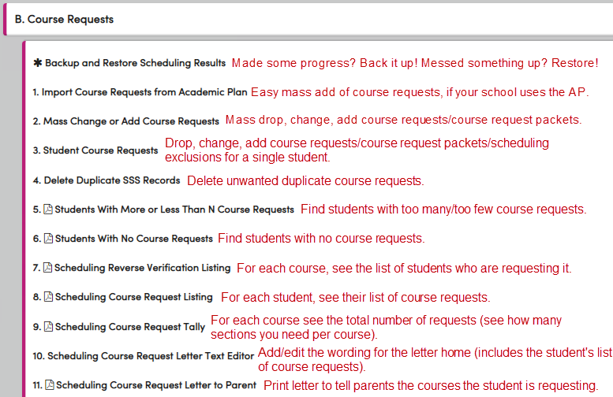
Scheduling Process Dashboard

Slide 10
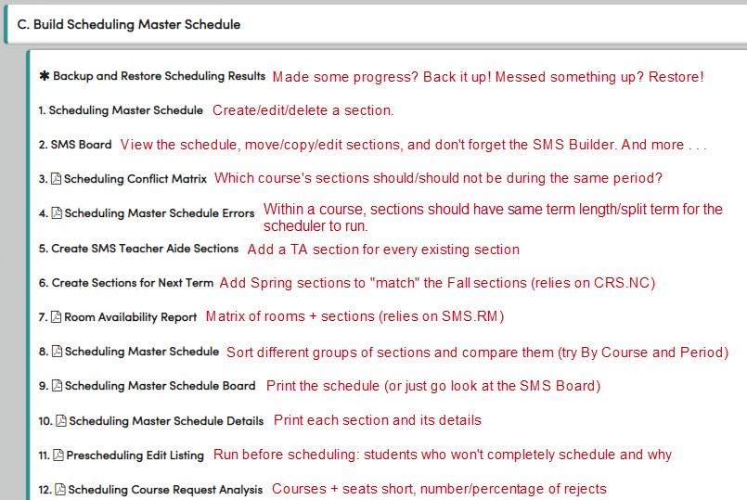
Scheduling Process Dashboard
Also: add Complex Schedules “tags” to students and sections if needed

Slide 11
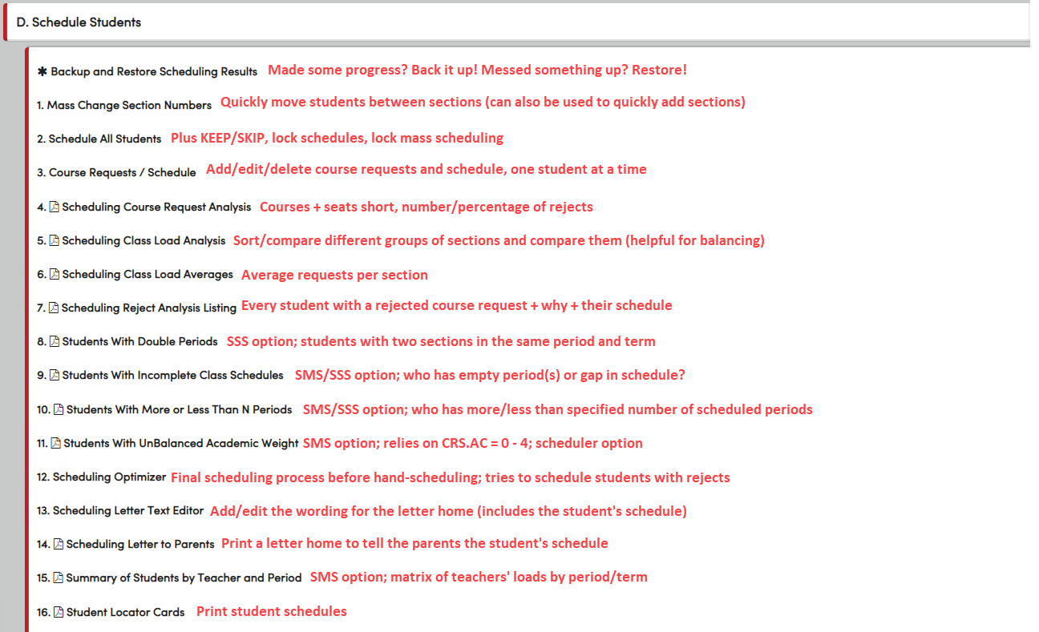
Scheduling Process Dashboard

Slide 12
Scheduling Process Dashboard

Slide 13
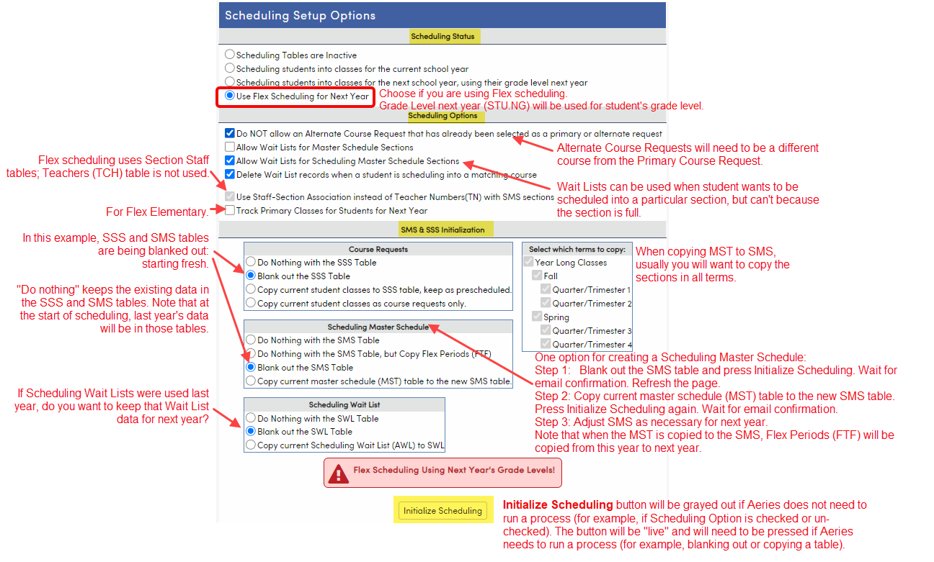
Scheduling Setup: Flex
Scheduling Setup is the very start of the scheduling process. What are we doing?
Telling Aeries how we are going to schedule.
Telling Aeries what to do with the Course Requests (SSS) table and the Scheduling Master Schedule (SMS) table, which contain last year’s data at this point.
To make changes on this page, Admin to SMS permissions are required.
When scheduling for next year, STU.NG (Next Grade) field is used for a student’s Grade Level.

Slide 14
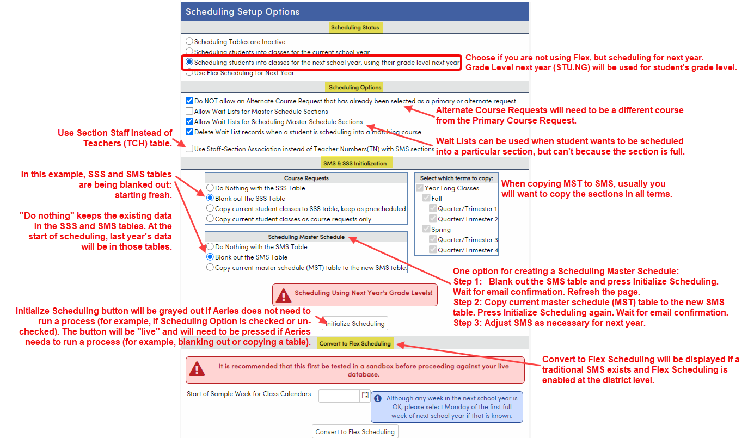
Scheduling Setup: Non-Flex
Scheduling Setup is the very start of the scheduling process. What are we doing?
Telling Aeries how we are going to schedule.
Telling Aeries what to do with the Course Requests (SSS) table and the Scheduling Master Schedule (SMS) table, which contain last year’s data at this point.
To make changes on this page, Admin to SMS permissions are required.
When scheduling for next year, STU.NG (Next Grade) field is used for a student’s Grade Level.
Convert to Flex Scheduling section will only display for schools where a traditional SMS exists and Flex Scheduling is enabled.

Slide 15
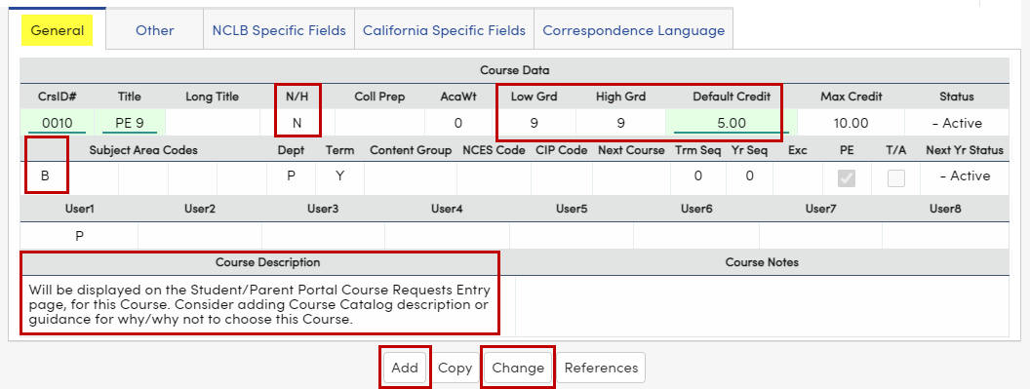
Courses
Course information impacts many areas: Scheduling, Grade Reporting/Standards Based Grade Reporting, Transcripts/Graduation Status, Career Pathways, State Reporting, Academic Plan.
The Courses table (CRS) is used by all schools in your district, so make sure everyone agrees with changes before changes are made. In other words, permissions to the CRS table should be assigned conservatively.
When to make changes?
If Courses are used in current year, make changes AFTER the New Year Rollover and before the new school year starts
New Courses for next year can be added now
Courses can be inactivated for this year (Status) or next year (Next Yr Status).
Data in these fields populate newly created sections in the SMS or MST:
Default Credit (CRS.CR)
Low Grd/High Grd (CRS.LO/CRS.HI)
These fields will display on Course Requests Entry on the Student./Parent Portal:
N/H (CRS.NH): Academic/non-Academic/Honors
Course Description: add Course Catalog data
Courses are grouped by Subject Area on the Portal
Prerequisite Crs (CRS.PR): Does not check credits/grades, etc.
Sets two Courses to not schedule into the same term
For example, if Course 100 is a prerequisite of Course 101, a student who requests both Course 100 and Course 101 is scheduled into Course 100 in the Fall and Course 101 in the Spring.
If not used correctly, this field may cause scheduling errors

Slide 16
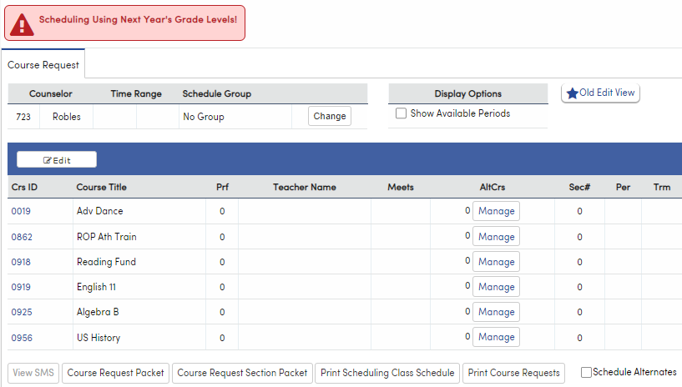
Methods for Gathering Course Requests
Import from Academic Plan
Mass Change or Add Course Requests page
Student/Parent Portal
Course Requests page
Other Options:
Import Data to Aeries (csv or Excel file into SSS)
Assign students to sections from class lists
Watch sessions 305-1 and 305-2 for more information on gathering Course Requests. 310-2 includes some discussion of the Course Requests page.

Slide 17
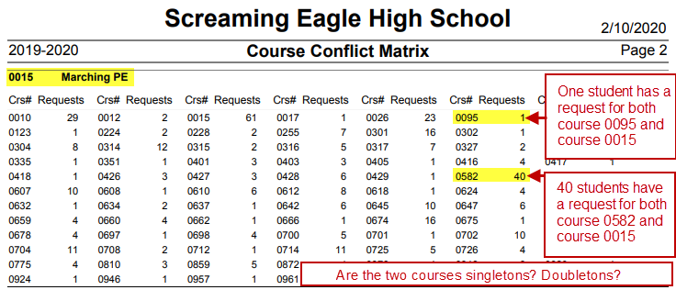
After Course Requests are gathered, plan for the SMS using these reports:
Scheduling Course Request Tally report
Total / Max = Number of Sections Needed
Look for potential issues (courses not offered; grade levels); then print the Scheduling Reverse Verification Listing to see who requested it
Large school? Print report to Excel; add a column to do the Total / Max math
Scheduling Conflict Matrix report
Compares Courses and tells you how many students requested both
Which Courses could have sections in the same period? Or should not be in the same period?
Run for ALL singletons and doubletons
The Tally + The Matrix + Your Time = the Scheduling Master Schedule

Slide 18
Identify school-specific factors that will impact building your Scheduling Master Schedule:
Teacher turnover (can create placeholders if necessary, if a new teacher has not been identified/hired)
Teachers on campus only certain periods/part-time
Teacher contracts
Instructional Aide (or other support personnel) coverage of different sections
Common prep periods for groups of teachers
Room availability
Sections required to be in specific period/term (ex: 6th grade PE in 7th period)
Repeating teacher year after year (ex: math teacher teaching all levels of math)
Linked courses split by lunch/break
Can teacher teach two sections during same period? For example, Art II with fifteen students and Art III with ten students, at the same time and with the same teacher
Make a list of “have to haves” and “want to haves” and “nice to haves,” but don’t let “nice to haves” turn into “have to haves”

Slide 19
Order of creating/placing sections:
Place all sections that are required to be in a particular period and/or with a particular teacher.
Place singleton sections in period with least conflicts.
Start with the singleton with the most requests, then next most, etc.
A singleton is when a course is offered once.
Place doubletons in same way. A doubleton is when a course is offered twice.
Place tripletons in same way. A tripleton is when a course is offered three times.
Start checking seat counts.* Place sections in periods where more seats for that Grade Level are needed.
Try to balance known small classes with known large classes.
Continue adding sections based on the number of sections per course. Check the seat counts after each addition.
* Seats counts are provided by this report: Scheduling Class Load Averages report – Display Only Totals option

Slide 20
Three options for building a Scheduling Master Schedule:
On the Scheduling Setup page, copy the current MST to the SMS; modify as needed.
On the Flex SMS Board or SMS Board:
Use the SMS Builder to mass add sections.
Use Add Class/Copy Class buttons to add more sections and copy existing sections.
AeriesCon Session 330 is must-watch if you are building the SMS using the SMS Board.
On the Scheduling Master page:
Add sections one at a time.
Add one section, then Copy the section as many times as needed.

Slide 21
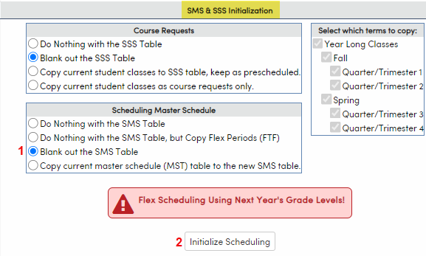
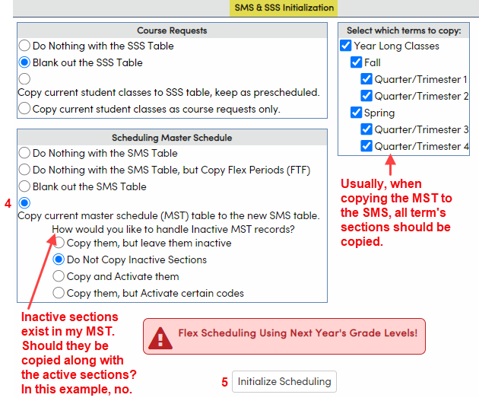
Build a Scheduling Master Schedule using Copy the MST to the SMS on the Scheduling Setup Page
In SMS & SSS Initialization, select Blank out the SMS Table. Typically, you’d also Blank out the SSS Table (Course Requests).
Press Initialize Scheduling button.
After receiving the email indicating the process ran, return to the Scheduling Setup page.
In SMS & SSS Initialization, select Copy current master schedule (MST) table to the new SMS table.
Press Initialize Scheduling button. After receiving the email indicating the process ran, proceed with SMS modifications using SMS Board or Scheduling Master page.
To identify inactive sections in your MST, run this Query:
LIST MST CRS MST.SE CRS.CN CRS.CO MST.STG MST.STG? IF MST.STG > ' '

Slide 22
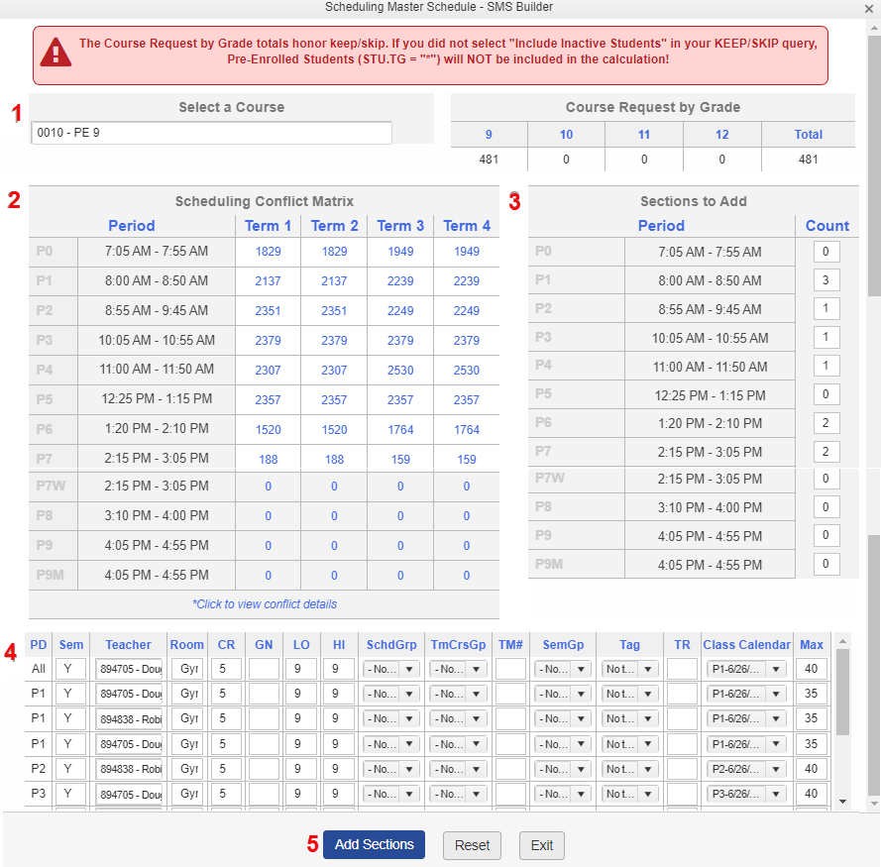
Build a Scheduling Master Schedule using the SMS Builder:
On the SMS Board, press the SMS Builder button.
Type the Course Number or Course Name.
Check the Conflict Matrix for period(s) with fewest conflicts.
Add the count of how many sections per period to add.
Each section specified in No. 3 will have its own row. Add data for each section.
Press Add Sections button.

Slide 23
Build a Scheduling Master Schedule using SMS Board buttons:
Using Add Class:
Click on the cell corresponding to the period/teacher.
Press the Add Class button.
Add the section’s information at the top.
Press Save.
Using Copy Class:
Click on the section that should be copied.
Click on the Copy Class button; the button will change to Cancel Copy.
Click on the cell corresponding to the period/teacher where the new section should be copied.
Note: watch AeriesCon Session 330 to learn more about the Flex SMS Board/SMS Board.

Slide 24
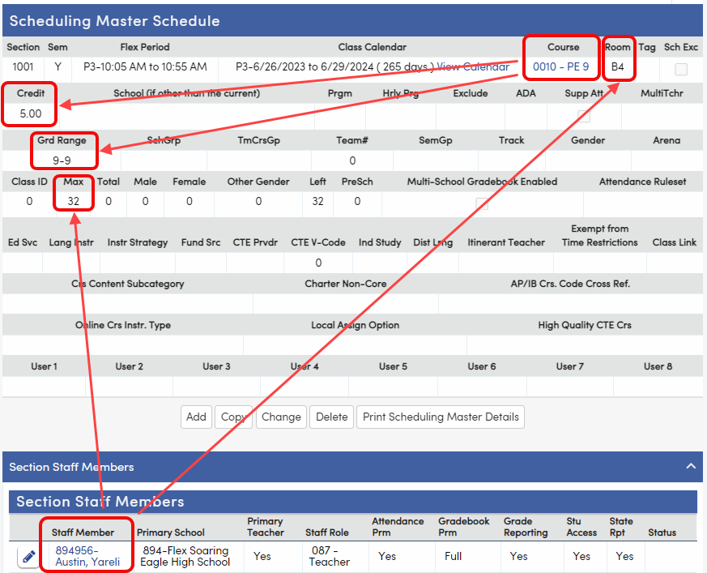
Add a Section on Scheduling Master page: Flex
Add a new section
Change or Delete an existing section
Credit and Grd Range come from Course
Grd Range 0-0 is Kindergarten
Max and Room come from Scheduling Info section on Staff page.
Room prints on Locator Cards report.
Max of 0 means that no students will schedule into it.

Slide 25
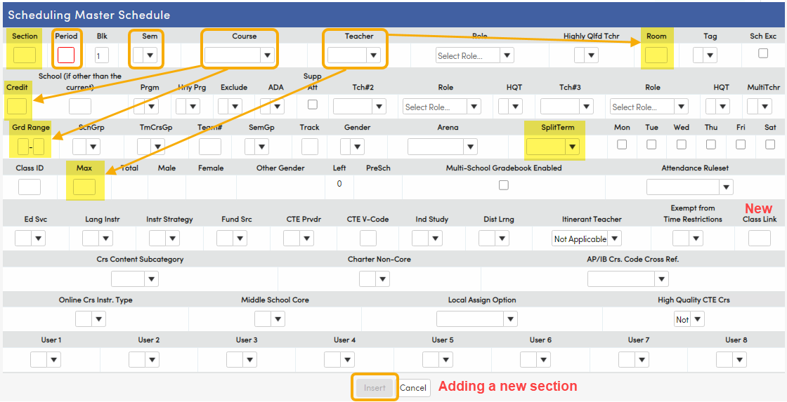
Add a Section on Scheduling Master page: Non-Flex
Add a new section
Change or Delete an existing section
Room and Max come from Teacher
Put teacher in room most likely and change the exceptions
Consistency (C-2 is not C2)
Max of 0 means no seats in section
Credit and Grd Range come from Course
Grd Range 0-0 is Kindergarten

Slide 26
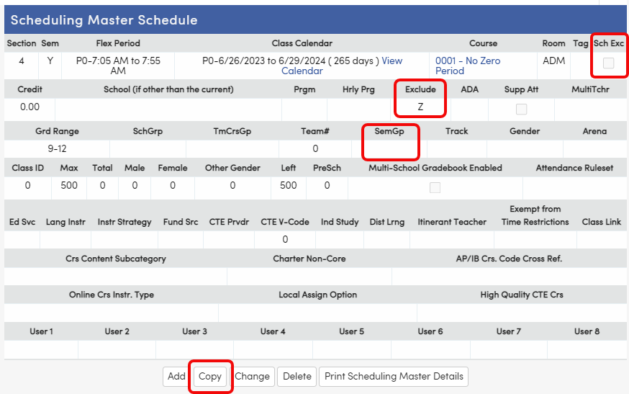
More fields on the Scheduling Master page
Exclude (don’t show this section on Grades, Attendance or both)
SemGp (same SemGp will force two sections for a pair of courses into different terms)
Use the Copy button to quickly create multiple sections:
Add a section
Copy the section
Change fields as needed
Save
Repeat
Sch Exc field
Only at a Flex school
If checked, the Scheduler will not put students into this section; students will need to be hand-scheduled into it

Slide 27
Where to go for more information:
Documentation below is all from the Aeries support website:
https://support.aeries.com
Student Scheduling for Next Year category on support.aeries.com:
https://support.aeries.com/support/solutions/folders/14000116178
Session 310-1 Student Scheduling for Next Year – Building the Scheduling Master Schedule:
https://support.aeries.com/support/solutions/articles/14000079378-session-310-1-student-scheduling-for-next-year-building-the-scheduling-master-schedule
Session 310-2 Student Scheduling for Next Year – Scheduling Students:
https://support.aeries.com/support/solutions/articles/14000121287-session-310-2-student-scheduling-for-next-year-scheduling-students
Secondary Scheduling Videos (Flex and Non-Flex):
https://support.aeries.com/support/solutions/folders/14000128208
Got questions? Bring them to Open Forum!

Slide 28
Quick start for traditional elementaries with Master Schedules
Traditional elementary schools that use a Master Schedule typically do only part of the process.
Next steps to get started:
Assess enrollment for next year using Next Grade (STU.NG) with a Query or a report (for example, the Summary of Students report).
Create the class lists for next year.
Create the Master Schedule (two options – see next three slides).
Assign the students to sections using the class lists.
1. Gather Course Requests | Find out what courses next year’s students will take. Recorded in the SSS table (Course Requests). | Sessions 305-1 and 305-2 | Elementary schools typically don’t gather Course Requests.
2. Build the Scheduling Master Schedule | Create a planning schedule (the Scheduling Master Schedule or SMS), which contains all the sections for the Courses that students will take next year. Recorded in the SMS table. | Sessions 310-1 | Elementary schools that use a Master Schedule will build a Master Schedule.
3. Schedule Students | Let Aeries schedule the students into the sections (run the Scheduler) and/or hand schedule students into sections. | Session 310-2 | Elementary schools typically do not run the Scheduler to randomly assign students to sections. Instead, students are assigned to sections using pre-planned class lists.

Slide 29
Two options for an elementary creating a Master Schedule
Elementary schools that use a Master Schedule typically don’t gather Course Requests or mass schedule students. But they still need to put students into sections. How is this accomplished?
Option 1: Create an SMS, then copy it to the MST after the New Year Rollover.
Use scheduling pages and reports
Start during the current school year, before the New Year Rollover
Create SMS
Assign students to SMS sections
After New Year Rollover, copy SMS to MST
Option 2: Wait for next year, then create an MST.
Wait until after the New Year Rollover
Create MST
Assign students to MST sections
Do not use scheduling pages and reports
Quick Start guides for Option1 and Option 2 are on the next two slides. For more details, see the Aeries Academy module: Elementary School Management > Elementary Primary Class Scheduling.

Slide 30
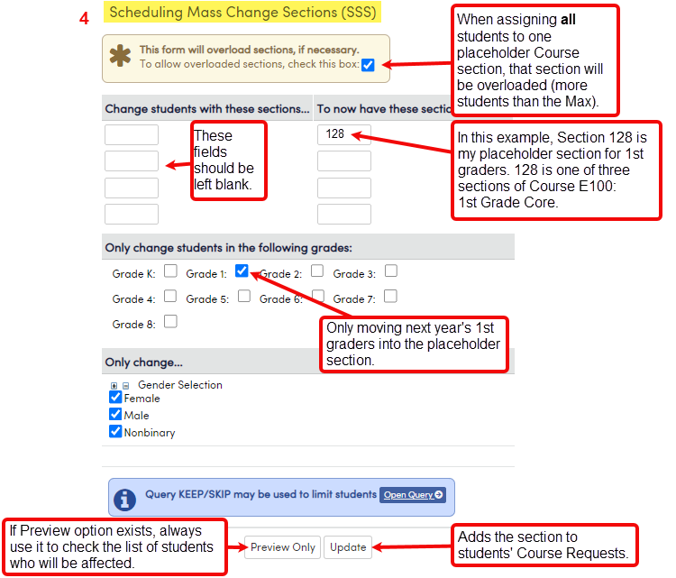
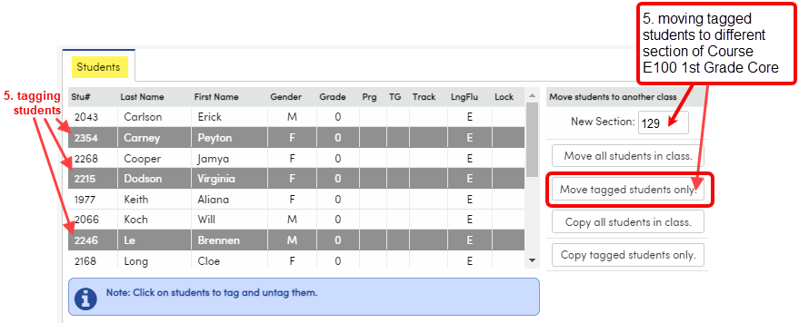
Option 1: assign students to SMS sections, then copy to MST next year
On Scheduling Setup page, set to Flex or Student Scheduling for Next Year.
Create an SMS using method of your choice.
Print the Scheduling Master Schedule report, sorted by Course and Period.
Use Scheduling Mass Change Section Numbers page to assign students to a placeholder section (the first section for each Course listed on the Scheduling Master Schedule report).
Can assign students By Grade Level
Can assign students using KEEP/SKIP to select groups of students
Note: this process will add a Course Request (and section); be aware that duplicate Course Requests could be created
Use Scheduling Master page to tag students and move them from the placeholder section to other sections of each Course until each student is properly scheduled.
After the New Year Rollover, Copy Scheduling Results to SEC & MST.
From now on:
Use the Master Schedule page to modify sections
Use the Classes page to modify student schedules

Slide 31
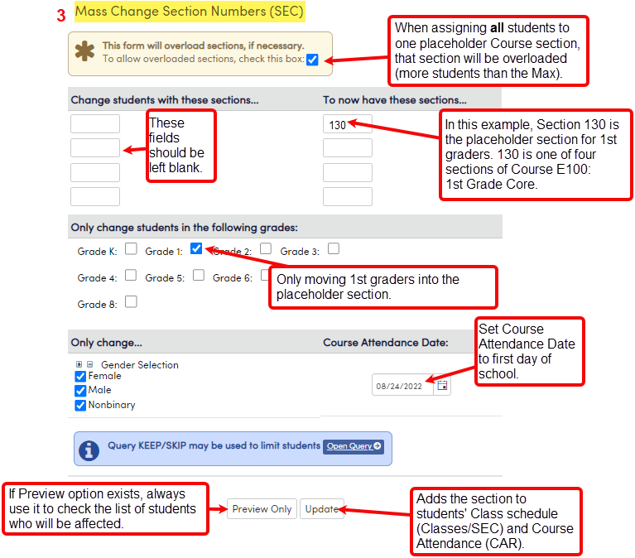
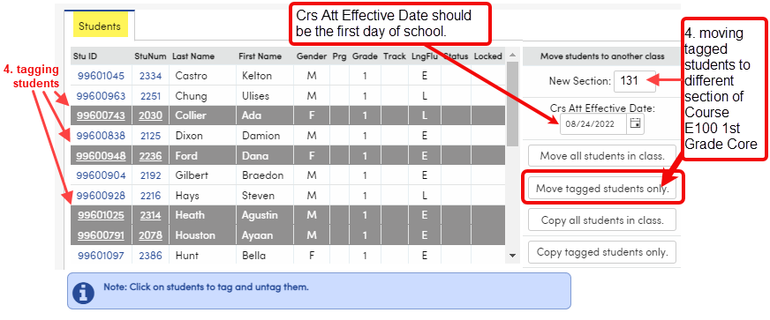
Option 2: create MST and assign students to MST sections
After the New Year Rollover, create a Master Schedule (MST) or modify an existing MST using the Master Schedule page.
Print Master Schedule report sorted by Course and Period.
Use Mass Change Section Numbers page to add students to the first section for each Course listed on the Master Schedule report (using it as a placeholder)
Can assign by Grade Level
Can use KEEP/SKIP to select groups of students
Use Master Schedule page to tag students and move them from each placeholder section to the other sections of each Course until each student is scheduled into all the sections they need.
Use the Master Schedule page to modify sections. Use the Classes page to modify student schedules.

Slide 32
Key Takeaways
Refer to the Scheduling Process Dashboard to find all scheduling-related pages and reports, in order
Use the Scheduling Setup page to set scheduling options
Options for building the Scheduling Master Schedule:
Copy the current MST to the SMS on Scheduling Setup
Use the SMS Builder or other SMS Board tools
Use the Scheduling Master page to add and copy sections

Slide 33
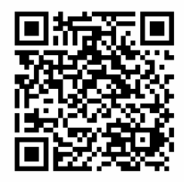
We want your feedback!
Scan the QR code below, or visit the survey link at the bottom, to provide feedback on this session:
310-1 Student Scheduling for Next Year -- Building the Scheduling Master Schedule.
http://surveys.aeries.com/s3/AeriesCon-Session-Feedback-Survey-Spring-2024

