Slide 1
AERIES Scheduling Workshop Day #2 – PM Session
WELCOME!
This workshop will start about 12:30 PST/2:30 CST.
Sam Defeo - Aeries Trainer

Slide 2
AERIES Scheduling Workshop Day #2 – PM Session
12:30 – 4:00 PST/2:30 – 6:00 CST - Flex Periods & Class Calendars
PM Break about 2:15 PST/4:15 CST
Sam Defeo - Aeries Trainer

Slide 3
DOCUMENTATION
The documentation for this workshop:
https://support.aeries.com/support/solutions/articles/14000126743

Slide 4
DOCUMENTS USED FOR THIS WORKSHOP
The documents that will be used in this workshop:
SW D2 PM Doc1 Flex Periods & Class Calendars.pptx
Finals Day.docx

Slide 5
CHANGES IN THE MST & SMS TABLES
TRADITIONAL SCHEDULING FLEX SCHEDULING
1. Period & Block 1. Flex Period (FTF) Table
2. Bell Schedule (BEL) Table 2. Flex Period Times (FTF) Table
3. Split Term & Day Tags 3. Class Calendar (CCL) Table
4. Block Schedule Calendar 4. Class Calendar Dates (CCD) Table
5. Teacher (TCH) Table 5. Staff (STF) Table
6. Primary Teacher, TCH #2, TCH #3 6. Section Staff Members (SSM) Table and Highly Qualified Teacher (1, 2, 3)

Slide 6
FLEX PERIODS - OVERVIEW
Flex Periods are created and linked to sections in the MST and/or the SMS tables.
Flex Periods include start/end times for each period, so a bell schedule (BEL) table is not used.
Custom bell schedules (BSD table) may be defined and linked to the school calendar (DAY table).
Custom bell schedule times are defined with the Flex Periods and replace the bell schedule times (BST) table.

Slide 7
CREATING FLEX PERIODS (FTF & FTT Tables)
A.7. Flex Periods:
Select the academic year (FTF.YR).
Enter the short title – maximum of 6 characters (FTF.STI).
Tiny Title – 2 characters (FTF.TT). This is to be used where Short Title does not fit. For Texas, this field is used for state reporting to identify periods. For California, this field has not been programmed in reports.
Enter the description – 50 characters (FTF.DE).
Enter the start & end times (FTF.ST & FTF.ET).
Enter the type (FTF.TY). Blank = Standard Flex Period, C = Non-Conflict Flex Period.
Enter any Custom Bell Schedule start & end times (FTT Table).

Slide 8
CREATING CUSTOM BELL SCHEDULES
A bell schedule definition (BSD table) must be created for any custom bell schedule that the school will need (i.e.: Short Day, Finals, Late Start, Monday, Tuesday, etc.).
For each of the custom bell schedules that have been defined, the Start/End times may be entered on the Flex Period page.
If a Flex Period does not meet on a custom bell schedule, then you do not have to adjust the Start/End times for that custom bell schedule.
After the school calendar (DAY table) has been created in the 2024-25 database, identify the school dates when the custom bell schedule will be in effect.

Slide 9
CLASS CALENDARS - OVERVIEW
Class Calendars are created and linked to sections in the MST and/or the SMS tables.
Class Calendars are used to indicate which school days a section, or class, meets.
Class Calendars can be created for sections that meet every day, every other day, all Mondays and Tuesdays, Fridays only, etc.
It is recommended that for each Flex Period there is a corresponding Class Calendar.

Slide 10
CLASS CALENDARS REPLACE THE BLOCK SCHEDULE CALENDAR
The Block Schedule Calendar was used to indicate the school days that each period (0-9) did or did not meet.
Since the Block Schedule Calendar is not used in Flex Scheduling, the Class Calendar is used to indicate specific school dates that a section will or will not meet.
For this reason, it is recommended that for each Flex Period there is a corresponding Class Calendar.

Slide 11
CREATING CLASS CALENDARS (CCL & CCD Tables)
A.8. Class Calendars:
Select the academic year (CCL.YR).
Enter the short title – maximum of 6 characters (CCL.STI).
Enter the description – 255 characters (CCL.DE).
Mass Select dates (CCD Table).
Admin users can COPY the Class Calendars (within the same school).
Admin users can PUSH the Class Calendars (to other schools).
It is recommended that for each Flex Period there is a corresponding Class Calendar.

Slide 12
TRADITIONAL BELL SCHEDULE – PERIODS 1-6, 0-6, 1-8, ETC. – 1 LUNCH
Flex Periods – 1 Lunch. If Lunch is a course, create a lunch period.
Flex Period | Start/End Times | Class Calendar | Meeting Days
0 | 7:05 – 7:55 | 0 | MTWRF
1 | 8:00 – 8:50 | 1 | MTWRF
2 | 8:55 – 9:45 | 2 | MTWRF
3 | 10:05 – 10:55 | 3 | MTWRF
4 | 11:00 – 11:50 | 4 | MTWRF
LUNCH | 11:50 – 12:20 | LUNCH | MTWRF
5 | 12:25 – 1:15 | 5 | MTWRF
6 | 1:20 – 2:10 | 6 | MTWRF
7 | 2:15 – 3:05 | 7 | MTWRF

Slide 13
TRADITIONAL BELL SCHEDULE – PERIODS 1-6, 0-6, 1-8, ETC. – 2 LUNCHES
Flex Periods – 2 Lunches. If Lunch is a course, create a lunch period.
Flex Period | Start/End Times | Class Calendar | Meeting Days
0 | 7:05 – 7:55 | 0 | MTWRF
1 | 8:00 – 8:50 | 1 | MTWRF
2 | 8:55 – 9:45 | 2 | MTWRF
3 | 10:05 – 10:55 | 3 | MTWRF
4 | 11:00 – 11:50 | 4 | MTWRF
5A | 11:55 – 12:45 | 5A | MTWRF
LUNCHB | 12:45 – 1:15 | LUNCHB | MTWRF
LUNCHA | 11:50 – 12:20 | LUNCHA | MTWRF
5B | 12:25 – 1:15 | 5B | MTWRF
6 | 1:20 – 2:10 | 6 | MTWRF
7 | 2:15 – 3:05 | 7 | MTWRF

Slide 14
DEFINE SECTIONS IN THE SMS TABLE
Add/Copy a section in the SMS table. C.1. Scheduling Master Schedule C.2. SMS Board
Select a Flex Period.
Select a corresponding Class Calendar.
Enter Course ID, Room, Grade Range, Max, and other necessary fields.
Assign a primary Staff record to the section.
If needed, assign additional Staff records to the section.

Slide 15
WHAT CREATES A CONFLICT?
A scheduling conflict is created when these three criteria are met:
Sections meet in the same or overlapping terms (i.e.: Fall and Quarter 1 are overlapping terms).
Sections meet at the same or overlapping time.
Sections meet on the same day(s).
To avoid scheduling conflicts, create different Flex Periods and/or different Class Calendars.
To help identify the Flex Periods and Class Calendars to create, consider these questions:
What day/days do all or most of the periods meet?
What day/days are the exceptions?

Slide 16
EVEN DAY /ODD DAY SCHEDULE
Classes meet on alternate days. Even numbered periods meet on one day and odd numbered periods meet on the following day. This is very similar to an A-Day/B-Day schedule, but the periods are named differently.
Flex Period | Start/End Times | Class Calendar | Week # | Meeting Days
1 | 8:00 – 9:45 | 1 | 1 2 | M W F T R
2 | 8:00 – 9:45 | 2 | 1 2 | T R M W F
3 | 10:05 – 11:50 | 3 | 1 2 | M W F T R
4 | 10:05 – 11:50 | 4 | 1 2 | T R M W F
LUNCH | 11:50 – 12:20 | LUNCH | Every Week | M T W R F
5 | 12:25 – 2:10 | 5 | 1 2 | M W F T R
6 | 12:25 – 2:10 | 6 | 1 2 | T R M W F

Slide 17
VARIATION OF AN EVEN DAY / ODD DAY SCHEDULE
Even numbered periods meet on Monday, Wednesday, and Friday.
Odd numbered periods meet on Tuesday, Thursday, and Friday.
Since all classes meet on Friday, the Friday bell schedule must be used for the Flex Period.
Custom Bell Schedules would be created for Monday/Wednesday and Tuesday/Thursday.
In the school calendar (DAY table), Monday/Wednesday Bell Schedules would be linked to every Monday and Wednesday, and Tuesday/Thursday Bell Schedules would be linked to every Tuesday and Thursday.
In the school calendar (DAY table), Friday will not have a Custom Bell Schedule. The Flex Period Start/End times will be used.
Flex Period | Start/End Times | Class Calendar | Meeting Days | Start/End Times - Friday
1 | 8:00 – 9:45 | 1 | T R F | 8:00 – 8:50
2 | 8:00 – 9:45 | 2 | M W F | 8:55 – 9:45
3 | 10:05 – 11:50 | 3 | T R F | 10:05 – 10:55
4 | 10:05 – 11:50 | 4 | M W F | 11:00 – 11:50
LUNCH | 11:50 – 12:20 | LUNCH | M T W R F | 11:50 – 12:20
5 | 12:25 – 2:10 | 5 | T R F | 12:25 – 1:15
6 | 12:25 – 2:10 | 6 | M W F | 1:20 – 2:10

Slide 18
INTERMISSION – PM Break

Slide 19
A-DAY/B-DAY SCHEDULE
Classes meet on alternate days. A-Day classes meet on one day and B-Day classes meet on the following day.
Flex Period | Start/End Times | Class Calendar | Week # | Meeting Days
1A | 8:00 – 9:45 | 1A | 1 2 | M W F T R
1B | 8:00 – 9:45 | 1B | 1 2 | T R M W F
2A | 10:05 – 11:50 | 2A | 1 2 | M W F T R
2B | 10:05 – 11:50 | 2B | 1 2 | T R M W F
LUNCH | 11:50 – 12:20 | LUNCH | Every Week | M T W R F
3A | 12:25 – 2:10 | 3A | 1 2 | M W F T R
3B | 12:25 – 2:10 | 3B | 1 2 | T R M W F

Slide 20
VARIATION OF AN A-DAY/B-DAY SCHEDULE
Most courses meet every day, but 2 courses meet on alternate days (i.e.: PE/Elective). The courses that meet on alternate days (PE/Elective ) could have sections every period.
Flex Period | Start/End Times | Class Calendar | Week # | Meeting Days
1 | 8:00 – 8:50 | 1 | Every Week | M T W R F
1 or 1A | 8:00 – 8:50 | 1A | 1 | M W F
 |  |  | 2 | T R
1 or 1B | 8:00 – 8:50 | 1B | 1 | T R
 |  |  | 2 | M W F
2 | 8:55 – 9:45 | 2 | Every Week | M T W R F
2 or 2A | 8:55 – 9:45 | 2A | 1 | M W F
 |  |  | 2 | T R
2 or 2B | 8:55 – 9:45 | 2B | 1 | T R
 |  |  | 2 | M W F
3 | 10:05 – 10:55 | 3 | Every Week | M T W R F
3 or 3A | 10:05 – 10:55 | 3A | 1 | M W F
 |  |  | 2 | T R
3 or 3B | 10:05 – 10:55 | 3B | 1 | T R
 |  |  | 2 | M W F
Flex Period | Start/End Times | Class Calendar | Week # | Meeting Days
4 | 11:00 – 11:50 | 4 | Every Week | M T W R F
4 or 4A | 11:00 – 11:50 | 4A | 1 | M W F
 |  |  | 2 | T R
4 or 4B | 11:00 – 11:50 | 4B | 1 | T R
 |  |  | 2 | M W F
5 | 12:25 – 1:15 | 5 | Every Week | M T W R F
5 or 5A | 12:25 – 1:15 | 5A | 1 | M W F
 |  |  | 2 | T R
5 or 5B | 12:25 – 1:15 | 5B | 1 | T R
 |  |  | 2 | M W F
6 | 1:20 – 2:10 | 6 | Every Week | M T W R F
6 or 6A | 1:20 – 2:10 | 6A | 1 | M W F
 |  |  | 2 | T R
6 or 6B | 1:20 – 2:10 | 6B | 1 | T R
 |  |  | 2 | M W F

Slide 21
ROTATING PERIODS
On Monday Periods 1- 6 meet in order.
On Tuesday, the 2nd day of the week, the classes start with period 2, followed by periods 3, 4, 5, 6, and 1.
On Wednesday, the 3rd day of the week, classes start with period 3, followed by periods 4, 5, 6, 1, and 2.
On Thursday, the 4th day of the week, classes start with period 4, followed by periods 5, 6, 1, 2, and 3.
On Friday, the 5th day of the week, classes start with period 5, followed by period 6, 1, 2, 3, and 4.
Holidays do not affect the schedule. If Monday is a holiday, then Tuesday of that week starts with period 2.
Monday | Tuesday | Wednesday | Thursday | Friday
1 | 2 | 3 | 4 | 5
2 | 3 | 4 | 5 | 6
3 | 4 | 5 | 6 | 1
4 | 5 | 6 | 1 | 2
5 | 6 | 1 | 2 | 3
6 | 1 | 2 | 3 | 4

Slide 22
ROTATING PERIODS
The Start/End times for each Flex Period will be based on the Monday bell schedule.
The Class Calendars indicate that the Flex Periods meet every day of the week.
Since the Flex Periods do not meet at the same time every day, Custom Bell Schedules will be used to show this variation.
Custom bell schedules will be created for Tuesday, Wednesday, Thursday, and Friday.
Each custom bell schedule will be linked to the corresponding days in the school calendar (Day table).

Slide 23
ROTATING PERIODS
Flex Period | Start/End Times – Monday Bell Schedule | Class Calendar | Meeting Days | Tuesday Bell Schedule | Wednesday Bell Schedule | Thursday Bell Schedule | Friday Bell Schedule
1 | 8:00 – 8:50 | 1 | MTWRF | 1:20 – 2:10 | 12:25 – 1:15 | 11:00 – 11:50 | 10:05 – 10:55
2 | 8:55 – 9:45 | 2 | MTWRF | 8:00 – 8:50 | 1:20 – 2:10 | 12:25 – 1:15 | 11:00 – 11:50
3 | 10:05 – 10:55 | 3 | MTWRF | 8:55 – 9:45 | 8:00 – 8:50 | 1:20 – 2:10 | 12:25 – 1:15
4 | 11:00 – 11:50 | 4 | MTWRF | 10:05 – 10:55 | 8:55 – 9:45 | 8:00 – 8:50 | 1:20 – 2:10
LUNCH | 11:50 – 12:20 | LUNCH | MTWRF | 11:50 – 12:20 | 11:50 – 12:20 | 11:50 – 12:20 | 11:50 – 12:20
5 | 12:25 – 1:15 | 5 | MTWRF | 11:00 – 11:50 | 10:05 – 10:55 | 8:55 – 9:45 | 8:00 – 8:50
6 | 1:20 – 2:10 | 6 | MTWRF | 12:25 – 1:15 | 11:00 – 11:50 | 10:05 – 10:55 | 8:55 – 9:45

Slide 24
STAGGERED START TIMES
As an example, 6th grade students start school 15 minutes after 7th & 8th grade students, and they have a different bell schedule and a different lunch period.
Flex Periods – 6th Grade | Start/End Times | Class Calendar | Week #
Flex Period | Start/End Times | Class Calendar | Meeting Days
1-6th | 8:15 – 9:05 | 1-6th | MTWRF
2-6th | 9:10 – 10:00 | 2-6th | MTWRF
3-6th | 10:20 – 11:10 | 3-6th | MTWRF
4-6th | 11:15 – 12:05 | 4-6th | MTWRF
L-6th | 12:05 – 12:35 | L-6th | MTWRF
5-6th | 12:40 – 1:30 | 5-6th | MTWRF
6-6th | 1:35 – 2:25 | 6-6th | MTWRF
Flex Periods – 7th & 8th Grade | Start/End Times | Class Calendar | Week #
Flex Period | Start/End Times | Class Calendar | Meeting Days
1-7/8 | 8:00 – 8:50 | 1-7/8 | MTWRF
2-7/8 | 8:55 – 9:45 | 2-7/8 | MTWRF
3-7/8 | 10:05 – 10:55 | 3-7/8 | MTWRF
4-7/8 | 11:00 – 11:50 | 4-7/8 | MTWRF
5-7/8 | 11:55 – 12:45 | 5-7/8 | MTWRF
L-7/8 | 12:45 – 1:15 | L-7/8 | MTWRF
6-7/8 | 1:20 – 2:10 | 6-7/8 | MTWRF

Slide 25
ANY QUESTIONS?

Slide 26
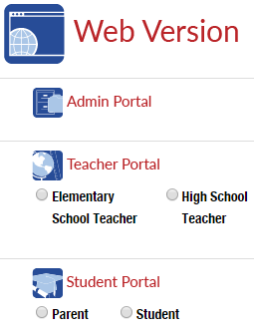
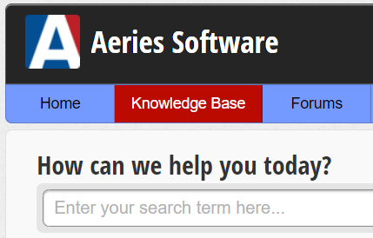
MANY SUPPORT RESOURCES
demo.aeries.net
Demo Database
Great for more practice!
learn.aeries.com
Aeries Teacher Academy
FREE online courses!
support.aeries.com
Aeries Documentation
& Video Library
Targeted support at your fingertips!

Slide 27
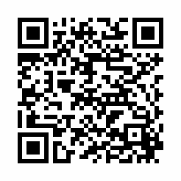
We value your feedback!
Please take a few minutes to complete our survey and let us know how we can better serve you in the future!
You will be enrolled in our monthly drawing for a gift card.
https://survey.alchemer.com/s3/7443595/Aeries-Training-Survey

Slide 28
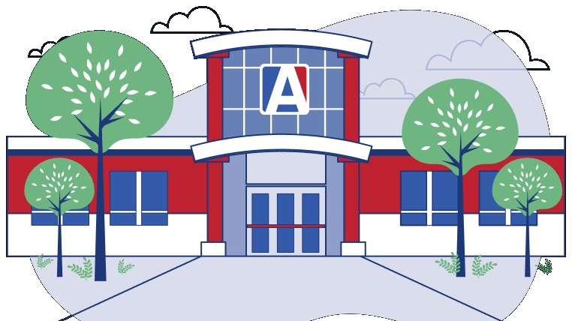
THANK YOU!

