Slide 1
Transitioning Your Secondary Master Schedule to Flex Scheduling
WELCOME!
January 26th – PM session starts at 1:00 PST.
February 26th – AM Session starts at 9:00 PST.
Sam Defeo - Aeries Trainer
Ron Anderson – Aeries Trainer & Today’s Moderator

Slide 2
Transitioning Your Secondary Master Schedule to Flex Scheduling
January 26th - PM Session – 1:00 – 4:00 PST
PM Break about 2:30 PST
February 26th - AM Session – 9:00 – 12:00 PST
AM Break about 10:30 PST
Sam Defeo - Aeries Trainer
Ron Anderson – Aeries Trainer & Today’s Moderator

Slide 3
DOCUMENTATION
The documentation for this workshop:
https://support.aeries.com/support/solutions/articles/14000126743

Slide 4
DOCUMENTS USED FOR THIS WORKSHOP
The documents that will be used in this workshop:
SW Transitioning Your Secondary Master Schedule to Flex Scheduling.pptx Aeries Simple New Tables Diagram.pdf Aeries New Tables Diagram.pdf
Flex Scheduling Setup. This links to the document Scheduling Setup Option for Transitioning to Flex Scheduling Master Schedule (SMS)

Slide 5
BASIC STEPS FOR SCHEDULING (No change)
Collect & Enter Course Requests
Print Reports (Tally, Conflict Matrix, Reverse Verification Listing)
Build & Enter the Scheduling Master Schedule
Print Scheduling Master Schedule Report by Teacher/Course/Period/Room
Schedule Students
Print Scheduling Analysis Reports (Course Request Analysis, Class Load Analysis, Class Load Averages)
Repeat Steps 1-6 as needed

Slide 6
SETUP REQUIREMENTS
Flex Scheduling must be enabled by your Aeries System Administrator by turning on two Feature Flags:
Flex Scheduling
Use StaffID Based Counseling
School Options – The Scheduling Type field remains as Secondary. This field impacts the current database, so DO NOT change this field! This field will be updated to Flexible in the new year’s database.
School Options – If the Master Schedule (MST table) will be copied to the Scheduling Master Schedule (SMS table) then the Bell Schedule (BEL table) will be used to initially create the Flex Periods.

Slide 7
SECURITY SETTINGS - TABLES USED
Scheduling for next year (2024-25) Scheduling in the current
while still in current year (2023-24). year (2023-24).
SSS – Course Requests SEC – Current sections
SMS – Scheduling Master Schedule MST – Master Schedule
SSM – Section Staff Members
STF – Staff Data TCH – Teacher Data
FTF – Flex Periods
FTT – Flex Period Times BEL – Bell Schedule
CCL – Class Calendar
CCD – Class Calendar Dates DAY – Block Schedule Calendar
BST – Custom Bell Schedule Times
Tables used for scheduling in the current year and the future year
CRS – Courses CRS – Courses
BSD – Bell Schedule Definition BSD – Bell Schedule Definition

Slide 8
Additional Aeries Tables
ALTERNATE COURSE REQUESTS PORTAL COURSES
ACA – Alternate Course Request Association CRQ – Course Request Sheet Table
ACR - Alternate Course Requests
COURSE REQUEST SECTION PACKETS
BACKUPS SPK – Section Packets
BAA – Alternate Course Request Association Backup SMP – SMS Sections
BAC – Alternate Course Requests Backup MSP – MST Sections
SBU – Scheduling Backups
SMB – Scheduling Master Schedule Backup SCHEDULING EXCLUSIONS
SSB – Student Scheduling Schedules Backup SED – Scheduling Exclusions
COURSE REQUEST PACKETS STAFF DATA
CRD – Course Request Packets SSI – Staff Scheduling Info
CRP – Course Request Packet Courses STJ – Staff Job Assignments

Slide 9
INITIALIZE SCHEDULING TABLES FOR NEXT YEAR
The Scheduling Setup Options page will prepare the SSS/SMS tables for next year.
Initialize the SSS and SMS tables by blanking out these two tables.
The steps to initialize the SMS table will vary depending on what you choose to do. You may choose to start with a blank SMS table, or you may choose to copy your current master schedule (traditional MST table) to the new scheduling master schedule (Flex SMS table).
Refer to the document Scheduling Setup Option for Transitioning to Flex Scheduling Master Schedule (SMS) https://support.aeries.com/support/solutions/articles/14000134306-scheduling-setup-option-for-transitioning-to-flex-scheduling-master-schedule-sms-

Slide 10
ENTER COURSE REQUESTS (No change)
PORTAL – Uses CRQ Table. Enter start/end dates for each grade level.
IMPORT from ACADEMIC PLAN – Select term and grade level to import.
MASS ADD or CHANGE COURSE REQUESTS – Select courses to mass add, change, or delete. Select grade level. Query KEEP & SKIP can be used.
MANUAL ENTRY – Individual student. Can add one course or many courses. Can use Course Request Packets.

Slide 11
CHANGES IN THE MST & SMS TABLES
TRADITIONAL SCHEDULING FLEX SCHEDULING
1. Period & Block 1. Flex Period (FTF) table
2. Bell Schedule (BEL) table 2. Flex Period Times (FTF) table
3. Split Term & Day Tags 3. Class Calendar (CCL) table
4. Block Schedule Calendar 4. Class Calendar Dates (CCD) table
5. Teacher (TCH) table 5. Staff (STF) table
6. Primary Teacher, TCH #2, TCH #3 6. Section Staff Members (SSM) table and Highly Qualified Teacher (1, 2, 3)

Slide 12
INTERMISSION – Break

Slide 13
FLEX PERIODS - OVERVIEW
Flex Periods are created and linked to sections in the MST and/or the SMS tables.
Flex Periods include start/end times for each period, so a bell schedule (BEL table) is not used.
Custom bell schedules can still be defined (BSD table) and linked to the school calendar (DAY table).
Custom bell schedule times are defined with the Flex Periods, so the bell schedule times (BST table) are not used

Slide 14
CREATING FLEX PERIODS (FTF & FTT Tables)
A.7. Flex Periods:
Select the academic year (FTF.YR).
Enter the short title – maximum of 6 characters (FTF.STI).
Tiny Title – 2 characters (FTF.TT). This is to be used where Short Title does not fit. For Texas, this field is used for state reporting to identify periods. For California, this field has not been programmed in reports.
Enter the description – 50 characters (FTF.DE).
Enter the start & end times (FTF.ST & FTF.ET).
Enter the type (FTF.TY). Blank = Standard Flex Period, C = Non-Conflict Flex Period.
Enter any Custom Bell Schedule start & end times (FTT Table).

Slide 15
CREATING CUSTOM BELL SCHEDULES
A bell schedule definition (BSD table) must be created for any custom bell schedule that the school will need (i.e.: Short Day, Finals, Late Start, Monday, Tuesday, etc.).
For each of the custom bell schedules that have been defined, the Start/End times may be entered on the Flex Period page.
If a Flex Period does not meet on a custom bell schedule, then you do not have to adjust the Start/End times for that custom bell schedule.
After the school calendar (DAY table) has been created in the 2024-25 database, identify the school dates when the custom bell schedule will be in effect.

Slide 16
CLASS CALENDARS - OVERVIEW
Class Calendars are created and linked to sections in the MST and/or the SMS tables.
Class Calendars are used to indicate which school days a section, or class, meets.
Class Calendars can be created for sections that meet every day, every other day, all Mondays and Tuesdays, Fridays only, etc.
It is recommended that for each Flex Period there is a corresponding Class Calendar.

Slide 17
CLASS CALENDARS REPLACE THE BLOCK SCHEDULE CALENDAR
The Block Schedule Calendar was used to indicate the school days that each period (0-9) did or did not meet.
Since the Block Schedule Calendar is not used in Flex Scheduling, the Class Calendar Dates are used to indicate specific school dates that a section will or will not meet.
For this reason, it is recommended that for each Flex Period there is a corresponding Class Calendar.

Slide 18
CREATING CLASS CALENDARS (CCL & CCD Tables)
A.8. Class Calendars:
Select the academic year (CCL.YR).
Enter the short title – maximum of 6 characters (CCL.STI).
Enter the description – 255 characters (CCL.DE).
Mass Select dates (CCD Table).
Admin users can COPY the Class Calendars (within the same school).
Admin users can PUSH the Class Calendars (to other schools).
It is recommended that for each Flex Period there is a corresponding Class Calendar.

Slide 19
TRADITIONAL BELL SCHEDULE – PERIODS 1-6, 0-6, 1-8, ETC. – 1 LUNCH
Flex Periods – 1 Lunch. If Lunch is a course, create a lunch period.
Flex Period | Start/End Times | Class Calendar | Meeting Days
0 | 7:05 – 7:55 | 0 | MTWRF
1 | 8:00 – 8:50 | 1 | MTWRF
2 | 8:55 – 9:45 | 2 | MTWRF
3 | 10:05 – 10:55 | 3 | MTWRF
4 | 11:00 – 11:50 | 4 | MTWRF
LUNCH | 11:50 – 12:20 | LUNCH | MTWRF
5 | 12:25 – 1:15 | 5 | MTWRF
6 | 1:20 – 2:10 | 6 | MTWRF
7 | 2:15 – 3:05 | 7 | MTWRF

Slide 20
TRADITIONAL BELL SCHEDULE – PERIODS 1-6, 0-6, 1-8, ETC. – 2 LUNCHES
Flex Periods – 2 Lunches. If Lunch is a course, create a lunch period.
Flex Period | Start/End Times | Class Calendar | Meeting Days
0 | 7:05 – 7:55 | 0 | MTWRF
1 | 8:00 – 8:50 | 1 | MTWRF
2 | 8:55 – 9:45 | 2 | MTWRF
3 | 10:05 – 10:55 | 3 | MTWRF
4 | 11:00 – 11:50 | 4 | MTWRF
5A | 11:55 – 12:45 | 5A | MTWRF
LUNCHB | 12:45 – 1:15 | LUNCHB | MTWRF
LUNCHA | 11:50 – 12:20 | LUNCHA | MTWRF
5B | 12:25 – 1:15 | 5B | MTWRF
6 | 1:20 – 2:10 | 6 | MTWRF
7 | 2:15 – 3:05 | 7 | MTWRF

Slide 21
DEFINE SECTIONS IN THE SMS TABLE
Add/Copy a section in the SMS table. C.1. Scheduling Master Schedule C.2. SMS Board
Select a Flex Period.
Select a corresponding Class Calendar.
Enter Course ID, Room, Grade Range, Max, and other necessary fields.
Assign a primary Staff record to the section.
If needed, assign additional Staff records to the section.

Slide 22
WHAT CREATES A CONFLICT?
A scheduling conflict is created when these three criteria are met:
Sections meet in the same or overlapping terms (i.e.: Fall and Quarter 1 are overlapping terms).
Sections meet at the same or overlapping time.
Sections meet on the same day(s).
To avoid scheduling conflicts, create different Flex Periods and/or different Class Calendars.
To help identify the Flex Periods and Class Calendars to create, consider these questions:
What day/days do all or most of the periods meet?
What day/days are the exceptions?

Slide 23
WHAT PAGES ARE DIFFERENT?
Course Requests
Scheduling Master Schedule
SMS Board & SMS Builder
Classes
Period Attendance

Slide 24
ANY QUESTIONS?

Slide 25
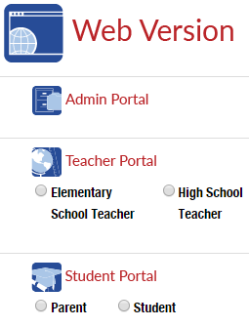
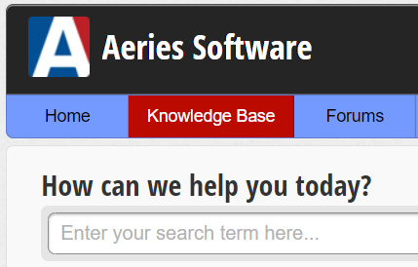
MANY SUPPORT RESOURCES
demo.aeries.net
Demo Database
Great for more practice!
learn.aeries.com
Aeries Teacher Academy
FREE online courses!
support.aeries.com
Aeries Documentation
& Video Library
Targeted support at your fingertips!

Slide 26
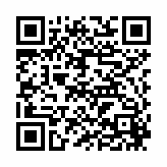
We value your feedback!
Please take a few minutes to complete our survey and let us know how we can better serve you in the future!
You will be enrolled in our monthly drawing for a gift card.
https://survey.alchemer.com/s3/7443595/Aeries-Training-Survey

Slide 27
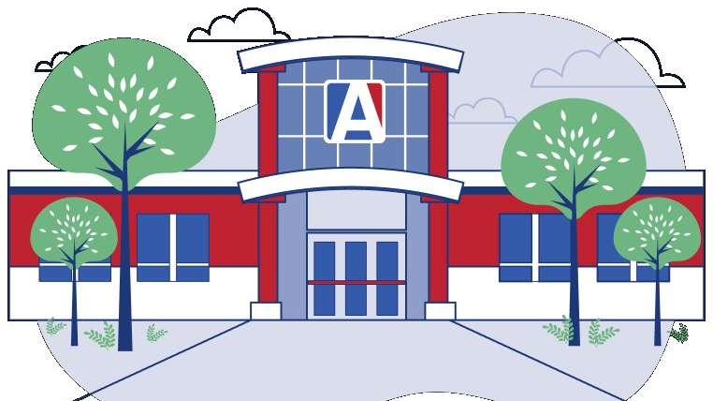
THANK YOU!

