Slide 1
Good morning, Aeries!
College Credit Courses

Slide 2
Speaking today:
Sandy Madrid| Trainer
sandy@aeries.com
Andrea MacDonald | Trainer

Slide 3
Good morning, Aeries!
Keep topics to 30-45 minutes
Show & Tell
Casual Setting
Time for Q&A
Power Point and Recordings Posted

Slide 4
Understanding the compliance required for reporting to the CALPADS System
Impact on your College and Career Indicator (CCI) for the CA Dashboard
How to manage Course Data for College Credit
Entering College Credit on Student Transcript
How to manage Student Transcript for students who do not qualify for Dual Enrollment College Credit
Need
To
Know

Slide 5
CCI Readiness Matrix
Notes:
The College/Career Indicator
College/Career Indicator (English)(PDF)
Understanding the College/Career Readiness Measure: Prepared (English)(PDF)
Understanding the College/Career Readiness Measure: Approaching Prepared (English)(PDF)

Slide 6
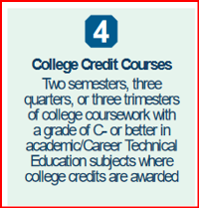
CCI – Indicator 4 - Prepared
CCI Measures
College Credit and Leadership/Military Science
Career Technical Education (CTE) Pathway
a-g
State Seal of Biliteracy
Pre-Apprenticeship Certification Program
Pre-Apprenticeship Program (Non-Registered)
State or Federal Job Program
Transition Work-based Experience/Transition Classroom-based Work Exploration
Notes:
Beginning this academic year, the California Department of Education (CDE) will collect new career measures for potential use in the College/Career Indicator (CCI) on the California School Dashboard. The CCI is based on students in the four-year graduation cohort or the Dashboard Alternative School Status (DASS) graduation rate. (Please disregard this notification if your local educational agency [LEA] or school does not serve high school students.)
The CDE is committed to building out the CCI over the next several years and, specifically, to develop additional career measures. In order to ensure that these new measures reflect the needs of all school types and student populations, the CDE is working closely with several stakeholder groups, including the CCI Work Group, the California Alternative Schools Task Force, the Technical Design Group, and the Advisory Commission on Special Education.
Make sure CTE Coordinators are aware of WHERE these data should be input in the SIS

Slide 7
Reporting College Courses
There are limited state course codes used for college courses.
CRS-State Course Codes in the range of 7000 – 8999 identify CTE Courses.
CTE Postsecondary Articulated Course Indicator Y/N
Non-Standard Instructional Level code used to identify college CTE courses
23 – College Credit only
24 – Dual Enrollment
OR
All college courses that are not CTE should consider using "College credit course" in the CALPADS name (e.g., College Credit Course – English)
College courses are reported with codes 9020, 9082, 9096, 9120, 9154, 9200 ,9227, 9273, 9303, 9358.

Slide 8
How to implement College Credit Courses
Key Points
A Consideration that is defined here would be to add a set of college credit courses per each Non-Standard Course Level (CRS.CL)
Review the Subject Area Codes (S1-S3) and A-G area for correct coding for these courses with your Subject Matter Experts
Courses Needed for Proper Reporting
There should be a set of specific College Course Codes added to the Course Table to use in these circumstances. There are 10 specific college course codes created by CALPADS to report College Courses.
There are 10 specific college course codes created by CALPADS to report College Courses.
9020 College Credit Course - Visual Arts
9082 College Credit Course - Dance
9096 College Credit Course - Theater
9120 College Credit Course - English
9154 College Credit Course - World Languages
9200 College Credit Course - History/Social Science
9227 College Credit Course - Other
9273 College Credit Course - Mathematics
9303 College Credit Course - Music
9358 College Credit Course - Science
Districts should create TWO sets of these courses, one marked with Course Level 23-College Only and one with 24-Dual Credit. The set of courses with the Course Level 24 should have the Subject area codes and UC/CSU codes reviewed, as these courses WILL count towards the student's Graduation Status.
College type definition and options:
Course Level 23 - A college-level, college credit bearing course in which a student receives only college credit upon successful completion. Option on TDF to either hide Credits on transcript, and leave course and college on transcript or hide all courses with CL=23 completely.
Course level 24 - A college-level, college credit bearing course in which a student receives both high school and college credit upon successful completion.

Slide 9
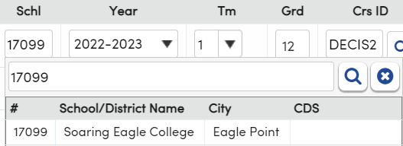
Courses
What’s needed to begin
Course History Institution
Courses that are solely provided by the Higher Education Institution will need to have the College Name added to CHI for use on the Student Transcript field for “school taken”
Management Courses Page
College State Course Code (CRS.CC3) – This field is only available if the Course Level is "24". If it is populated, it is used in lieu of the regular State Course Code when extracting to CALPADS for Transcript records that earn College credit. This new field only allows codes for CTE and specific College Credit Course codes.

Slide 10
How to tag College Credit Courses
Key Points
Course Page, Other Tab
CRS.CL = Course Non-Standard Instructional level field
CALPADS Extract
Obtain a good understanding of CCI for your courses
Articulated Courses
These courses may already be a part of your MST
AND
One Note
Retire code 40 from code table - If still in use
Aeries has created two new Course Level codes to support the new CALPADS "Course Non Standard Instructional Level" codes. Make sure these codes are translated in your Calpads code translations table.
23 - College Credit Only- A college-level, college credit bearing course in which a student receives only college credit upon successful completion. Here are some examples:
Courses taken voluntarily by the student with no affiliation to the district or teacher
Taught only by a college professor
Student only gets college credit (no high school credit)
Cannot count towards graduation requirements or GPA calculations but MUST be recorded on Transcript (HIS) so it gets reported to CALPADS
Course WILL count towards the student's College-Career Indicator (CCI) status.
24 - Dual Credit- A college-level, college credit bearing course in which a student receives high school credit and may also receive college credit upon successful completion of any other specific requirements.
Articulated course (meaning they have an agreement between community college and teacher) taught by a high school teacher or college professor
Course received college credit AND high school credit if they meet the requirements
Student has no choice if this counts for graduation or displays on transcript just like a normal course
Course WILL count towards the student's College-Career Indicator (CCI) status.
Note: The Course Level of "40 – College Level" should be retired. All current courses with the Course Level of "40 – College Level" should be updated to either the 23 or 24 code as appropriate.

Slide 11
How to tag College Credit Courses
Key Points
Which of the two options fit for your local courses, perhaps both…
Courses tagged 23 or 24 represent the student’s “preparedness” for CCI when applied to student transcript (HIS) table
ALL - College Credit courses need to managed on student transcript, including those on your MST
These changes impact the following areas:
Transcripts Page and Reports - Adding courses that students take at college to their Course History table (HIS) will demonstrate the student's College/Career Readiness.
Two Options:
Courses with a Course Level of "23 – College Credit Only" are not included in the GPA calculation
A new Transcript Definition option has been added under the Record Details pane that can be applied to any Transcript Definition: Hide College Credit Only Courses (CRS.CL = 23)
Hide Credits on transcript, and leave course and college on transcript
Hide entire record completely
Courses - A new field for “College State Course Code” has been added under the California Specific Fields tab. This field will only be available if the Course Level is "24 – Dual Credit". This new field only allows codes for CTE and specific college credit courses. If it is populated, it will be used in lieu of the regular State Course Code when extracting for any student who has College Credit Hours (HIS.CH) greater than 0, and the School of Dual Enrollment field (HIS.SDE) matched to one of their local schools to indicate they met any other specific requirements to receive the college credit. These records will have virtualized course section records (CRSE and SCSC) in order to differentiate them from the students who did NOT receive college course credits for this same course.
State Course Code vs College State Course Code
When only some students in a section receive college credit for a course completed, and some do not. Those that Do Not Qualify for college credit (grade received too low, or incomplete project, etc.) would receive transcript credit for the State Course code. Those that DO qualify (determined if College Hours > 0) will receive transcript credit under the CALPADS Course Code listed under the College State Course Code.

Slide 12
How to enter College Credit to Student Transcript
Key Points
For the College Credit data to be submitted to CALPADS for CCI preparedness All students who qualify must have these data fields populated on the student transcript from the College Credit courses defined in CRS.
Qualification equals a Grade Mark of C- or Better
Course level 23 - The College Credit Only course must be added to the transcript in order to be reported to CALPADS with the following fields populated. The School (HIS.ST) should be the college code set up in your CHI table. The year, term, grade, course number and mark should be filled out and optionally the credits attempted, and credits completed.
If the course was not taught by a teacher in the district, leave the Staff ID number blank. When the staff ID is left blank, a SEID of 10 9's is inserted into the file. A section number is not required since it is virtualized. If a section is entered, it must be a valid section that has the correct tags for the course being reported.
In addition, you must also populate the HIS.SDE (Dual Enrollment Credit School) and HIS.CH (College Credit Hours) fields. These fields are very important as they are trigger fields for the college course to extract properly for this code.

Slide 13
How to enter College Credit to Student Transcript
Key Points
For Course Level 24,. Students Transcript data must be managed for student’s who Qualify and those who Do Not Qualify.
The Course Table will contain a field for State Course Code used for non-qualifiers and the College State Course Code for qualifiers.
Sections will be virtualized or created automatically for the extract file
Course level (CRS.CL) 24 - The Dual Credit Course must be populated in the same manner as shown for Course Level 23. The transcript in order to be reported to CALPADS with the following fields populated. The School (HIS.ST) should be the college code set up in your CHI table. The year, term, grade, course number and mark should be filled out and optionally the credits attempted, and credits completed. When reporting the staff ID, the number must exist in the Staff table if taught by a teacher in the district. When the staff ID is left blank, a SEID of 10 9's is inserted into the file.
A section number is not required since it is virtualized. If a section is entered, it must be a valid section that has the correct tags for the course being reported. In addition, you must also populate the HIS.SDE (Dual Enrollment Credit School) and HIS.CH (College Credit Hours) fields. These fields are very important as they are trigger fields for the college course to extract properly for this code.
A unique difference with CRS.CL 24 is the data entry on the student transcript when the student meets qualification for college credit and when the student does not.
Students who qualify for college credit must contain the Dual Enrollment Credit School populated
For those student who do not meet qualification will not have any data in School of Dual Enrollment and College Credit Hours
The College State Course Code (CRS.CC3) populated, will extract for those students qualifying for college credit
The State Course Code (CRS.C3) populated, will extract for those not meeting qualification

Slide 14
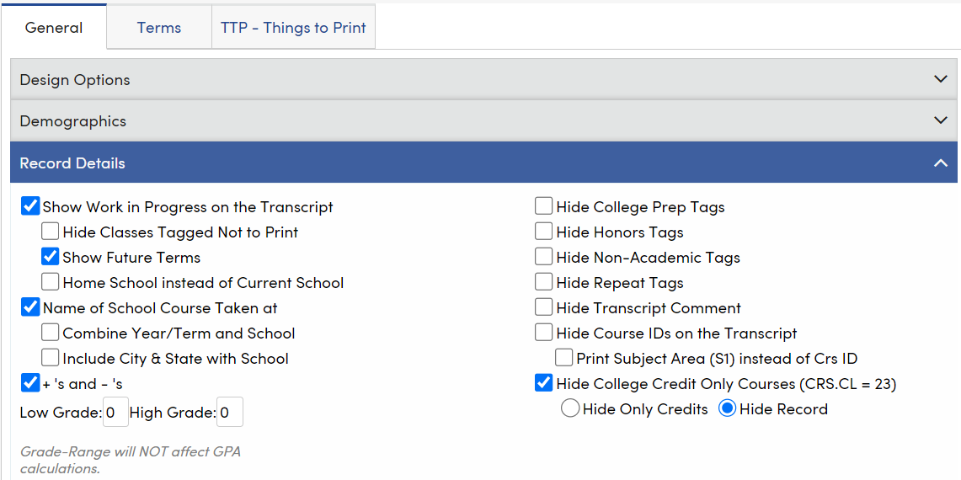
Courses with a Course Level of "23 – College Credit Only" are not included in the GPA calculation
A new Transcript Definition option has been added under the Record Details pane that can be applied to any Transcript Definition: Hide College Credit Only Courses (CRS.CL = 23)
Hide Credits on transcript, and leave course and college on transcript
Hide entire record completely
Student Transcript Definition
Key Points
Consider Transcript Definition set up for courses tagged course level 23
In this example the Course ID DEENSC = CRS.CL 23 and The Transcript Definition is set to “Hide Record”

Slide 15
Transcript Definition and College Credit Course Level 23
Transcript Indicator Definitions Course Characteristics Fields
https://support.aeries.com/support/solutions/articles/14000115804-transcript-indicator-definitions
Nice
To
Know

Slide 16
https://aeries.com/events
Many More GMA Sessions
Webinars
Watch for more upcoming webinars!

Slide 17
We value your feedback!
Please take a few minutes to complete our survey and let us know how we can better serve you in the future! Have a great rest of your day.
Good-Morning-Aeries-Survey

Slide 18
Thanks for joining us!
Where to Go
Aeries Demo Data
Aeries Academy
How to tag College Credit Courses
https://support.aeries.com/support/solutions/articles/14000125990-eoy-1-faqs#How-to-tag-College-Credit-Courses%C2%A0%E2%86%91

