Slide 1
Good morning, Aeries!
Assertive Discipline
May 23, 2023

Slide 2
Speaking today:
Deb McConnell | Aeries Trainer/Presenter
Lori Leal | Training Specialist/Moderator

Slide 3
Good morning, Aeries!
Session will last 30 – 45 minutes
Show & Tell
Casual
Time for Q&A
PPT & Recordings Posted

Slide 4
NEED TO KNOW
Importance of System Setup and Configuration District policies should guide documentation of discipline incidents Thorough understanding of all components and how to enter data on the Assertive Discipline page How to print Suspension Letters Role of Incident ID numbers Attendance is not linked to Assertive Discipline and must be updated to reflect the student’s absences
Assertive Discipline

Slide 5
NICE TO KNOW
How to use Victims and Witnesses pages How to view and use the Discipline Dashboard Comparison of Assertive Discipline and Discipline pages
Assertive Discipline

Slide 6
WHAT IS THE ADL KIT?
Assertive Discipline Setup
Adjusted/confirmed prior to each school year by district admins
To reflect district/school policies
Code Table
Violation codes & descriptions, including order on drop-downs (ADS)
Disposition codes & descriptions (DSP)
Suspendable Offense Codes
Codes match Violation codes
Include Ed Code Section, full text, other setups
Used on Suspension letters
Translations possible

Slide 7
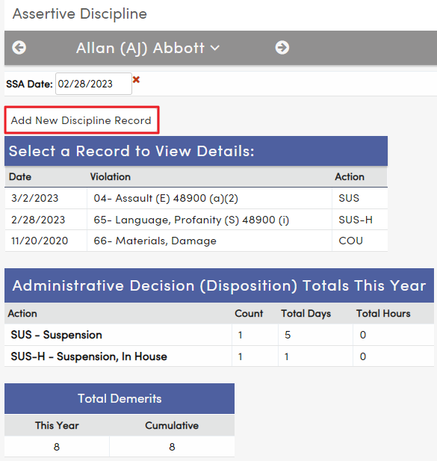
Assertive Discipline
Initial View
“Add New Discipline Record”
Past Discipline events appear, if applicable
Types and totals for prior Dispositions
SSA (Safe School Act) Date

Slide 8
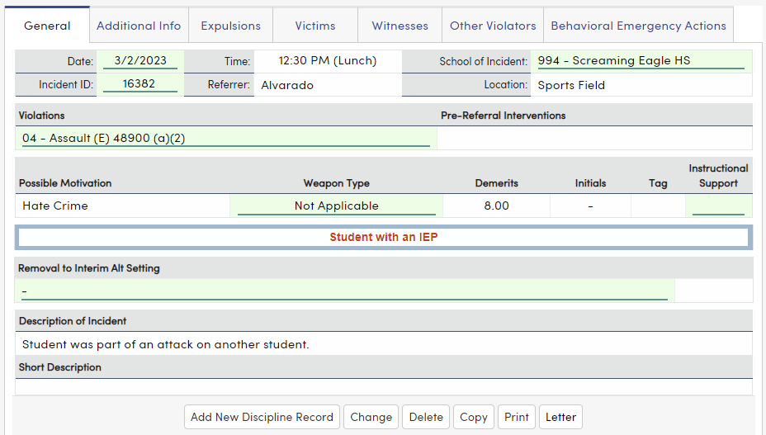
Assertive Discipline
California & Texas
Violation
State reporting fields highlighted
Incident ID automatically created upon Save
Note multiple tabs
IEP or 504 info in red

Slide 9
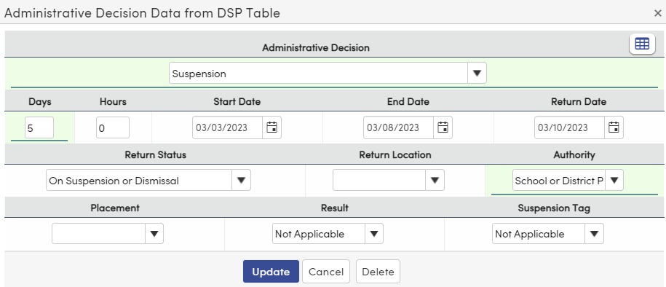
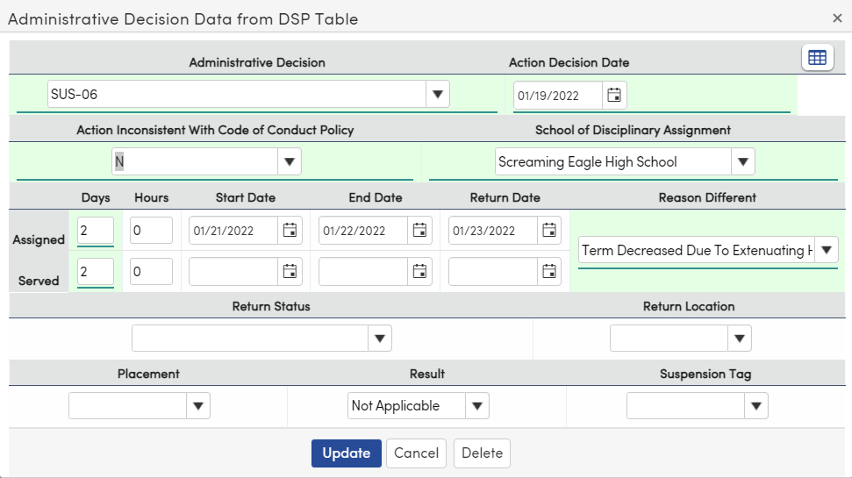
California:
Assertive Discipline
Administrative Decision(s)/Action
(Dispositions)
Required fields in green
Days may not be needed for non-suspensions
Others as appropriate
Texas:

Slide 10
Assertive Discipline
Related to Violations:
District Settings Affecting Appearance/ Function
Related to Admin Decision/Dispositions:

Slide 11
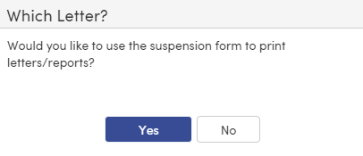
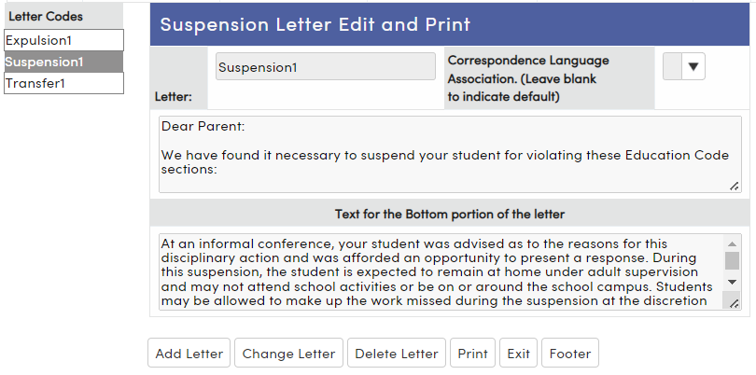
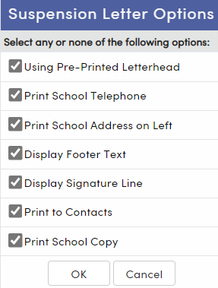
Assertive Discipline
Printing Suspension Letters
Text set in advance
Translations may be created

Slide 12
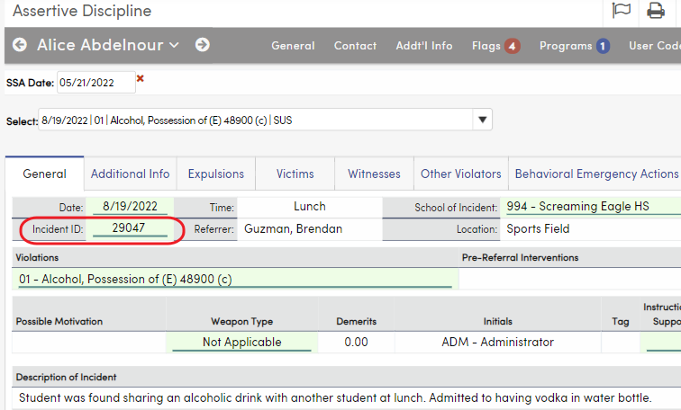
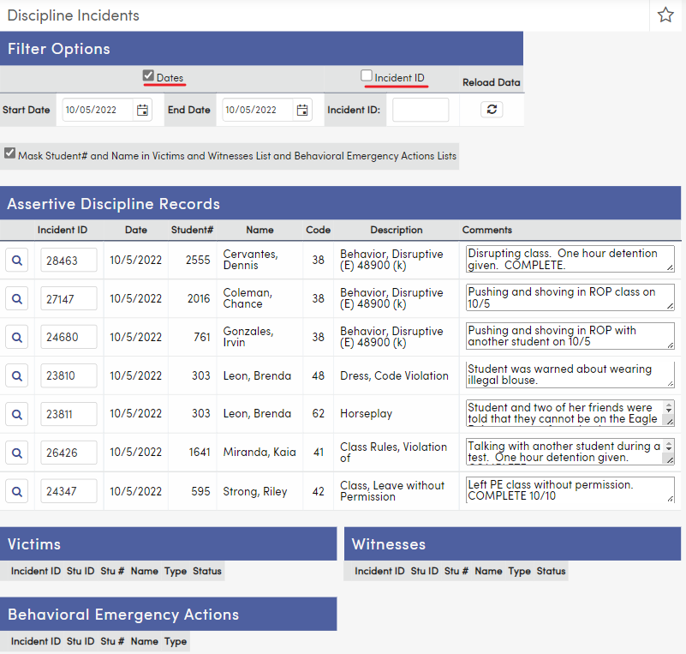
Assertive Discipline
Incident ID #s
Generated automatically upon Save of ADS record
Purpose: to show connections between
Students involved in the same incident
Victims or Witnesses connected to an incident
Discipline Incident page: Lookup by Date or Incident #
Not the same as Law Enforcement ID

Slide 13
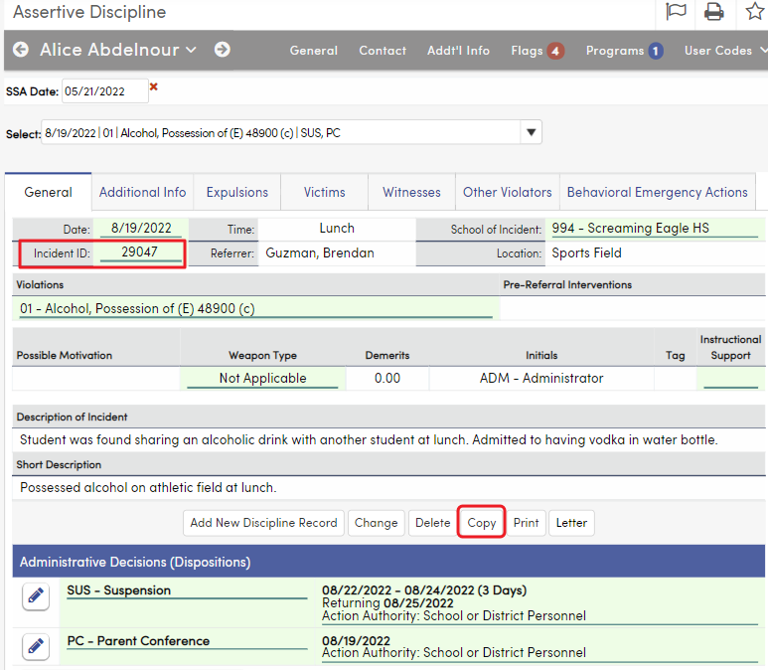
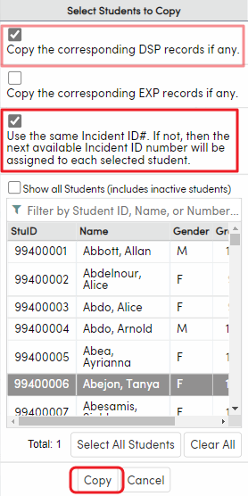
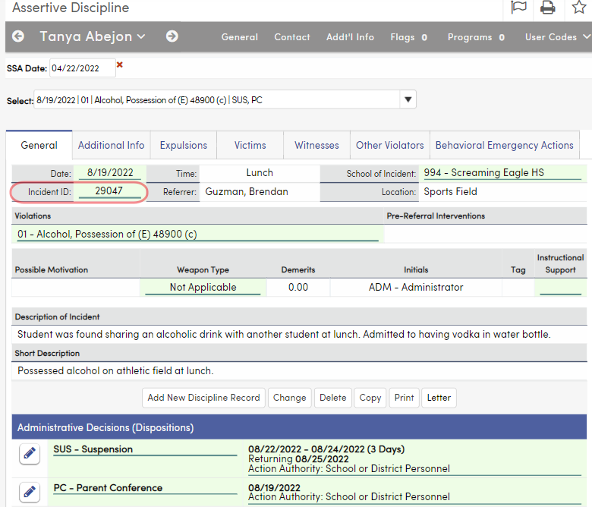
Assertive Discipline
Incident ID #s / Copy
Copy feature used when more than 1 student is involved in a single incident
Able to make changes to copied record as needed
Note: SSA Date on copied record must be filled manually

Slide 14
Assertive Discipline
Victims
Connected to Incident ID of original ADS record of student committing violation (can use lookup tool)
Can be used by Civil Rights report to track victims of harassment
Witnesses
page works similarly

Slide 15
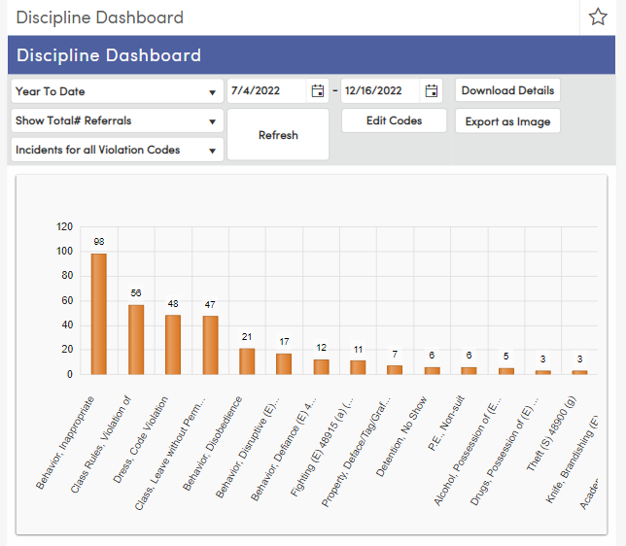
Assertive Discipline
Discipline Dashboard
Displays variety of charts analyzing ADS incidents
Change dates and types, then click Refresh to see updated chart
Download details with or without student demographic info
Export as image

Slide 16
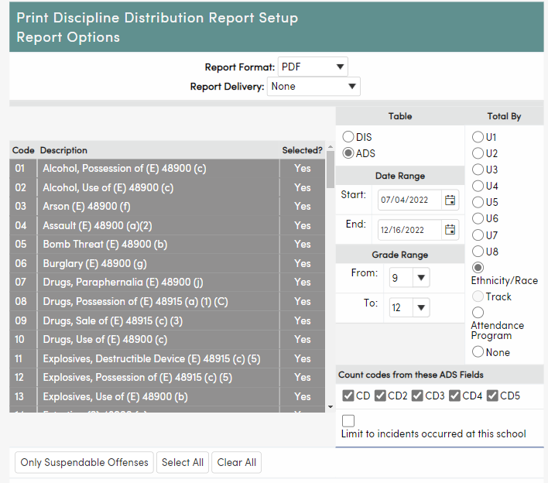
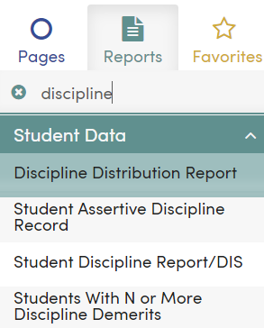
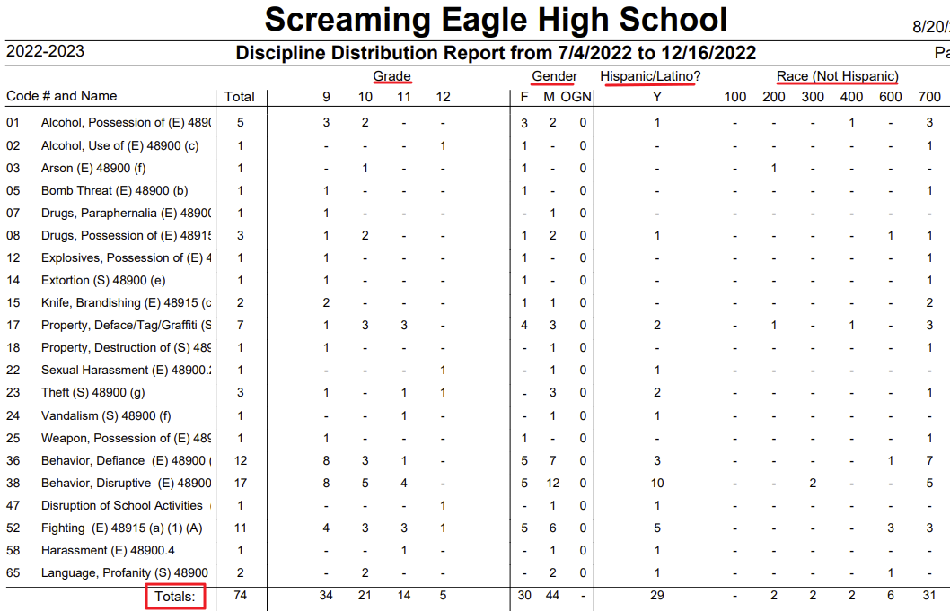
Assertive Discipline
Discipline Reports

Slide 17
Compare:
“Assertive Discipline” (ADS) and
“Discipline” (DIS)
Feature | ADS | DIS
Report to CALPADS | YES | NO
Document Suspensions | YES | NO
Document Minor Infractions | YES, if not in DIS | YES, if not in ADS
Data shows on Discipline Dashboard | YES | NO
Links to Victims form (assists with OCR Report) | YES | NO
Links to Witnesses form | YES | NO
Generates Letters to Parents | YES | NO
Positive Behavior Intervention System (PBIS) fields | More than DIS | Some (in Advanced DIS)
Teachers may enter Classroom Discipline | NO | YES, if allowed
Aeries Analytics Item Definitions | Yes - by Violation, Disposition Count, or Disposition Days | No

Slide 18
Thanks for joining us!
Where to Go
Aeries Demo Data
Aeries Academy- General
Assertive Discipline Articles: Aeries Software Discipline Videos: Aeries Software Aeries Academy Course-Discipline

Slide 19
Please take a moment
to complete the survey
https://survey.alchemer.com/s3/6899809/Good-Morning-Aeries-Survey

Slide 20
Watch for more upcoming Good Morning Aeries! and other events
Transcripts-Repeat Tags
Discipline Dashboard
Standard Based Report Card Templates
Calpads EOY
Texas-Back to School Power Up with Aeries Workshop
Updated List of All Events Here

