Slide 1
Good morning, Aeries!
Career Pathway Management

Slide 2
Speaking today:
Presenter - Arlene Suval | Aeries Trainer
arlene@aeries.com
Moderators – Leeni Mitchell | Aeries Trainer
Athina Firman |Training Specialist

Slide 3
Good morning, Aeries!
Short & sweet… only 30-40 minutes
Show & Tell
Casual Setting
Time for Q&A
Power Point and Recordings Posted to Aeries Support Home Page

Slide 4
Security Permissions to update Career Pathways Mgmt Page
CPW & CPH tables must be enabled on District Settings page
Career Pathways coding Required on Courses Page -Others tab, Career Pathways tab, and on MST Section
Need
To
Know
Only Career Pathways History levels for Completers will extract in the SCTE file for EOY

Slide 5
AeriesCon Sessions 605-1 & 605-2 on Aeries Support, offer very complete Career Pathways information
You can mass add experiences & outcomes codes to many students within a pathway
A Pathways status can be enabled on a Grad Track that will appear on the Grad Status page
Nice
To
Know

Slide 6
Where To Go : Career Pathways in Aeries Support
Aeries Support- Career Pathways

Slide 7
Career Pathway Queries
What are the first steps before using Career Pathways Mgmt?
Calpads Valid Code Combinations
Sec 605-1 Fundamentals
Sec 605-2 Career Pathways Mgmt
Where To
Go

Slide 8
Courses Page Coding on 3 tabs
MST Section Coding

Slide 9
Career Pathways Management Page
Only student with a current Academic Record in Career Pathways History (CPH) as a Participant of a Concentrators(Lvl 2) and Completer (Lvl 3) will be extracted for Calpads SCTE

Slide 10
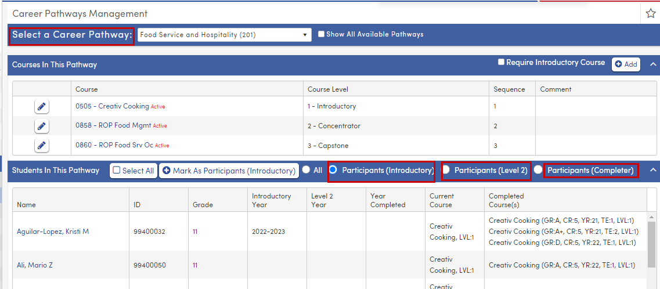
Career Pathways Management Page

Slide 11
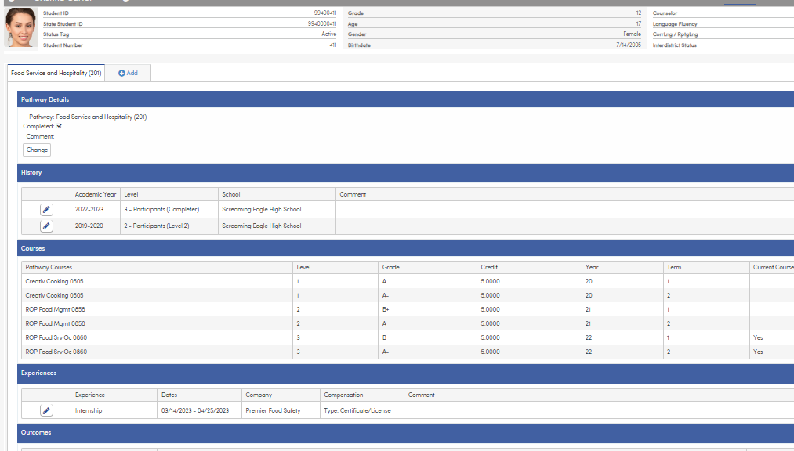
Student Career Pathways Page
Student Data > Programs > Career Pathways
May code Pathways individually for each student
Will reflect any coding added by the Pathways Management Page
Also contains sections to input Outcomes and Experiences information*
Student Profile page also contains Career Pathways widget

Slide 12
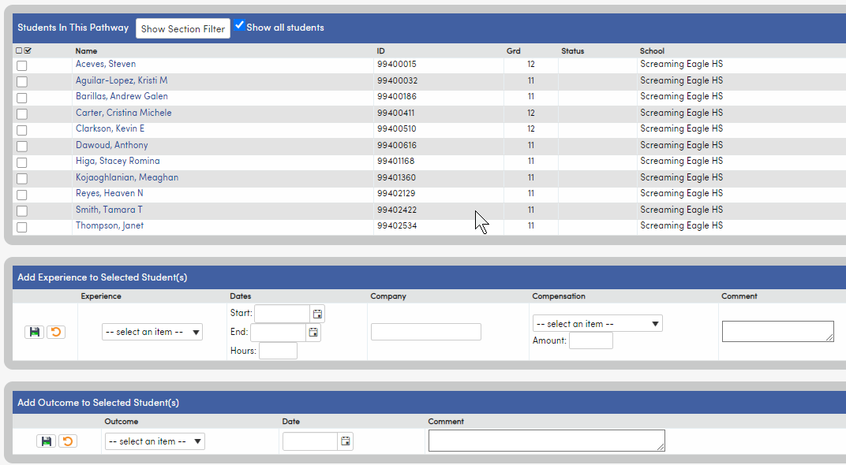
Career Pathways Mass Add Events
Used to mass add Outcomes and Experiences to the Student Career Pathway page
Outcome code = CPO.0C
Compensation codes = CPE.TY and CPE.CT are required

Slide 13
Thanks for Joining Us!
Watch for future February GMAs (9am PST/11am CST)
Assertive Discipline, 5/23
Transcripts/Repeat Tags, 5/24
Discipline Dashboard, 5/25
SBG Report Card Templates, 5/30
Calpads EOY/Dual Enrollment, 5/31
Calpads EOY/Where Does Data Go?, 6/1
https://www.aeries.com/events/

Slide 14
We Value Your Feedback…
Please take a few minutes to complete our survey; let us know how we can better serve you in the future. Have a great rest of your day!
Good-Morning-Aeries-Survey

