Slide 1
Good morning, Aeries!
Parent Data Confirmation
Document Request Part 4 of 4

Slide 2
Speaking today:
Theresa Nicolaou | Aeries Trainer
theresan@aeries.com
Moderators | Leeni Mitchell, Aeries Trainer
Arlene Suval, Aeries Trainer

Slide 3
Good morning, Aeries!
Keep topics to 30-45 minutes
Show & Tell
Casual Setting
Time for Q&A
Power Point and Recordings Posted

Slide 4
Difference between Portal Document Request & Portal Documents
Can create requests for specific type of documents
Parents can upload multiple documents
Requests can be optional or required
Submitted documents appear as Pending Documents for schools to review
School process to approve documents
Need
To
Know

Slide 5
Coordinate with school staff as needed
Translations available
Portal Documents Requests are district level, not school site level
Parents can delete document before approval, but not after
Allowed document types controlled in District Settings
Parents can view approved documents in Parent Portal
Nice
To
Know

Slide 6
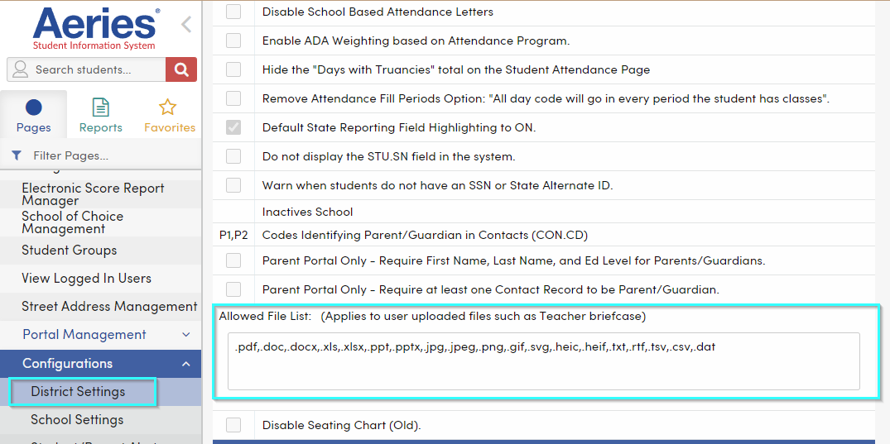
District Settings
Allowed File List - Comma-separated list of File types that can be uploaded in Aeries. The default list is shown. These extensions can be removed or others added.

Slide 7
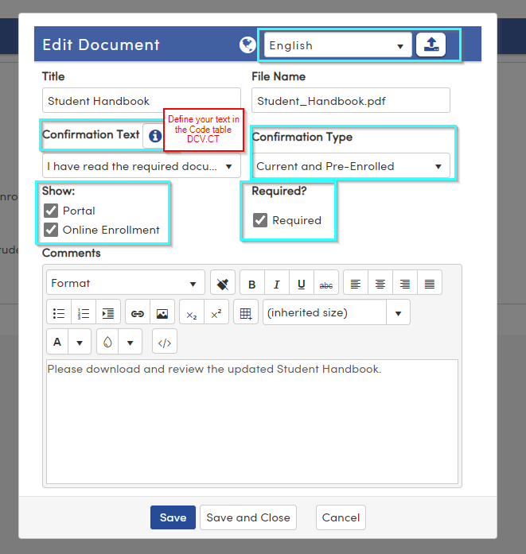
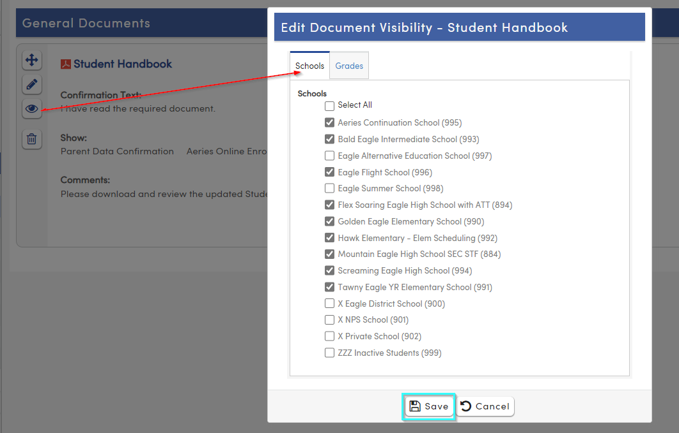
Portal Documents
Key Areas
Highlighted
Very Important
Define your Schools and Grades
Have your Documents translated and ready to go – especially if set to required

Slide 8
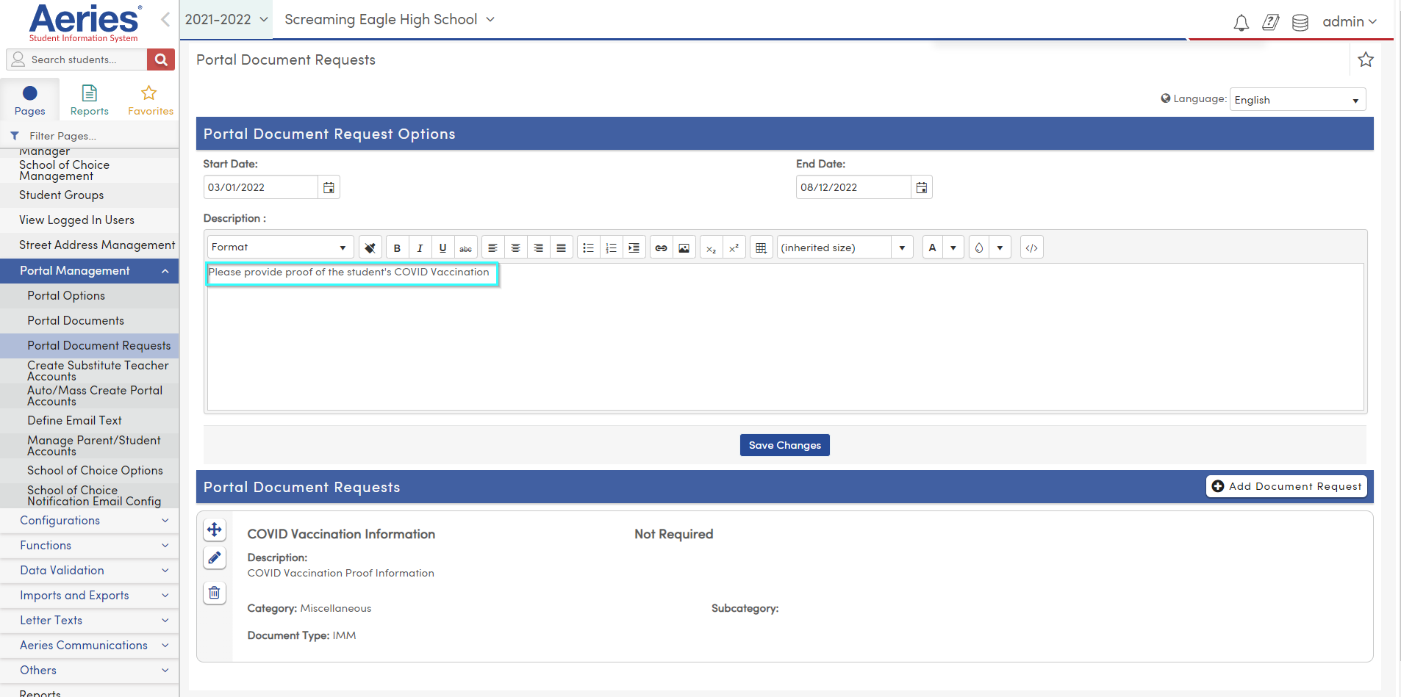
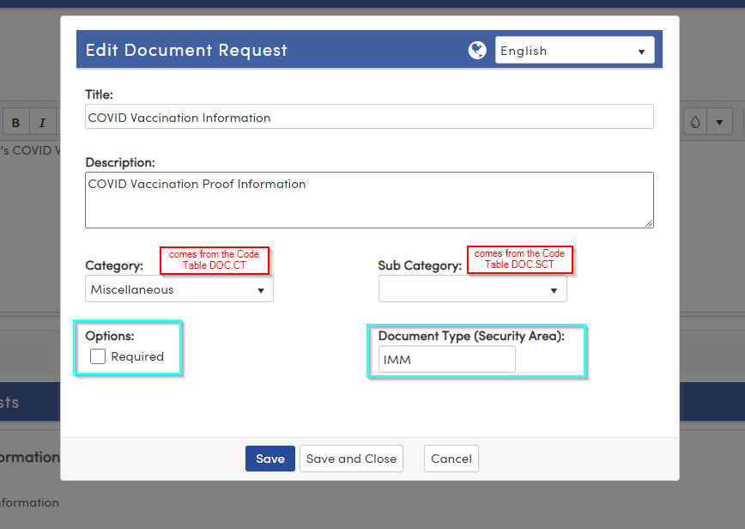
Portal Documents Requests
Key areas – highlighted
Requests are District, not School based
Document Type - This relates to the Security Area in Student Documents and will imported with this area.

Slide 9
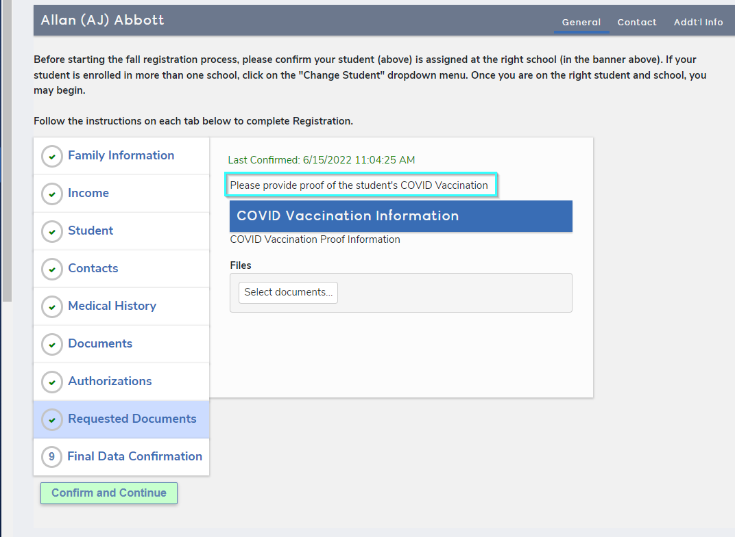
Parent view
Portal Documents Request

Slide 10
Portal Documents Request – End User Approval
Query the results

Slide 11
We value your feedback!
Please take a few minutes to complete our survey and let us know how we can better serve you in the future! Have a great rest of your day.
Good-Morning-Aeries-Survey

Slide 12
Thanks for joining us!
Where to Go
Parent Data Confirmation Setup
Portal Documents Requests
Aeries Demo Data
Aeries Academy
Parent Data Confirmation Videos

