Slide 1
Good morning, Aeries!
Attendance Reports

Slide 2
Speaking today:
SUSAN PROW | Implementation Coordinator
susan@aeries.com
CHRISTIE REIDER | Aeries Trainer
christier@aeries.com

Slide 3
Attendance Reports
Using Aeries Attendance Reports for
Attendance Accounting and More!

Slide 4
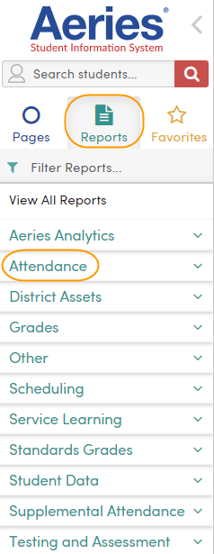
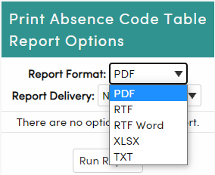
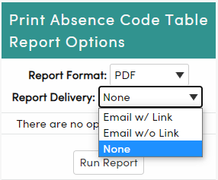
Accessing Attendance Reports
Reports Tab
Go Green!
Attendance Node
Report Format
Report Delivery

Slide 5
What reports support attendance practices?
Absence Code Report
Displays the accounting configuration for absence codes
Attendance Calendar
Displays attendance months
Displays non-school days
Attendance Submission Log
Ensures that every teacher has taken attendance
Students Absent or Tardy Today
Absence list for circulation

Slide 6
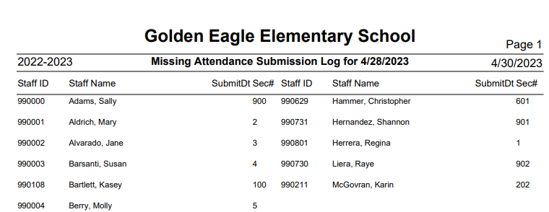
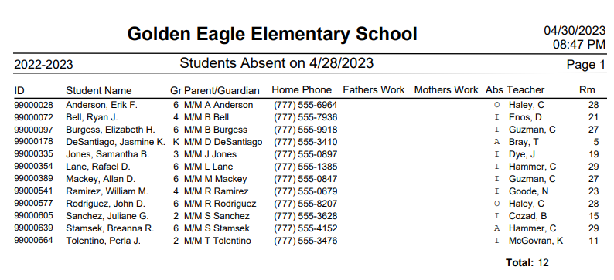
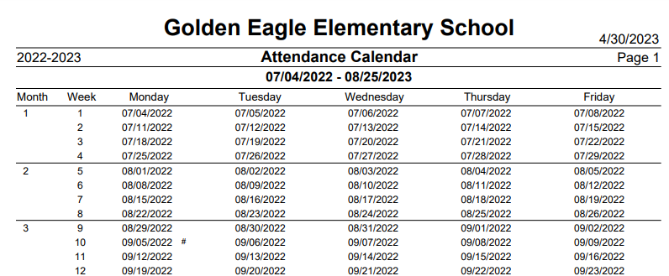
Report Samples

Slide 7
What reports audit attendance?
Attendance Audit Listing Report
Checks for 50 potential attendance errors that impact accounting results
Must be error-free
Course Attendance Audit Report
Checks for scheduling errors that do not align with attendance reporting
Must be run at period attendance school
Period Attendance Audit Report
Checks for anomalies in student period attendance
Allows teachers to sign for the attendance anomalies

Slide 8
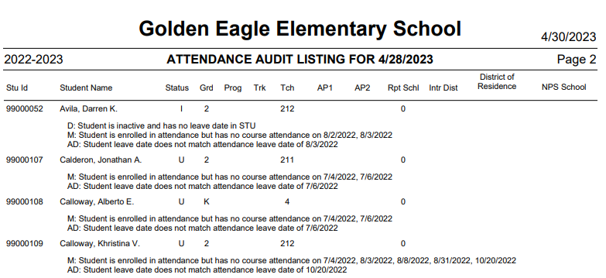
Audit Report Samples

Slide 9
Weekly Attendance Report by Teacher (Daily Attendance)
Weekly Attendance Report by Class (Period Attendance)
Required for schools where electronic signatures have not been obtained
Must match submitted attendance report data
Must be signed by the teacher
Gain and Loss Report
Provides details of student enrollment/exits for the attendance month
Monthly Attendance Report
This report displays the student details of absences for the attendance month
Monthly Attendance Summary Report
This report displays the summary results from the Monthly Attendance Report
Displays the ADA reporting information
Cumulative ADA Report!
Attendance Notes Report
Provides the absence reasons for reconciling attendance
Meets audit needs for validation of attendance
What reports support monthly reconciliation processes?

Slide 10
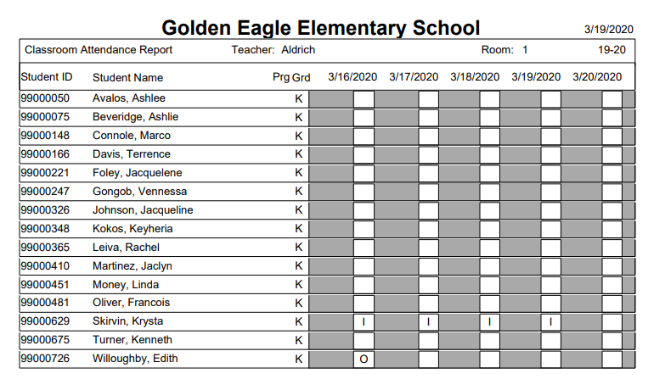
Weekly Teacher Attendance Report
Displays absences by class for the week
Edits must be initialed otherwise, rerun the report
Must be signed by the teacher
Electronic Signature approval eliminates the need for this report

Slide 11
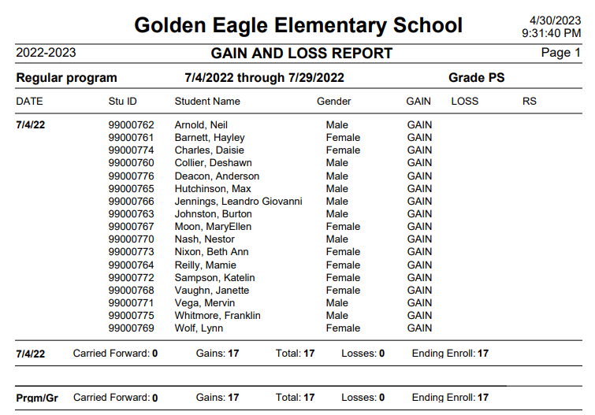
Gain and Loss Report
Displays detailed student information of gain and losses during the attendance month
Summary of this information is displayed on the Monthly Teacher Attendance Report and the Monthly Attendance Summary

Slide 12
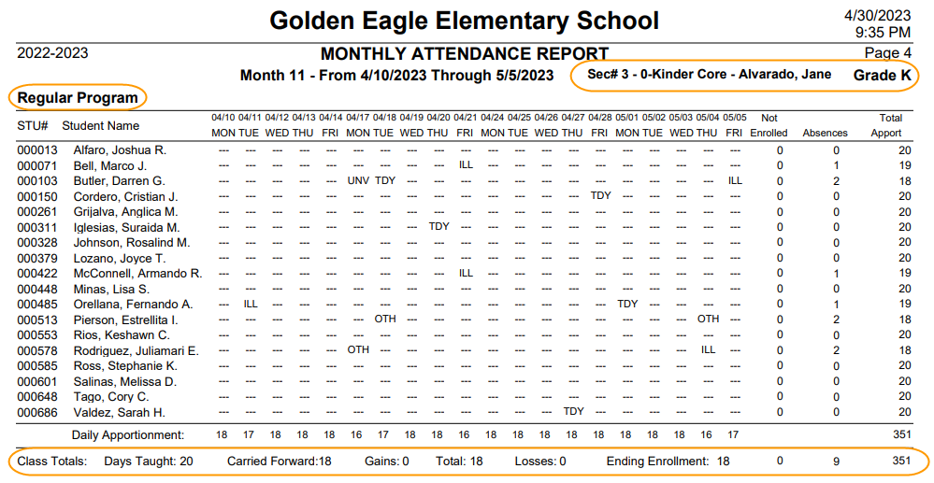
Monthly Attendance Report
Displays “detailed” student attendance information
Prints by:
Attendance Program (SP AP1 AP2)
Grade Level
Teacher

Slide 13
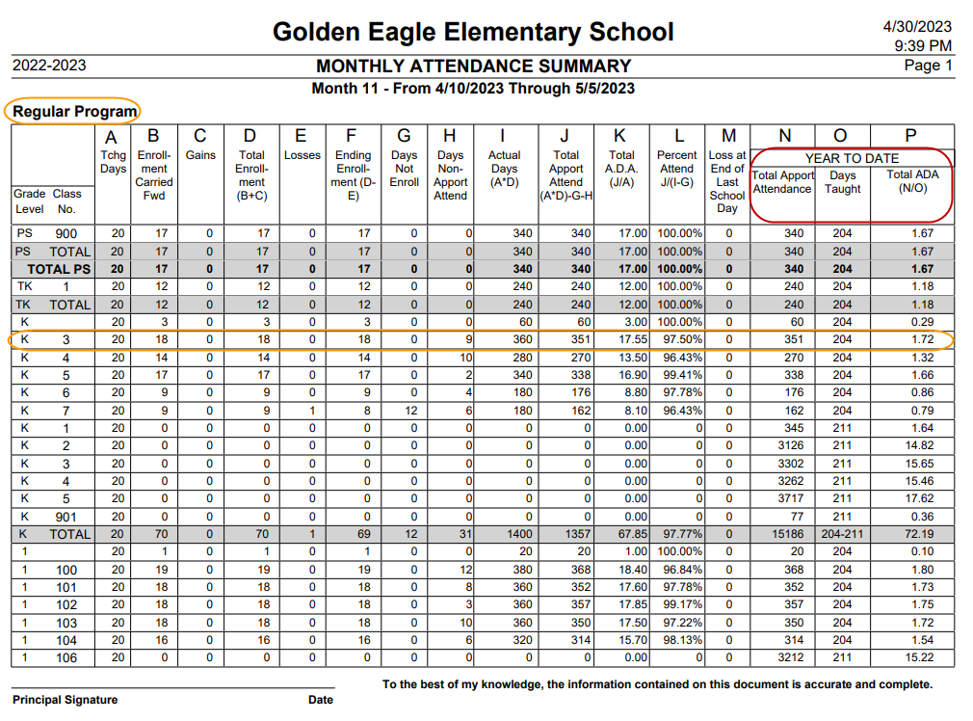
Monthly Attendance Summary Report
Displays summary data of student attendance information
CUMULATIVE ADA REPORT!
Always matches the Monthly Attendance Report unless changes were made to attendance and the YTD was not updated on this report
Prints by Attendance Program
Signed by Principal/Administrator

Slide 14
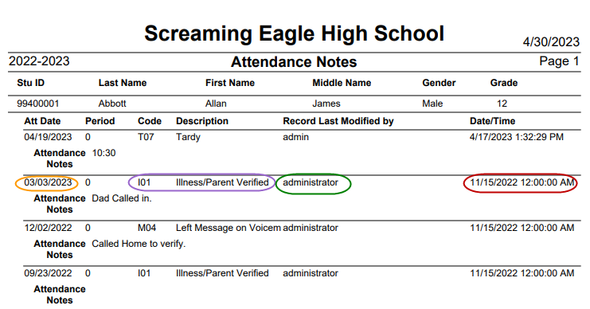
Attendance Notes Report
Listing of attendance validation
Run by attendance month date range
Includes 5 auditor checkpoints:
When was absence?
Why was student absent?
Who informed the school?
Who updated the information?
When was the information obtained?

Slide 15
Class Roster Report
Versatile report that has many options
Can add 3 STU fields to report
Substitute Folders
Homeroom Parents
Grade Roster for Itinerant Teachers
Students with Absences
Select which codes to monitor
Select count threshold
Attendance Log
Identifies changes made and by whom
Audit trail
Daily Enrollment by Class
Similar to the Attendance History page but, displays by class
Daily Apportionment Report
Daily ADA by school
Daily Attendance Record for All Students
Period Attendance for All Students
Displays student summary
Add to cum annually
What other attendance reports are helpful?

Slide 16
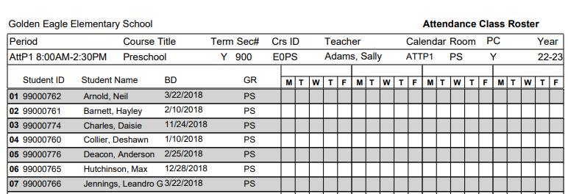
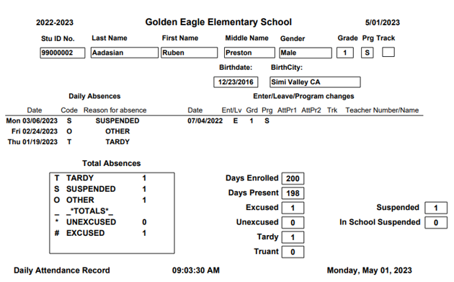
Report Samples
There’s so many!

Slide 17
Take a Discovery Walk!
Visit
Aeries
Attendance
Reports Listing
for a
comprehensive list of available attendance reports.

Slide 18
Thanks for joining us!
Info and links
Attendance FAQs
What procedures should be performed to reconcile monthly attendance at the school level?
What procedures should be performed to reconcile monthly attendance at the district level?
Report Directory: Attendance Reports
Attendance Reports Documentation
Attendance Videos

