Slide 1
Good morning, Aeries!
Parent Data Confirmation – Part 1

Slide 2
Speaking today:
PRESENTER | THERESA NICOLAOU , AERIES TRAINER
THERESAN@AERIES.COM
MODERATOR | LEENI MITCHELL, AERIES TRAINER

Slide 3
Good morning, Aeries!
Keep topics to 30 – 45 minutes
Show & Tell
Casual
Time for Q&A
PPT & Recordings Posted

Slide 4
NEED TO KNOW
Parent Data Confirmation vs Online Enrollment Have a plan Establish expected outcomes (gather documents, discuss with stakeholders) PDC Setup Parent Portal Account Requirements/Permissions Portal Options Options to use Electronic Surveys (Military, Foster, Residence, Income) Income Survey locked once completed
Parent Data
Confirmation:
Part 1

Slide 5
NICE TO KNOW
Language translations Low maintenance Fewer paper documents are needed to be returned Cost savings (time, postage, etc.) Immediate return of authorized data for the school year Ability to establish family restrictions
Parent Data
Confirmation:
Part 1

Slide 6
WHAT IS THE ADL KIT?
Parent Data Confirmation Setup
If the option to limit Data Confirmation to Ed Rights Holders is enabled in Contacts Options. Only those Contacts tagged with a code of ERH = Y can complete the Data Confirmation process.
The Change Details Email Address field must contain a valid email address, but can contain multiple email addresses separated by commas

Slide 7
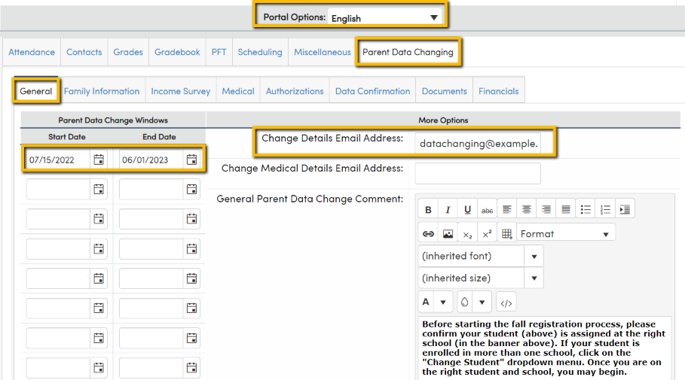
Portal Options > Parent Data Confirmation > General
Determine Dates
Email Required
Ability to Translate
Customize Text
Recommend only gather email from parent/guardian

Slide 8
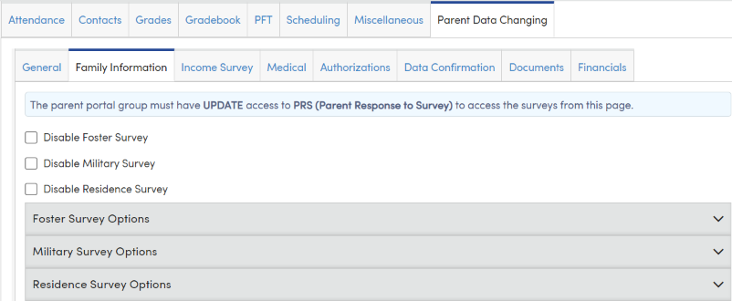
Portal Options > Parent Data Confirmation > Family Information
Foster Survey Options
Military Survey Options
Residence Survey Options

Slide 9
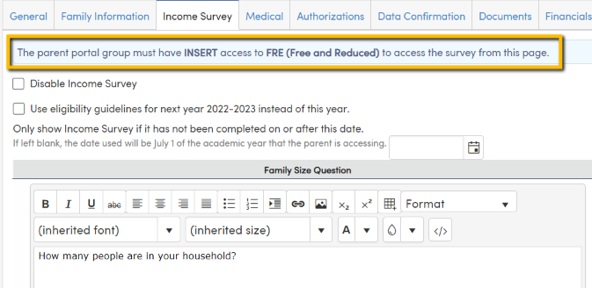
Portal Options > Parent Data Confirmation > Family Information
Permissions – Requires Insert Permission to FRE
Enable/Disable
Use Guidelines for next year
Collects limited financial
data

Slide 10
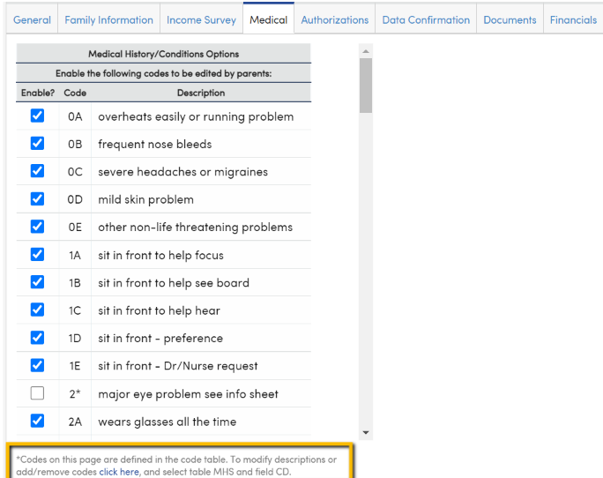
Portal Options > Parent Data Confirmation >
Medical
Options defined in Code Table
Choose what parent views

Slide 11
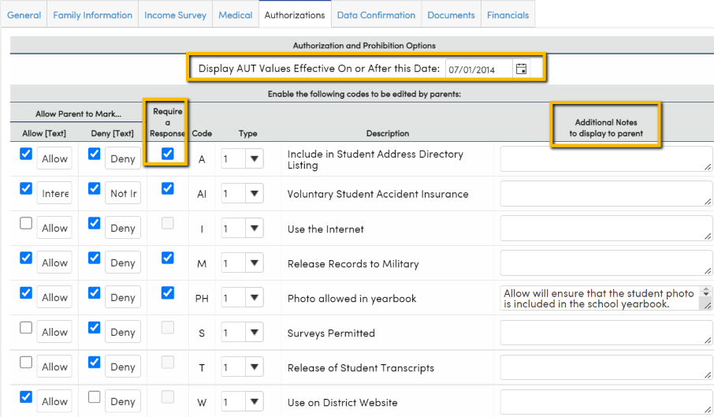
Portal Options > Parent Data Confirmation >
Authorizations
Choose date
Allow/Deny
Require a Response
Additional notes to parents

Slide 12
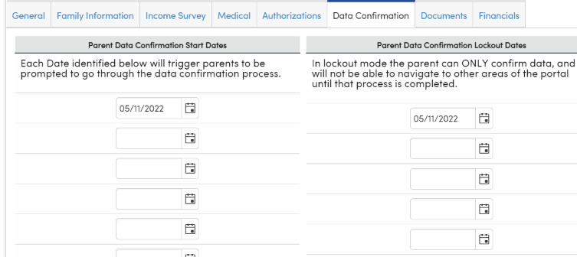
Portal Options > Parent Data Confirmation >
Authorizations
Start Date-
When banner triggered
Ability for multiple dates
Lockout Mode

Slide 13
Thanks for joining us!
Where to Go
Parent Data Confirmation Setup
Aeries Demo Data
Aeries Academy
Parent Data Confirmation Videos
Parent/Data Confirmation and New School Year Registration

Slide 14
Please take a moment
to complete the survey
https://survey.alchemer.com/s3/6899809/Good-Morning-Aeries-Survey

Slide 15
Watch for more upcoming webinars!
Parent Data Confirmation – Part 2 – Parent View
Thursday, May 4 @ 9 am PST (11:00 am CST)
Parent Data Confirmation – Part 3 – Process for Office Staff
Tuesday, May 9 @ 9 am PST (11:00 am CST)
Parent Data Confirmation – Part 4 – Portal Documents
Thursday, May 11 @ 9 am PST (11:00 am CST)
Did you know?
Monday, May 15 @ 9 am PST (11:00 am CST)

