Slide 1
Good morning, Aeries!
Transcript Processes

Slide 2
Speaking today:
LEENI MITCHELL| TRAINER
LEENI@AERIES.COM
MODERATOR | Sandy Madrid

Slide 3
Transcript Processes
Printing Transcripts for Students
Printing Transcripts to Colleges
Copying Grades to HIS and Recomputing GPA’s
Mass Update Graduation Status

Slide 4
NEED TO KNOW
How to Print for one Student How to print for multiple students How to print to colleges How to copy records to HIS How to recompute GPA’s End of Year Mass Update Graduation Status
Transcript Processes

Slide 5
NICE TO KNOW
How to set up for parent/student printing College Requests Page Tables that affect Transcripts Courses (CRS) Course History Institutions (CHI) Valid Marks District & School Options Transcript Definition Page College Table
Transcript Processes

Slide 6
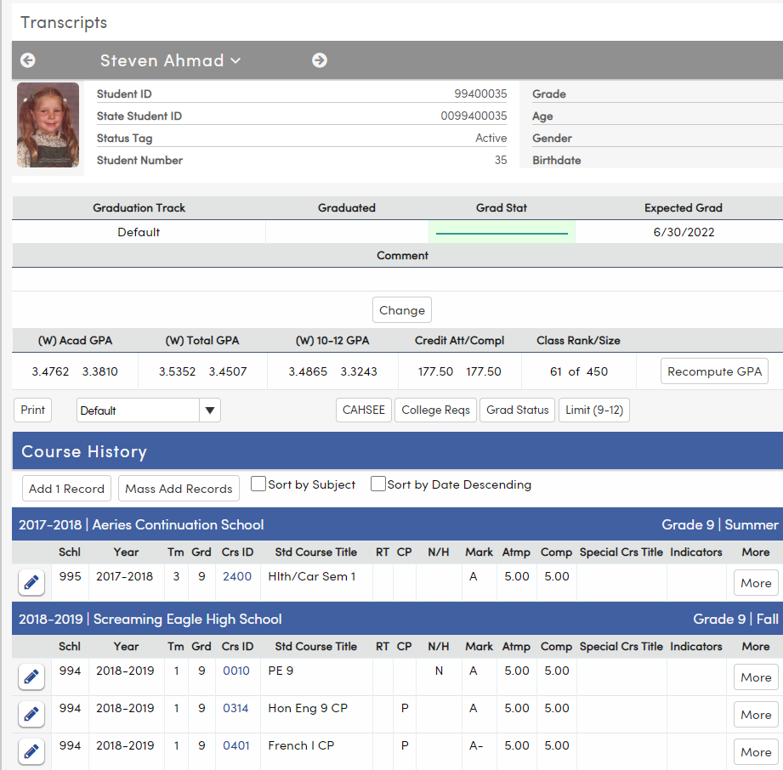
Printing a Transcript for one student
Access the student’s transcript page
Locate the Transcript Definition Selection Dropdown
Choose the desired Definition
Click the Print button

Slide 7
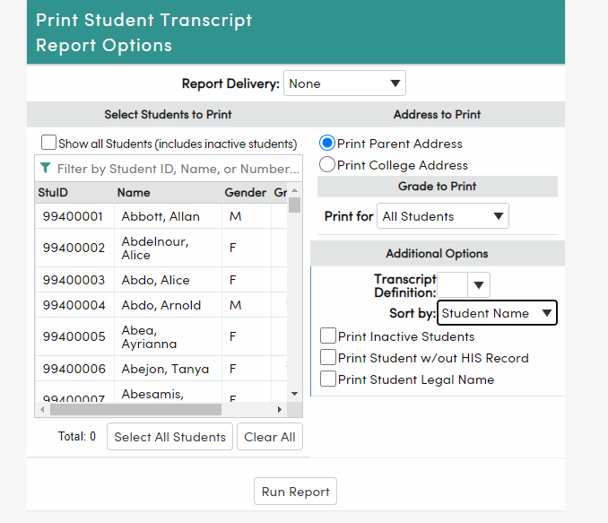
Intro to Transcripts
Printing Transcripts for Many Students
Use Student Transcript Report
Select one student or many
Can address to Parent or College
Can select whole grade levels
Ability to sort by name, counselor, teacher
Can choose a period and date
Can limit to a specific section

Slide 8
Printing a Transcript for many students
Access the Student Transcript Report page
Select Students from the List
Ability to filter
May Select groups of students from the Grade to Print Dropdown
Select the desired Transcript Definition from the Dropdown
Select other options if needed
Select Run Report

Slide 9
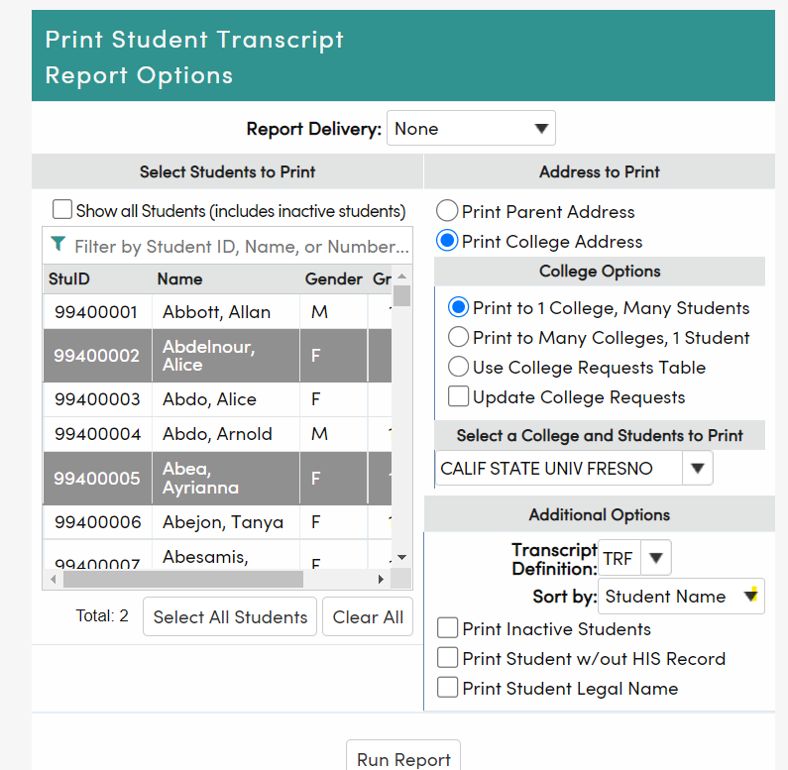
Printing Transcripts to Colleges
Access the Student Transcript Report page
Select Students from the List
Ability to filter
Select Print College Address
Select College Options
Select the college(s)
Select the desired Transcript Definition from the Dropdown
Select other options if needed
Select Run Report

Slide 10
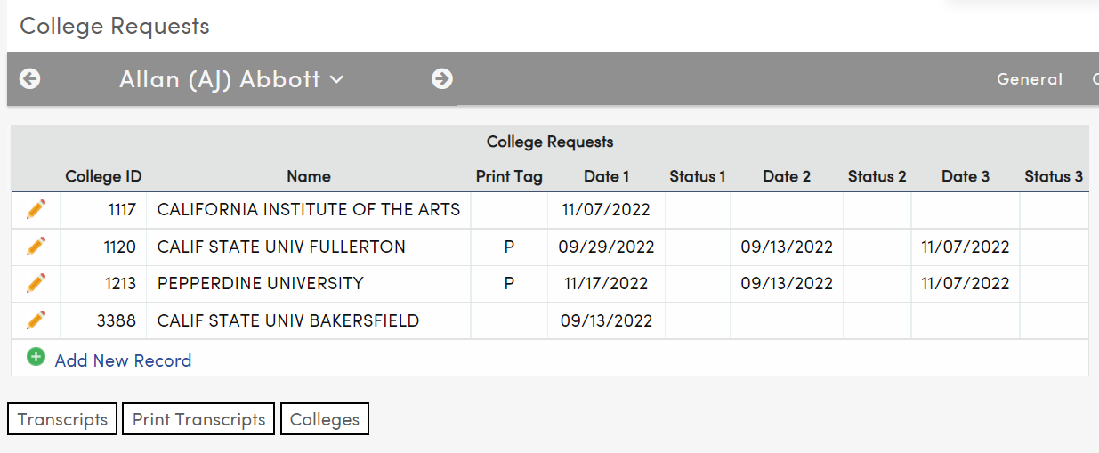
College Requests Page
The College Requests page shows the log of Student Transcripts printed to Colleges or set up to be sent to Colleges. The information is stored in the CRT Table.

Slide 11
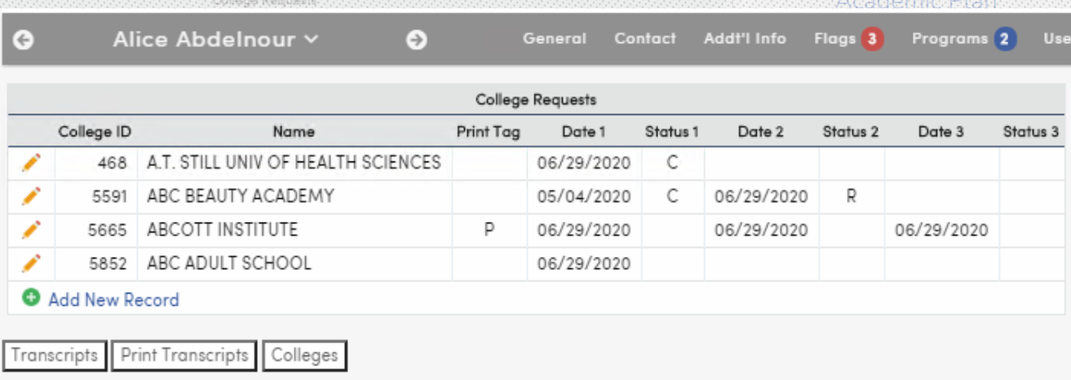
Using the College Requests Page
When printing to colleges from the Print Student Transcripts Report and Update College Requests is selected, records will be added to the CRT table with the date the transcript was printed. Colleges must have an entry in the COL table (Colleges) to use this feature.
To set up records in CRT for future printing, enter the appropriate college(s) in the student’s CRT record and add a Print Tag of P or X. Then access the Print Students Transcripts page, select Print to Colleges and select the Use College Requests Table Checkbox.
Status tags - C = College Requested R = Revised/Resent S = Student Requested

Slide 12
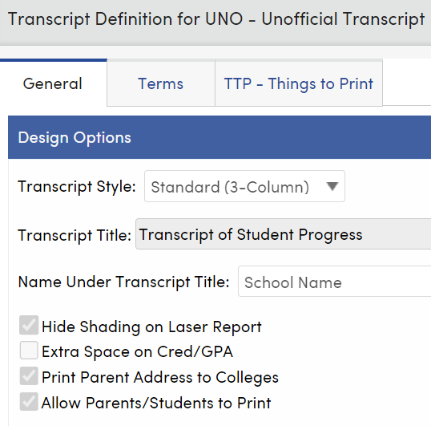
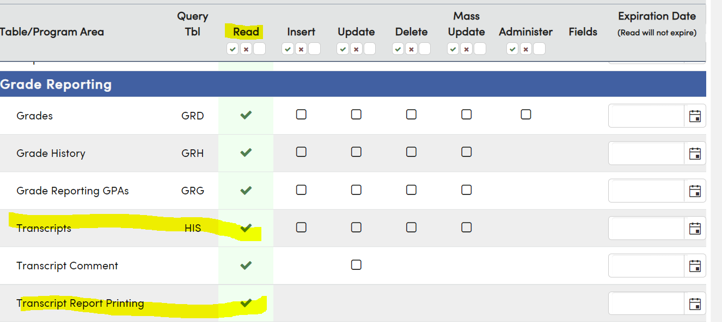
Intro to Transcripts
Parent/Student Ability to Print
TDF – In the appropriate transcript definition setup, check the box to allow parents/students to print.
Suggestion: Place an Unofficial watermark on that definition in the Images tab.
Security for Parent and/or Student Portal Groups
Need Read Access to Transcripts
Checkbox for Transcript Printing

Slide 13
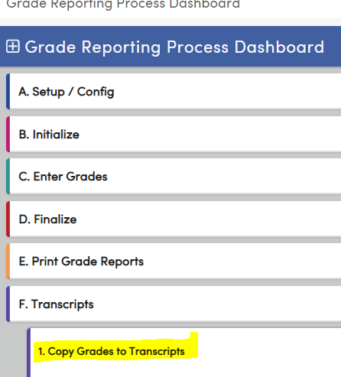
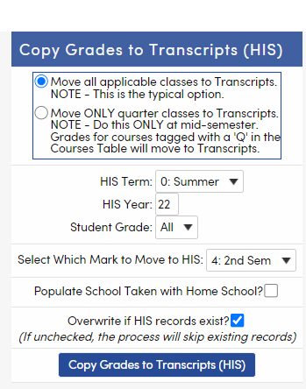
Copy Grades to Transcripts (HIS)
Process
At the end of the appropriate grading period, verify all grade changes have been entered in GRD
Access the Grade Reporting Dashboard – F - Transcripts –Copy Grades to Transcripts
Select the appropriate option for copying all classes or just quarter classes
Select the term and year to be used in HIS
Select the student grade level to update – generally ALL
Select the marking period to be copied
Option to populate School Taken with Home School
Overwrite if HIS records exist checkbox
Select the Copy Grades to Transcripts button

Slide 14
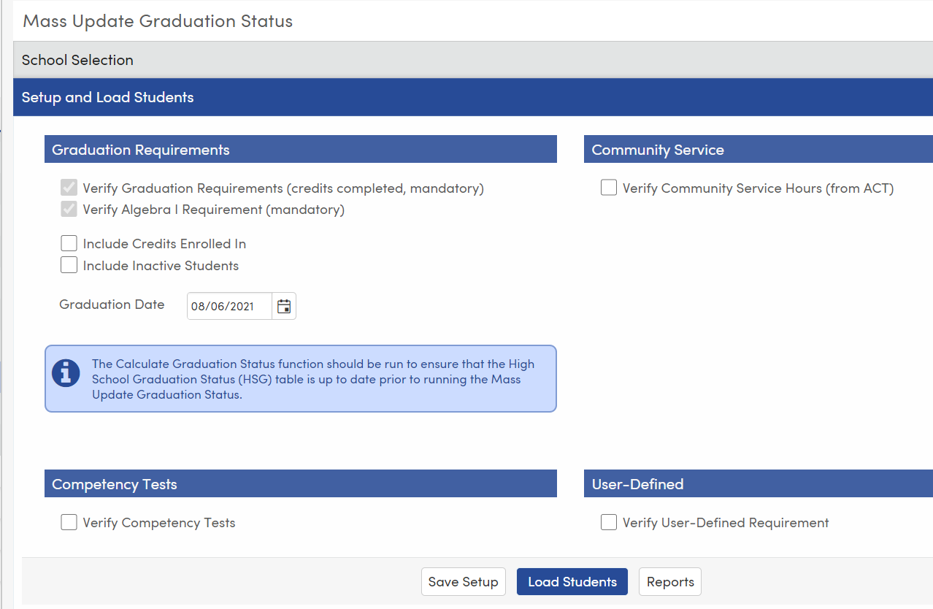
Mass Update Graduation Status
Designed to update students’ graduation status at the end of the year for CALPADS reporting
Can be a tool prior to that to track student progress on multiple requirements
Will track on 4 areas
Graduation Requirements
Will verify Algebra 1
Can includes credits enrolled
Can include inactive students
Community Service
Can verify community service hours from ACT
Competency Tests
User Defined Requirement
Process
Set up the form
Load the students
Preview the summary
Preview the students
Reports
=

Slide 15
Mass Update Graduation Status - part 2
End of Year reporting to CALPADS
Can be run at District or School Level
Will honor Skip or Keep to update for selected students
Verify selected options are appropriate
Options saved at the District Level will be saved for all schools selected
When running at the school level, process will only run for the school where user is logged in
Make certain graduation date is populated
If Community Service hours are required, select the appropriate ACT codes and make certain hours needed is populated
If competency tests are required, verify definitions
If User Defined Requirement is needed, select the appropriate options
Example: Career Pathways completer requirement – CPW.CM = 1
Save the Setup
Load Students
Review Summary
Review the Students and make needed individual changes
Select the appropriate graduation code for each group of students
Print Verification Report
Update STU and ENR
=

Slide 16
Thanks for joining us!
Where to Go
Transcript Documentation
Aeries Demo Data
Aeries Academy

Slide 17
Please take a moment
to complete the survey
Good Morning Aeries Survey

Slide 18
Watch for more workshops and webinars!
Graduation/College Readiness Dashboard- Thursday, April 27
Aeries Upcoming Workshops and Webinars

Slide 19
Watch for more workshops and webinars!

