Slide 1
Good morning, Aeries!
Elementary Primary Class Scheduling

Slide 2
Speaking today:
SUSAN PROW| Implementation Coordinator
susan@aeries.com
TERRY SCOTT| Aeries Trainer
terrys@aeries.com
LEENI MITCHELL| Aeries Trainer
leeni@aeries.com

Slide 3
Elementary Primary
Class Scheduling
Using a Master Schedule to Support
Elementary and Middle School Class Assignments

Slide 4
Why use a
Master Schedule for elementary students?
Flexible start times to support elementary practices
Student schedules account for student campus location – including pullout for curriculum and services
Staff in Sections allows many options for additional staff access
A master schedule supports Grade Reporting and Standards Based Grade Reporting
Allows for CALPADS reporting of curriculum, student services, and teacher credentialing for itinerant teachers
Allows for simplified rostering of students with products that utilize One Roster and/or API integration
Benefits
CALPADS
Student Tracking/Safety
Flexibility

Slide 5
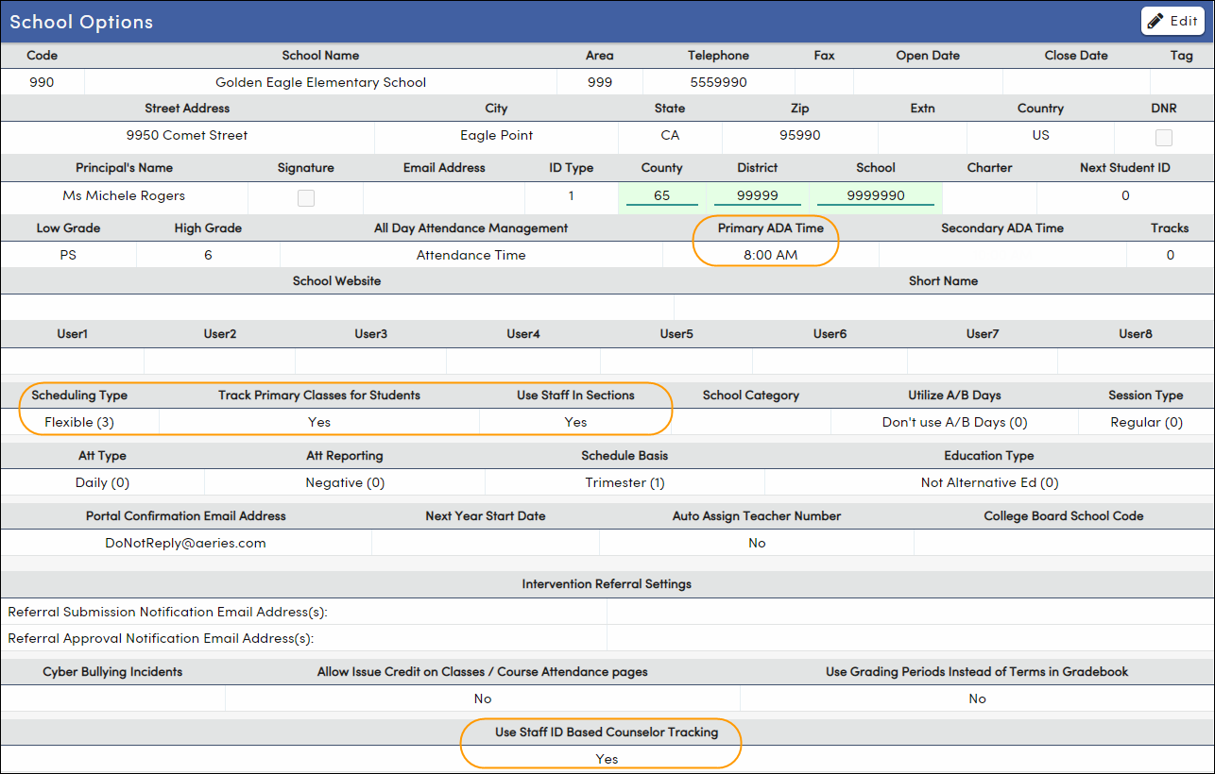
Daily Attendance
School Options
Primary ADA Time
Scheduling Type
Track Primary Classes
Use Staff in Sections
Use Staff ID Based Counselor Tracking

Slide 6
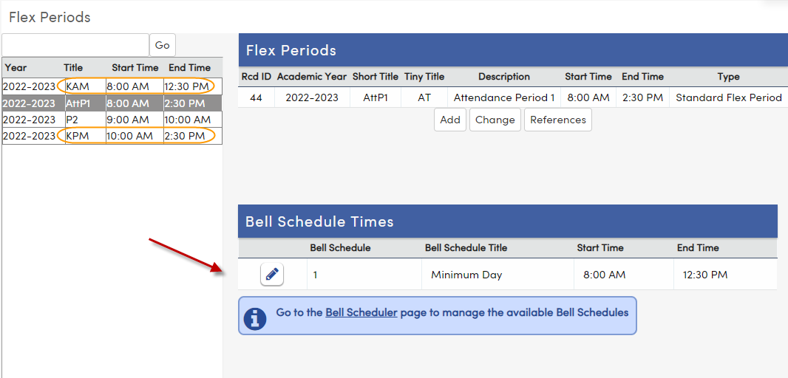
Master Schedule
Flex Periods
Allows for grade level start times
Supports Bell Schedules
Supports AM/PM Kindergarten
Identifies Class rotation times
Identifies student pullout services/curriculum times

Slide 7
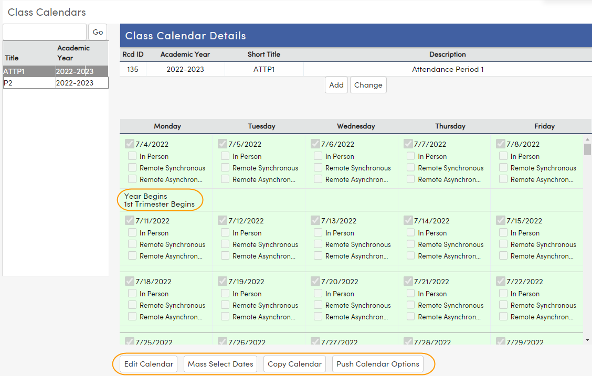
Master Schedule
Class Calendars
Allows for variables in class meeting days
Allows for Block or A/B scheduling
Accommodates school functions: Minimum Days, Assembly Days, Conference Week

Slide 8
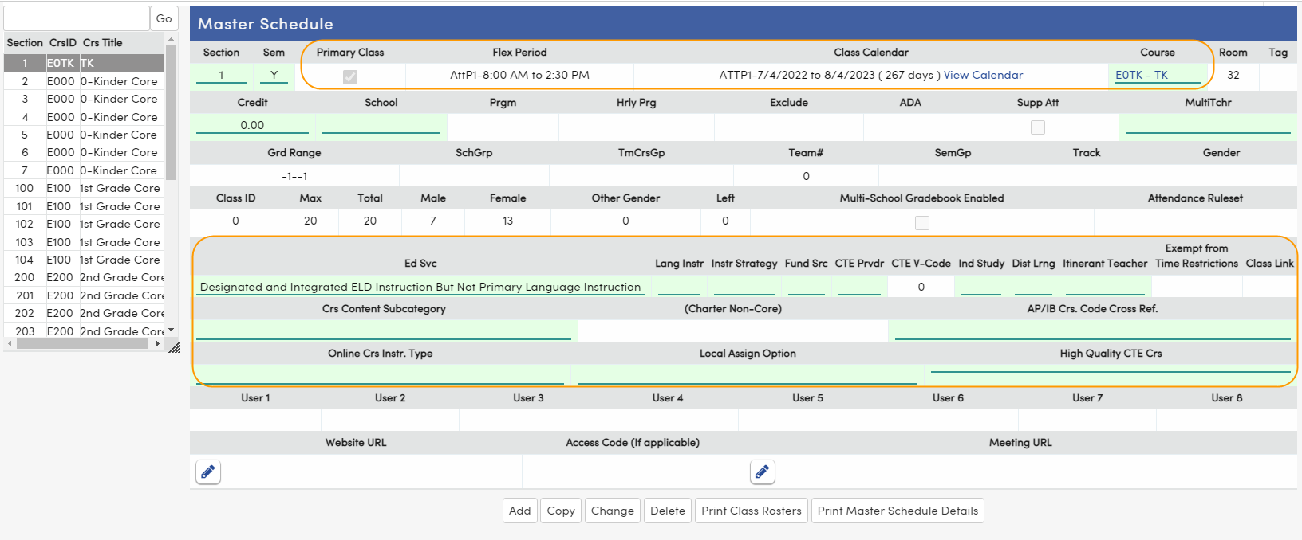
Master Schedule
Sections
Indicates designated time/period
Indicates assigned class calendar
Indicates course/curriculum
Displays fields previously located on the Teacher (TCH)
Grade level
Room #
Class Totals
State Reportable Fields

Slide 9
Master Schedule
Staff Section Members
Each section has ONE primary teacher
Additional staff can be added
Determines additional staff access/permissions
Determines state reporting of staff

Slide 10
Master Schedule
Students
Displays students in the class
Has mass change features
STU ID is hyperlink to Classes page - student schedules
An ↓ Denotes Primary Class – attendance period
Today column indicates current student location
STU Num is hyperlink to Demographics page

Slide 11
Student Schedules
Classes Page
Classes
Displays class information
Manages class changes/updates
Updates Attendance Enrollment
Course attendance is populated from the Classes page
Classes Page – Edit Mode
Course Attendance Page
Attendance Enrollment

Slide 12
Did we mention School Safety?
Did we mention SCHOOL SAFETY?
WHERE ARE YOU NOW?
Student location is
known throughout
the school day
Student location
is known
throughout
the school day!

Slide 13
Thanks for joining us!
Info and links
Quick Start Guide to Classes Page for a quick overview of the classes page
AeriesCon Registration Hope to see you there!
What is Flex Scheduling?
Elementary Primary Class Scheduling for access to scheduling documentation
Classes Page Video

