Slide 1







Good morning, Aeries!
Advanced Query

Slide 2

Speaking today:
Kim Hayes| Aeries Trainer
MODERATOR | Deb McConnell

Slide 3
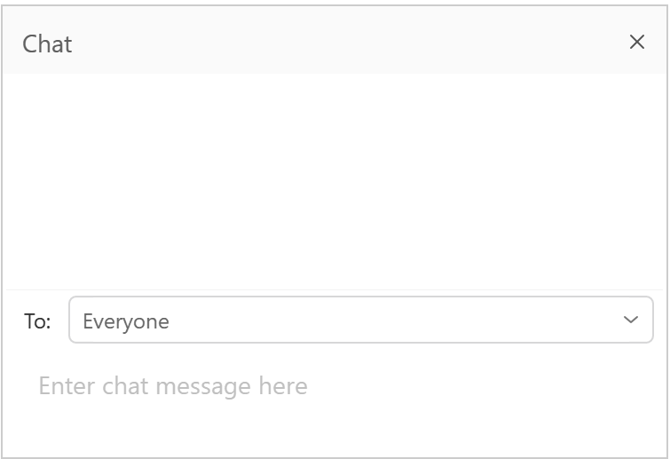

Zoom Tips
Mute Your Audio
Chat Questions to the Moderator
PHOTO CAPTION
Aeries SIS
Webinar

Slide 4

WHAT IS THE ADL KIT?
Advanced Query in Aeries
The Advanced Queries session will cover building complex query statements using multiple tables and fields. Also covered will be the use of the Database Table Information Report.

Slide 5
NEED TO KNOW
Advanced understanding of Aeries Tables Relations Defining Multiple Tables and Fields in a Query Use of the Database Table Information Report Building complex Query Statements Selecting Records by Criteria “IF” Using Connectives “AND” and “OR”
Advanced Query

Slide 6
NICE TO KNOW
When creating a comparison or (if) statement in a query you can string them together using and/or. The comparison symbols allow for multiple ways to determine what data you want on the report.
Advanced Query

Slide 7


Query Screen
Logging into Aeries Web
Statement Box
Tip Message
Functions
Query Commands
Tables
Fields
Special Characters
SORT Option
Filter
IF Comparison
Math
NAME OF THE PRESENTATION

Slide 8
We Will Be Covering
Query with Multiple Tables
What is a Field
1
What is a Record
2
4
And how does all this work together to create a query
What is a Table
3

Slide 9
Query Using Multiple Tables
What is a Field?
A Field is a single piece of information.

Slide 10
Query Using Multiple Tables
What is a Record?
A record is fields of the same kind of data grouped together and associated with the same entity.

Slide 11
Query Using Multiple Tables
What is a Table?
A table is a file that stores related data entered into the database.

Slide 12
Query Using Multiple Tables
Tables are Related
To link tables together, each table as a field that is the same in both.

Slide 13
How is the Data Configured
  Pieces of data are fields
  Fields are grouped into records
FIELDS
RECORDS
RELATION
TABLES
  Tables are linked by fields
  Records are grouped into tables

Slide 14
Query Using Multiple Tables
RECAP
STEP 1
STEP 2
STEP 3
STEP 4
What fields do you want
FIELDS
Tables are related in what order
RELATED
The fields are on what TABLES
Create your
QUERY

Slide 15
WHAT TABLES?
In creating a query with multiple tables you must list each table you will be gathering information from.
Creating a Query
What Tables, Fields, and Records do you need for your query.

Slide 16


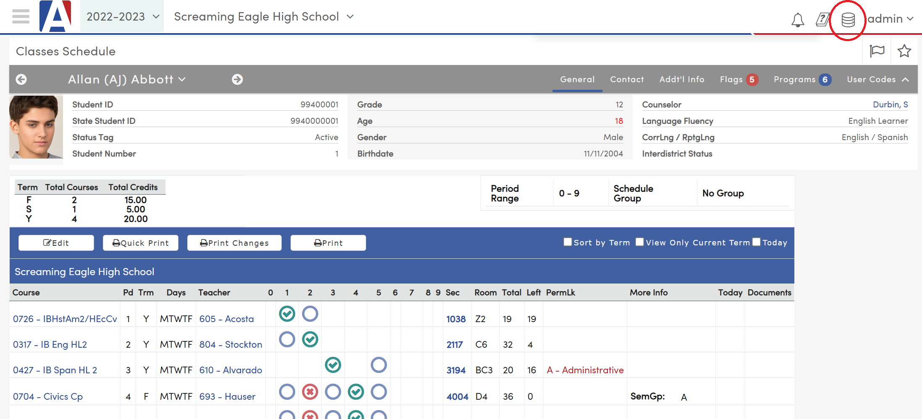
Creating a Query
A list of students with class period, course name, and teacher's name
What Tables Do I Need?
Look at the data
  Form Link
  DB Report
  Table List

Slide 17
Query Using Multiple Tables
LINKING TABLES
SN
SE
CN
STU
SEC
MST
CRS
TN
TCH

Slide 18

Multiple Table Query
LIST STU SEC MST CRS TCH STU.NM MST.PD CRS.CO TCH.TE
NAME OF THE PRESENTATION

Slide 19
Query Options
Multiple table queries
  Proper sequencing of tables
Multiple conditions
NULL (date fields) vs. “ “ (text fields)
Special Characters - ?
NAME OF THE PRESENTATION

Slide 20
District Query
I want a list from the district of students without a language fluency missing
LIST STU IDN LOC STU.SC LOC.NM STU.NM STU.LF IF STU.LF = " "
I want a district list of student that English learners without a US entry date.
LIST STU IDN LOC LAC STU.SC LOC.NM STU.NM STU.LF? LAC.USS IF STU.LF = "L" AND LAC.USS = NULL
NAME OF THE PRESENTATION

Slide 21
Query
MST: List of Students with Section Number and Teacher Name of the 1st Period Class by Teacher Name
List of students with Section Number and Teacher Name of 1st period class sorted by Teacher name
LIST STU SEC MST TCH STU.LN STU.FN STU.GR MST.SE TCH.TE BY TCH.TE IF MST.PD = 1
LIST STU SEC MST SSE STF STU.LN STU.FN STU.GR MST.SE STF.LN STF.FN BY STF.LN STF.FN IF MST.FSQ = 18 AND SSE.PR = 1
NAME OF THE PRESENTATION

Slide 22
Query
GRD: List of D, F, or I Grades for Specific Courses and Marking Period
List of students with a D, F, or I grades for selected Courses from a specific Marking Period in the Grading Table
LIST STU GRD STU.ID STU.NM STU.GR GRD.PD GRD.CN GRD.TN GRD.M1 BY GRD.CN IF ( GRD.CN = 0607 OR GRD.CN = 0645 OR GRD.CN = 0639 OR GRD.CN = 0646 ) AND ( GRD.M1 : D OR GRD.M1 : F OR GRD.M1 : I )
NAME OF THE PRESENTATION

Slide 23


Thanks for joining us!
Where to Go
Support Documentation
Sample Query/queries data bank.
Aeries Table Relations

Slide 24
We value your feedback!
Please take a few minutes to complete our survey and let us know how we can better serve you in the future! Have a great rest of your day.
Good-Morning-Aeries-Survey

Slide 25
Sign up for more upcoming webinars!
Scheduling Workshop
Elementary with Master Scheduling
Intervention Management
Creating Pre-Enrolled Students
Contact Management

