Slide 1
Speaking today:
PRESENTER | Sandy Madrid
Aeries Trainer
PRESENTER | Lindi Dreibelbis
Deb McConnell
Aeries Trainers

Slide 2
Q&A Fall 2 – CALPADS in Aeries
Where do we go with our questions and find our answers?

Slide 3
Need to Know
Taking a logical look at your scenarios – Ask – In this, scenario, what data fields are needed to report what is occurring with this Staff, Staff Assignment and Course. (SDEM, SASS and CRSE)
Students taking these courses with these teachers, if enrolled for reporting in a section – Ask – Do these rosters of students have any other reporting need?
If A-G course did that get defined at the course level?
If SPED did I indicate the Instructional Strategy?
If EL did I indicate the correct Education Service and if needed, the Language of Instruction if ed.service is for primary language support?
If Independent Study,
If Online
If CTE…?
Each LEA represents unique scenarios BUT the data fields that we are required to report remain the same for all. The data entered into those fields will submit the status of your LEA for Staff, Courses and Students enrolled in those courses. Itinerant Staff and Non-classroom Based Staff.
Understand in Aeries where these data fields are and how are they Mapped to the CALPADS fields for compliance.
During the Fall 2 Submission where do we go when the various scenarios in our own LEA produce questions of Compliance or Correction of Errors
Taking a logical look at your scenarios – Ask – In this, scenario, what data fields are needed to report correctly.
Errors, what data fields are producing these errors and what did I enter?

Slide 4
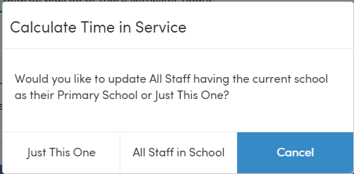
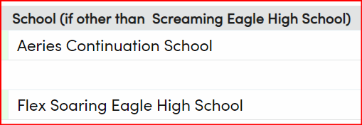
Questions: Can this be run the automation more then once? No, once the staff years has been incremented you can only do update every 9 months
Can I manually change the Years of Service if I made a mistake? Yes, you can manually change data field
Need to Know
SDEM
Some Key areas for questions
Calculate Time in Service
Increase by 1 for single or all staff members
Primary School and School assignments
Many more questions to ask, but this is a start
Your counts are not correct on the CALPADS reports for your Staff Members… Did you check the Primary School AND School assignments

Slide 5
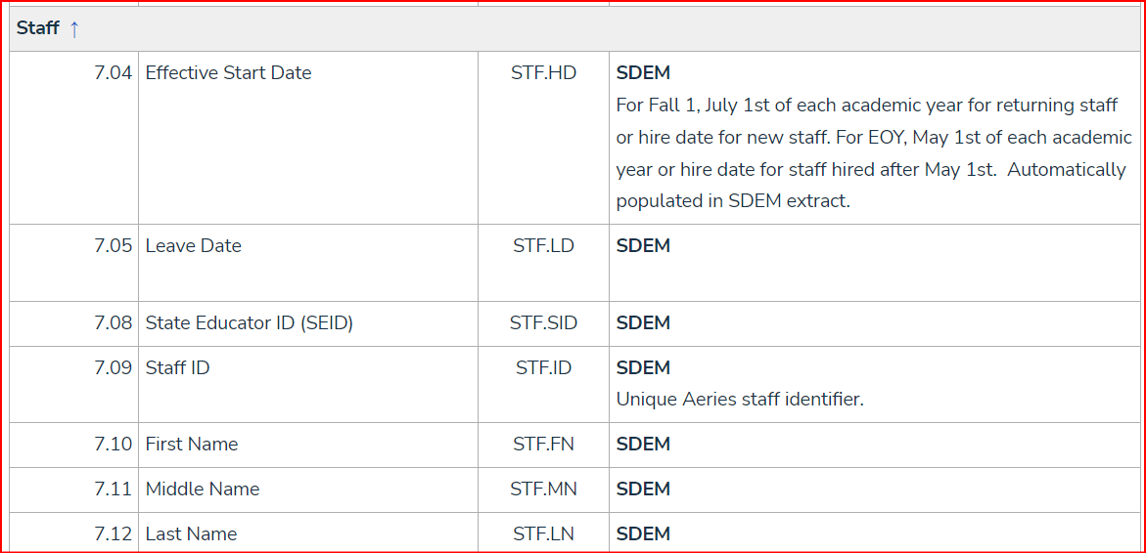
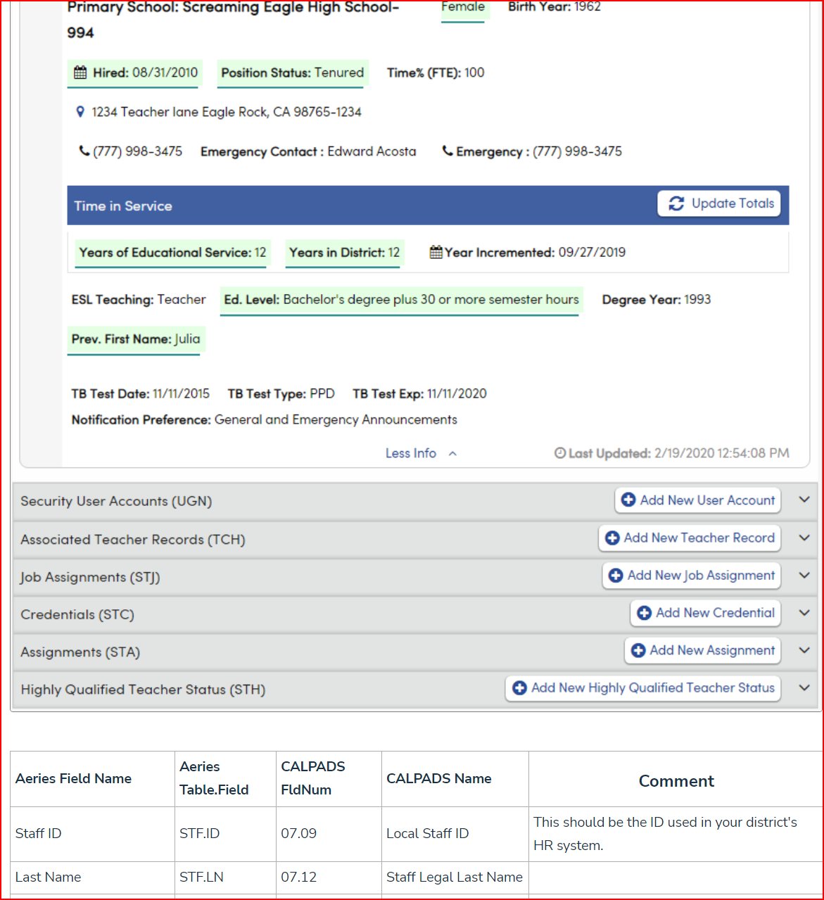
Need to Know
CALPADS in Aeries Basics - Field Mapping
https://support.aeries.com/support/solutions/folders/14000116298
Aeries Field Mapping
By Page
Will show fields mapped from a table view
By Extract
Will show the mapping based upon the Extract File for all reporting.
By Aeries page
Will contain the same table mapping, but include a snapshot of the page
Taking a logical look at your scenarios – Ask – In this, scenario, what data fields are needed to report correctly.
Errors, what data fields are producing these errors and what did I enter?

Slide 6
Need to Know
Fall 2 FAQs
Modified on: Wed, Sep 14, 2022 at 12:34 PM (always check the age of the articles)
Can classified employees be included in the staff table (STF)? Should the staff table contain certificated employees only?
How is the local mapping to the CALPADS Course Group State Codes managed for a district's courses?
How is a course section or class reported that has more than one instructional strategy?
How should a student be reported if on a short term independent study contract during CBEDS Information Day?
Where does a district designate that a course is a Special Education self contained class?
Does a district need to identify the content with the appropriate State Course Code on a credit recovery course for Fall 2 reporting?
How should a Teacher be reported if the Teacher was on leave on Information Day? May the School Site Administrator be reported with the assignment and course enrollment?
How should inactive Staff records be handled?
What does an LEA do if a teacher is on a local assignment option but that local assignment option is not available in the CALPADS Local Assignment Option code set?
Aeries FALL 2 Q&A page
When on that page here you will find some questions previously addressed.
Link:
https://support.aeries.com/support/solutions/articles/14000126225-fall-2-faqs
Taking a logical look at your scenarios – Ask – In this, scenario, what data fields are needed to report correctly.
Errors, what data fields are producing these errors and what did I enter?

Slide 7
All article categories CALPADS
This folder contains 87 articles
CALPADS Common Errors
CERT005 - Student Course Section for SSID Not Enrolled on Census Day
This error occurs because an error-free SENR file containing enrollment data for all students has not been posted. Do not address ANY CERT errors until ...
Thu, Nov 29, 2018 at 11:25 AM
CERT041 - All Intra-LEA CCEs Must Be Resolved Before Certifying
This error, most likely, occurs because enrollment updates (SENR, SINF, SELA and SPRG) did not fully post error-free or the student has duplicate enrollment...
Thu, Nov 29, 2018 at 11:26 AM
CERT047 - Teaching Staff Assignment Missing
This error occurs because a teacher's Staff record is missing a Job Assignment (STJ) record. If the teacher teaches at multiple sites, there may be a ...
Thu, Nov 29, 2018 at 11:23 AM
CERT048 - Missing Non-Classroom Based Assignment or Course Section Record
This error occurs when no course section is reported for a teacher. Do not address ANY CERT errors until after the Fall 2 submission (SDEM
Need to Know
Common Errors
Listed are previously post errors and suggested resolutions
*Errors may be no longer valid or new errors not listed but many are still addressed
Link:
https://support.aeries.com/support/solutions/folders/14000111479
Taking a logical look at your scenarios – Ask – In this, scenario, what data fields are needed to report correctly.
Errors, what data fields are producing these errors and what did I enter?

Slide 8
Fall 2 Queries Print
Modified on: Tue, Nov 8, 2022 at 1:33 PM (check the date last updated)
CALPADS Report Verify with Aeries Reports/Queries
2.4 English Learner Education Services - Student Count Unduplicated
At an elementary school environment, run the following query to verify English Learner Services:
LIST STU TCH STU.ID STU.NM STU.LF TCH.TE TCH.ESR TCH.LI TCH.INS IF STU.LF = 'English Learner code'
At a secondary school environment, run the following query to verify English Learner Services:
LIST STU SEC MST TCH STU.ID STU.NM STU.LF TCH.TE MST.SE MST.ESR MST.LI MST.INS IF STU.LF = 'English Learner code'
Change the code number in the IF statement to the applicable code for EL. Extract to Excel to manipulate the data for totals.
Flex:
LIST STU SEC MST CRS SSE STF STU.ID STU.NM STU.LF STF.LN STF.FN MST.SE MST.ESR MST.LI MST.INS IF STU.LF = 'English Learner code'
2.5 English Learner Education Services - Unduplicated Count of Teachers Providing EL Services At an elementary school environment, run the following total query to verify teacher services:
TOTAL TCH ESR LI INS BY ESR LI INS
At a secondary school environment, run the following total query to verify teacher services:
TOTAL MST ESR LI INS BY ESR LI INS
3.6 Course Section Enrollment - Count by Content Area At an elementary school environment, run the following total query to verify the number of sections offered:
TOTAL TCH CB BY CB
Need to Know
Aeries FALL 2 Queries
To aide with continued analysis of your data, listed are some suggested queries that mimic some of the certification reports that will report our data to CALPADS
Link:
https://support.aeries.com/support/solutions/articles/14000082404-fall-2-queries
Taking a logical look at your scenarios – Ask – In this, scenario, what data fields are needed to report correctly.
Errors, what data fields are producing these errors and what did I enter?

Slide 9
Need to Know
Taking a logical look at your scenarios – Ask – In this, scenario, what data fields are needed to report correctly.
Errors, what data fields are producing these errors and what did I enter?

Slide 10
Thanks for joining us!
Info and links
Aeries Demo Data
Aeries Academy
Good-Morning-Aeries-Survey
Aeries.com/aeriescon

