Slide 1
Good morning, Aeries!
Attendance Process Dashboard

Slide 2
Speaking today:
SUSAN PROW | Implementation Coordinator
susan@aeries.com

Slide 3
Attendance Process
Dashboard
A Navigation Roadmap for Attendance Accounting

Slide 4
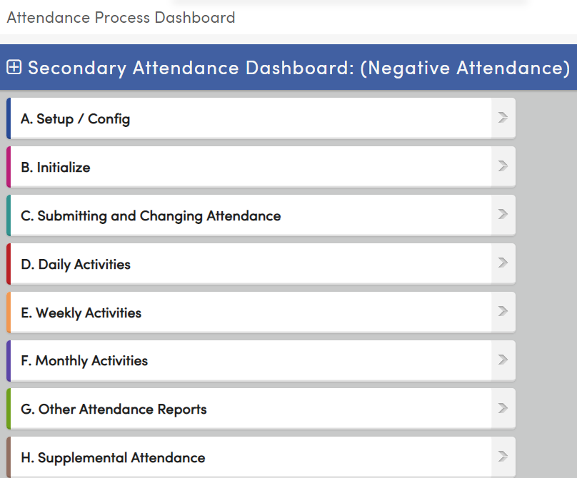
Attendance Process Dashboard
When to use?
At the start of a new school year
For data entry options
Reconciling Attendance
Accessing Reports
Supplemental Attendance

Slide 5
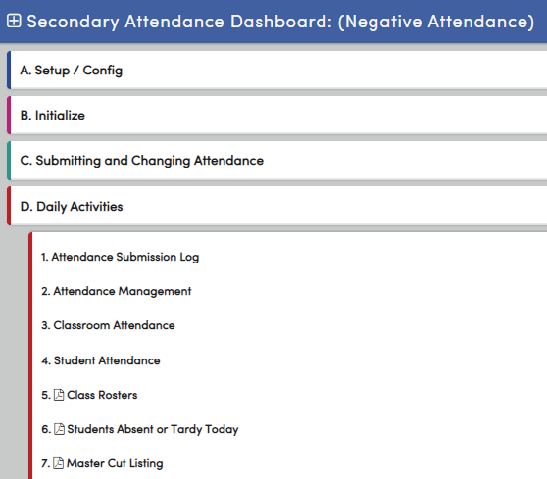
Attendance Process Dashboard
How to use?
Click any category to expand the section
Click to expand all sections
Each item is a link to the page
Each item with a is a link to the report
Not all links may be applicable

Slide 6
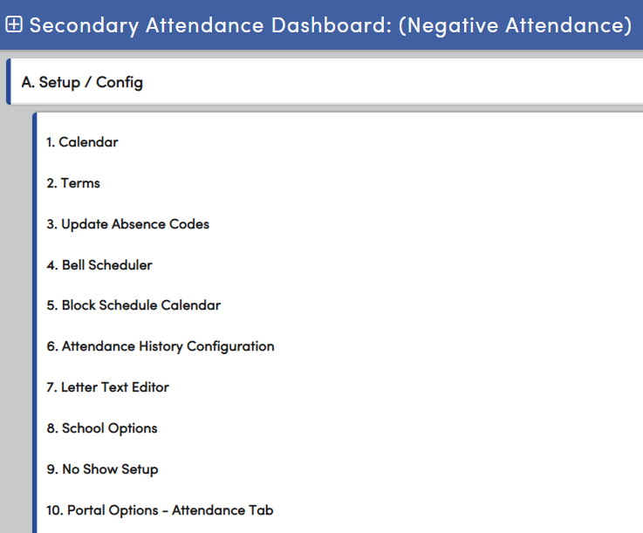
Attendance Process Dashboard
A – Setup/Config
Start of school page links
Some pages may be managed by district
Page Access is based on permissions
Typically, not accessed often

Slide 7
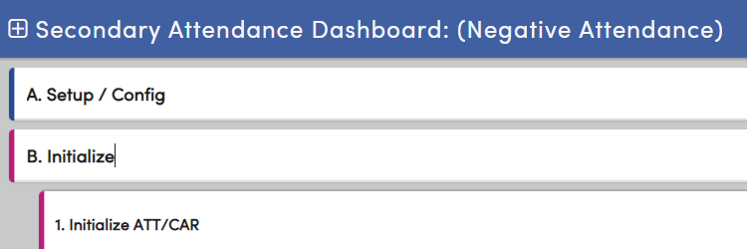
Attendance Process Dashboard
B – Initialize
Occurs only ONCE a year
Should be done as close to the first day of school as possible
Initializes attendance by creating an Attendance Enrollment record for every student (ATT)
Creates a Course Attendance record for every student for teacher attendance submission (CAR)

Slide 8
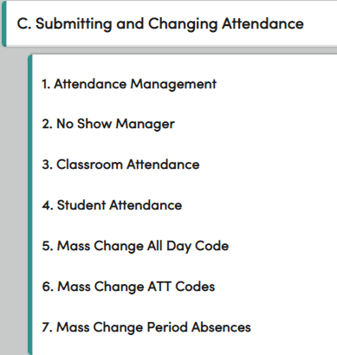
Attendance Process Dashboard
C – Submitting and Changing Attendance
Attendance Management – one stop for most attendance entry, including Mass Change functionality
Classroom Attendance – submit attendance for teachers/substitutes
Student Attendance – calendar view of attendance for students
Mass Change functionality:
Mass Change All Day Code
Mass Change ATT Codes
Mass Change Period Absences

Slide 9
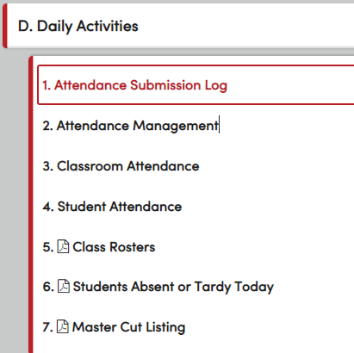
Attendance Process Dashboard
D – Daily Activities
Attendance Submission Log – ensure submission of attendance by all teachers
Classroom Attendance – submitting attendance for a teacher/substitute
Student Attendance – calendar view of attendance and attendance input
Related Reports:
Class Rosters
Students Absent or Tardy Today
Master Cut Listing

Slide 10
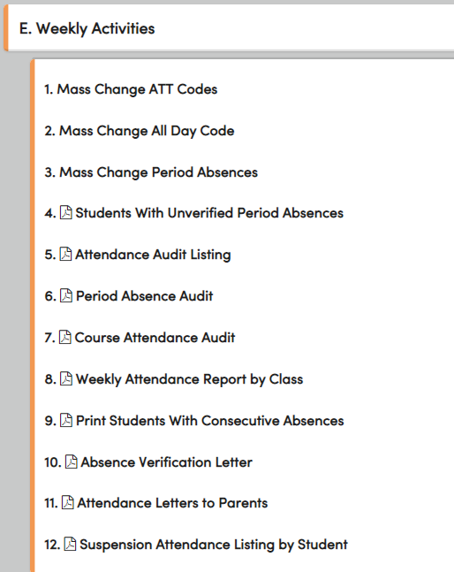
Attendance Process Dashboard
E – Weekly Activities
Monitor attendance using Mass Change functionality:
Mass Change ATT Codes (also located on Attendance Management page)
Mass Change All Day Code
Mass Change Period Absences
Related Reports:
Students with Unverified Period Absences
Attendance Audit Listing
Period Attendance Audit
Course Attendance Audit
Weekly Attendance Report by Class

Slide 11
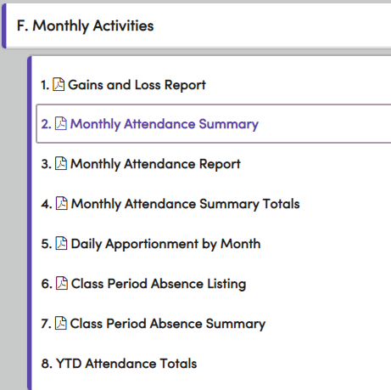
Attendance Process Dashboard
F – Monthly Activities
Reports for reconciling monthly attendance:
Gains and Loss Report
Monthly Attendance Summary
Monthly Attendance Report – details of summary
Related Reports:
Monthly Attendance Summary Totals
Daily Apportionment by Month
Class Period Absence Listing
Class Period Absence Summary
YTD Attendance Totals – summary by grade and program

Slide 12
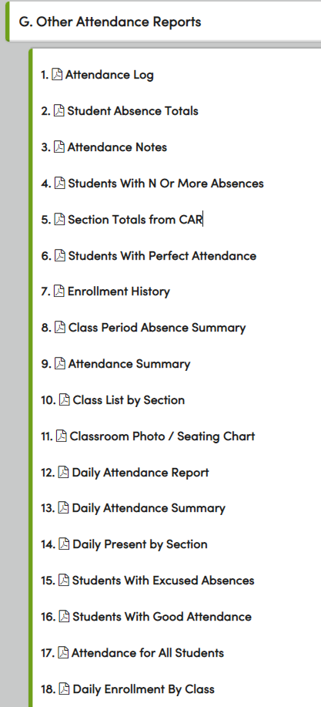
Attendance Process Dashboard
G – Other Attendance Reports
Comprehensive Listing of addition reports to support schools, for example:
Attendance Log – audit tool for reconciliation
Student Absence Totals – code selection option
Attendance Notes – supports verification student attendance
Classroom Photo/Seating Chart
Students with Good Attendance
Attendance for All Students – prints Attendance page for all students and can be placed in CUM at end of year

Slide 13
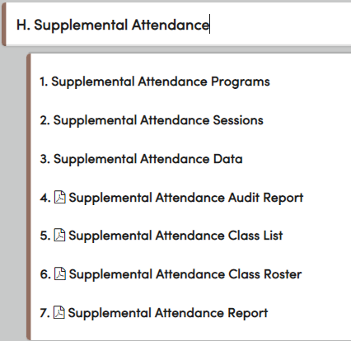
Attendance Process Dashboard
H – Supplemental Attendance
Supplemental Programs pages
Supplemental Attendance Programs
Supplemental Attendance Session
Supplemental Attendance Data
Related Reports
Supplemental Attendance Audit Report
Supplemental Attendance Class List
Supplemental Attendance Class Roster
Supplemental Attendance Report – shows attendance totals (participation), including an ASES report option

Slide 14
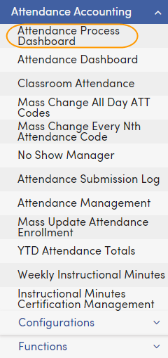
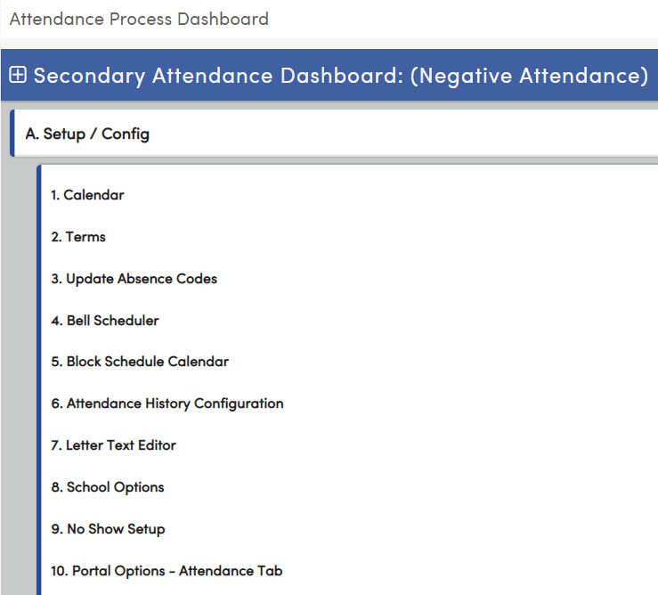
Attendance Process Dashboard A - H
Why use:
Ensures consistent procedures and protocol – key to meeting mandated audits
Quick retrieval of reports
Comprehensive resource for annual tasks
Supportive resource for new attendance staff

Slide 15
Thanks for joining us!
Info and links
Attendance Video Library for visual attendance support
Attendance Reports Listing for a complete listing of available attendance reports
AeriesCon Registration Hope to see you there!
Aeries Attendance for access to attendance documentation
Attendance FAQs for questions, charts, and queries

