Slide 1
Good morning, Aeries! Today’s Topic: Class Link
Carole Williams | Trainer
carolew@aeries.com
Theresa Nicolaou | Trainer
theresan@aeries.com

Slide 2
Today’s Presentation
Need to Know, Nice to Know, Where To Go
Starting off with a PowerPoint overview
Continuing in Aeries demo data with an overview of each page where Class Link is used
At the end, go to the Class Links documentation for more information
Please Add Questions and Input to the Chat Box
Type your questions into the Chat Box; address them to “Everyone”
If you’re already using Class Link, please add any “how” and “why” details to the Chat Box

Slide 3
Need to Know
What is a Class Link?
A field in the Scheduling Master Schedule table (SMS) and Master Schedule table (MST): SMS.CL and MST.CL. A unique Class Link value identifies two (or more) sections in the SMS or MST as “linked.”
Why use a Class Link?
If a student is scheduled into a Class Linked section, the student should also schedule into the other sections that are identified (or tagged) with the same Class Link.
How are Class Links added to sections?
The Class Link field is on both the Scheduling Master and the Master Schedule pages.
Where (else) uses Class Links?
Course Requests and the View SMS popup; the Flex SMS Board, the Scheduler, Classes.

Slide 4
Nice to Know
Examples of how Class Link might be used
Fall/Spring pair of Courses
A set of Wheel sections
Any sections that “go together”
Queries and other strategies
How to check your work
Alternatives to using Class Link
Tm/TmCrsGroup; Course Request Section Packets
Details to remember
Class Linked sections in prior terms will not be automatically added
“Prior terms” is relative to the Class Linked section being scheduled

Slide 5
Class Link Examples
Purpose | Term(s) | Example Course(s) | Teachers | Class Link | Notes
Fall/Spring pair of two Courses with different Course IDs | Fall Spring | ALG-F (Algebra I Fall) ALG-S (Algebra I Spring) | Single teacher | Section Number (SMS.SE or MST.SE) for Fall section | Original purpose: an easy way to link two sections for Fall/Spring halves of a course
Sections that “go together” | Any (example is term Year) | Language Arts Social Studies (grade level Core at Middle school) | Single or multiple teachers | Section Number (SMS.SE or MST.SE) for one of the sections; teacher name
Wheel sections | Quarter (1-4) or Trimester (1-3) | WHEELA WHEELV WHEELD WHEELR | Four teachers (one per course) | Section Number for term 1 section
Your example here

Slide 6
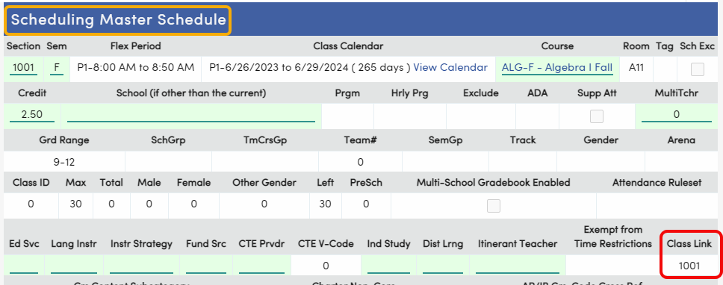
Creating a Class Link
The same Class Link identifies a pair or group of sections
Class Link field is on the Scheduling Master and Master Schedule pages
Sections are tagged; students are not tagged
Class Link field holds up to 6 alphanumeric characters
What should you use?
The section number for the first section in a sequence
A meaningful identifier for the set of sections
Whatever works for you

Slide 7
Add: Class Link to new sections on Scheduling Master or Master Schedule pages
Copy: create first section and Copy to create linked sections
Change: Add Class Link to existing sections on Scheduling Master or Master Schedule pages
Note:
Class Link field is six alphanumeric characters
Class Links can’t be added/changed on SMS Board or Flex SMS Board
Change query could be used
Adding Class Links

Slide 8
On Scheduling Master or Master Schedule page, filter for the section
Press Change to edit the section
Add the Class Link
Save the section
Repeat for rest of the Class Linked sections
Add the same Class Link to Existing Sections on Scheduling Master and Master Schedule to create Class Linked sections

Slide 9
Add Class (create first section in the set)
Add information including Class Link
Insert (save) first section
Copy Class (create second section in the set)
Change anything that needs to change for the second section: Sem, Pd/Flex Period, Class Calendar, Course, Teacher/Section Staff
Insert second section
Repeat as needed
Use Copy on Scheduling Master and Master Schedule to create Class Linked sections

Slide 10
Course Requests Old Edit View
When a Class Linked section is added:
If added using either the Add New Record or Add Many New Records buttons, the linked sections will not be automatically added
If added using the View SMS popup, the linked sections plus corresponding Course Requests will be automatically added (section(s) in prior terms will not be added)
Validations checks will be skipped for linked sections (Grade Range, full classes, etc.)
When the Reschedule button is pressed, it will honor Class Links for existing Course Requests, but it will not add Course Requests
When a Class Linked section is deleted, it will not ask if you want to delete linked sections

Slide 11
Course Requests New Edit View
When a Class Linked section is added:
If added using either the Add New Record or Add Many New Records buttons, the linked sections plus corresponding Course Requests will be added when Save is pressed (section(s) in prior terms will not be added)
If added using the View SMS popup, the linked sections plus corresponding Course Requests will be automatically added when Save is pressed (note that section(s) in prior terms will not be added)
When the Reschedule button is pressed, it will honor Class Links for existing Course Requests, but it will not add Course Requests
When a Class Linked section is deleted and Save is pressed, a popup will ask if the linked sections should also be deleted (only sections in same, overlapping, or future terms)

Slide 12
Course Requests View SMS Popup
Link symbol by the section number identifies sections with Class Links
ClsLink# column contains SMS.CL. ClsLink# = 0 means the section does not have a Class Link.
Add a Class Linked section and the linked sections plus corresponding Course Requests will also be added (sections in prior terms will not be added)
Old Edit View: add a section by clicking on the section number in the Sec# column
New Edit View: add a section by clicking on the green + in the Add column

Slide 13
The Scheduler
Schedule All Students button/page, Reschedule buttons on Course Requests and Classes pages, Schedule Students button on Flex SMS Board/SMS Board, and Scheduling Optimizer
Honors Class Links: if a student is scheduled into a Class Linked section, the linked sections will also be scheduled; note that validations will be skipped (Grade Range, full classes, etc.)
Will not create Course Requests on Course Requests page
Courses will not be added to the grid on Classes page

Slide 14
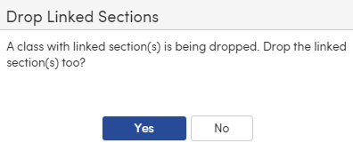
Classes
When a Class Linked section is added to the grid and scheduled:
Linked sections will be added when Save is pressed
When the Reschedule button is pressed, it won’t add linked sections with their Courses to the grid (but linked sections will be added when Save is pressed)
Linked section(s) in prior terms will not be added automatically
When a Class Linked section is deleted/dropped and Save is pressed, a popup will ask if the linked sections should also be deleted (only sections in same, overlapping, or future terms)

Slide 15
Verifying Class Link Data
Scheduling Master Schedule reports and Master Schedule reports do not currently include Class Links
Instead:
Use View SMS and View MST popups
Use Flex SMS Board
Use Query

Slide 16
Flex SMS Board
Link symbol will be displayed by any section with a Class Link
Hover over a Class Linked section and the Class Link plus the section numbers will be displayed:
Click on a Class Linked section:
The Class Link and the section numbers will be displayed
The Class Linked sections will be outlined in gold

Slide 17
Query Examples to Start With at a Flex School:
Show data for SMS sections with Class Links:
LIST SMS FTF SSM STF CRS SMS.SE FTF.STI SMS.SM SMS.CL SMS.CN CRS.CO STF.LN BY STF.LN FTF.STI SMS.CL SMS.SM IF SMS.CL > 0
Show data, including Class Links, for a particular Course (replace XXXX below with all or part of the course title):
LIST SMS FTF SSM STF CRS SMS.SE FTF.STI SMS.SM SMS.CL SMS.CN CRS.CO STF.LN BY STF.LN FTF.STI SMS.CL SMS.SM IF CRS.CN : XXXX
Show data for MST sections with Class Links:
LIST MST FTF SSE STF CRS MST.SE FTF.STI MST.SM MST.CL MST.CN CRS.CO STF.LN BY STF.LN FTF.STI MST.CL MST.SM IF MST.CL > 0
Show data, including Class Links, for a particular Course (replace XXXX below with all or part of the course title):
LIST MST FTF SSE STF CRS MST.SE FTF.STI MST.SM MST.CL MST.CN CRS.CO STF.LN BY STF.LN FTF.STI MST.CL MST.SM IF CRS.CO : XXXX

Slide 18
Query Examples to Start With at a Non-Flex School:
Show data for SMS sections with Class Links:
LIST SMS CRS TCH SMS.SE SMS.PD SMS.SM SMS.CL SMS.CN CRS.CO TCH.TE BY TCH.TE SMS.PD SMS.CL SMS.SM IF SMS.CL > 0
Show data, including Class Links, for a particular Course (replace XXXX below with all of part of the course title):
LIST SMS CRS TCH SMS.SE SMS.PD SMS.SM SMS.CL SMS.CN CRS.CO TCH.TE BY TCH.TE SMS.PD SMS.CL SMS.SM IF CRS.CN : XXXX
Show data for MST sections with Class Links:
LIST MST CRS TCH MST.SE MST.PD MST.SM MST.CL MST.CN CRS.CO TCH.TE BY TCH.TE MST.PD MST.CL MST.SM IF MST.CL > 0
Show data, including Class Links, for a particular Course (replace XXXX below with all of part of the course title):
LIST MST CRS TCH MST.SE MST.PD MST.SM MST.CL MST.CN CRS.CO TCH.TE BY TCH.TE MST.PD MST.CL MST.SM IF CRS.CO : XXXX

Slide 19
Where to Go for More Information on Alternatives to Class Link:
Documentation below is all from the Aeries support website: https://support.aeries.com
Team/Team Course Group: see Complex Schedules – Team / Course Group and Team Number Fields https://support.aeries.com/support/solutions/articles/14000081450-complex-schedules-team-course-group-and-team-number-fields
Course Request Section Packets: see Class Schedule Maintenance: Creating and Modifying Course Request Section Packets https://support.aeries.com/support/solutions/articles/14000137239-class-schedule-maintenance-creating-and-modifying-course-request-section-packets

Slide 20
Where to Go for More Information on Class Link:
Documentation below is all from the Aeries support website: https://support.aeries.com
Class Links: https://support.aeries.com/support/solutions/articles/14000136569-class-links
Student Course Requests: https://support.aeries.com/support/solutions/articles/14000069826
Student Course Requests Page (New): https://support.aeries.com/support/solutions/articles/14000136780-student-course-requests-page-new-
Group Scheduling Examples: Which Strategy to Use? https://support.aeries.com/support/solutions/articles/14000138889-group-scheduling-examples-which-strategy-to-use-
Flex Scheduling – Flex SMS Board: https://support.aeries.com/support/solutions/articles/14000111235-flex-scheduling-flex-sms-board

Slide 21
Where to Go for More Good Morning, Aeries:
Past Good Morning, Aeries! Webinars to watch replays and download PowerPoints: https://support.aeries.com/support/solutions/14000075940
Future Good Morning, Aeries! Webinars to register for and watch live: https://www.aeries.com/events/
Upcoming Scheduling-related GMAs:
Elementary with MST Scheduling: 2/7/2023 9am PST/11am CST
Create Pre-Enrolled Students: 2/9/2023 9am PST/11am CST
Course Requests: 2/21/2023 and 3/23/2023 9am PST/11am CST
Course Request Packets: 2/23/2023 and 3/28/2023 9am PST/11am CST
Flex Queries 4/18/2023 9am PST/11am CST

Slide 22
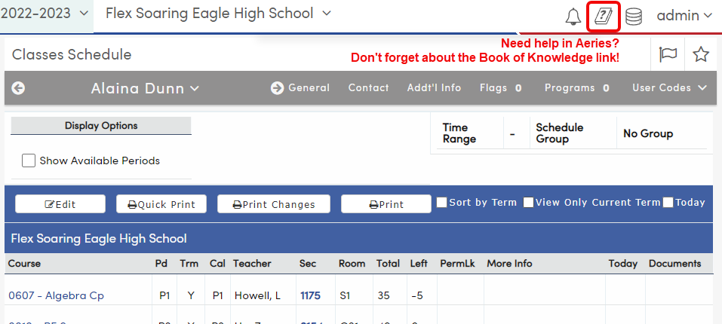
Where to Go: the Book of Knowledge

Slide 23
We value your feedback!
Please take a few minutes to complete our survey and let us know how we can better serve you in the future!
Have a great rest of your day.
Good-Morning-Aeries-Survey

