Slide 1
Good morning, Aeries!
Setting Up (Initializing) the Scheduling Master Schedule (SMS)

Slide 2
Speaking today:
JIM MORRISON | AERIES TRAINER
MODERATOR | COLIN BAXTER

Slide 3
Good morning, Aeries!
Session will last 30 – 45 minutes
Show & Tell
Casual
Time for Q&A
PPT & Recordings Posted

Slide 4
NEED TO KNOW
Function and purpose of Scheduling Master Schedule (SMS) and Master Schedule (MST) What does setting-up (initializing) SMS each year do? Factors to consider before initializing Specific steps to take when initializing, depending on current scheduling setup and plans for next year
Setting Up SMS

Slide 5
NICE TO KNOW
If moving to Flex Scheduling for the first time, advance setup and planning is important before initializing SMS If a mistake is made, it is possible to re-do SMS Setup (re-initialize), but realize that this will erase anything added since the first initialization, such as course requests or added sections It’s recommended to create a backup of the scheduling tables immediately after initialization and often thereafter
Setting Up SMS

Slide 6
Advance Preparation
Security: A user must have “Administer” security rights for SSS and SMS tables in order to access and use the Scheduling Setup page.
Planning:
Who will be responsible for setting up SMS? Recommend one primary person, one backup.
If not already using Flex Scheduling, moving to Flex?
Coordinate timing with overall scheduling process and scheduling team
If Moving to Flex for the First Time: Contact Aeries Support to turn on applicable “Feature Flags” before proceeding with SMS setup.

Slide 7
3 Master Scheduling Scenarios
 | Current Year | Next Year
1 | FLEX Scheduling | FLEX
2 | Traditional Scheduling | Traditional
3 | Traditional Scheduling | FLEX

Slide 8
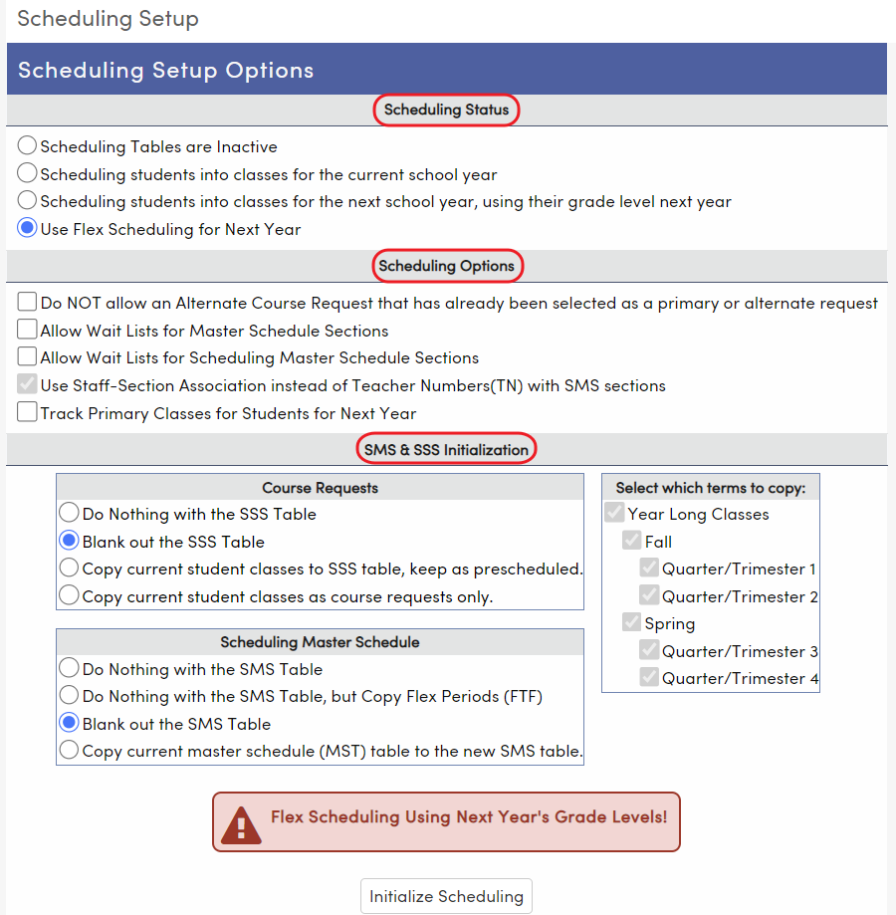
Scheduling Setup Page – Currently Using Flex
Sections:
Scheduling Status
Scheduling Options
SMS & SSS Initialization

Slide 9
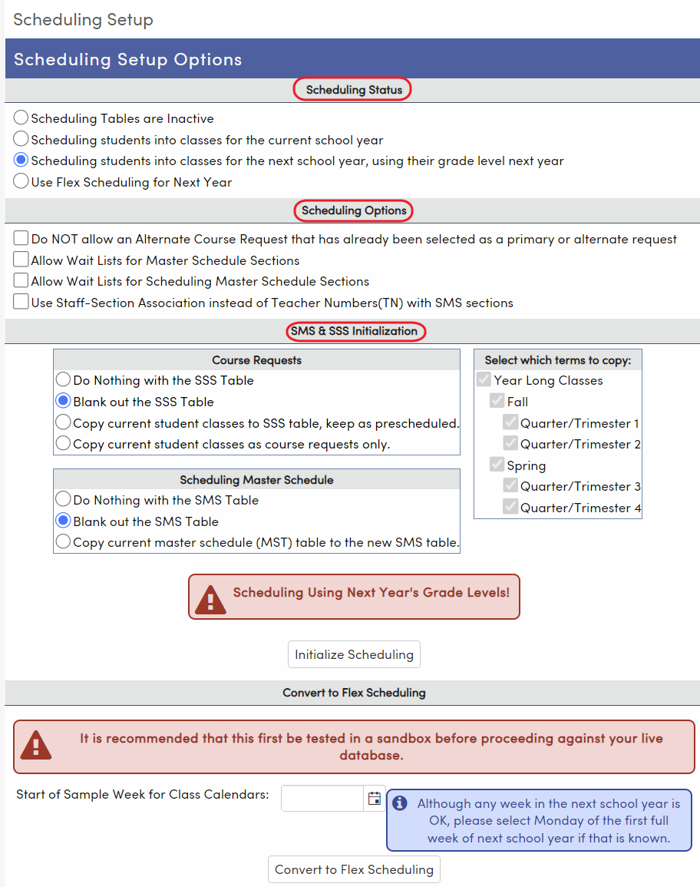
Scheduling Setup Page – Currently Using Traditional
Sections:
Scheduling Status
Scheduling Options
SMS & SSS Initialization
Convert to Flex Scheduling (not the only way to convert, not typically used)

Slide 10
Scenario 1: Flex Flex (typical settings, creating all new Flex SMS for next year)
Scheduling Status
Must choose “Use Flex Scheduling for Next Year”
Scheduling Options
Optional: “Do NOT allow an Alternate Course Request already selected as primary or alternate request”
“Use Staff-Section Association . . .” (no choice)
Wait Lists – if needed, see Aeries Wait List Documentation
SMS & SSS Initalization
“Blank out the SSS Table”
“Blank out the SMS Table”
Note: This process will not automatically create Flex Periods for next year. If you wish to copy the current year’s Flex Periods to next year, initialize a second time and choose “Do Nothing with the SMS Table, but Copy Flex Periods”

Slide 11
Scenario 2: Traditional Traditional (typical settings, creating all new traditional SMS for next year)
Scheduling Status
Must choose “Scheduling students into classes for next school year, using their grade level next year”
Scheduling Options
Optional: “Do NOT allow an Alternate Course Request already selected as primary or alternate request”
Optional “Use Staff-Section Association . . .” (not typical unless moving to Flex)
Wait Lists – if needed, see Aeries Wait List Documentation
SMS & SSS Initalization
“Blank out the SSS Table”
“Blank out the SMS Table”

Slide 12
Scenario 3: Traditional Flex (typical settings, creating all new Flex SMS for next year)
Scheduling Status
Choose “Use Flex Scheduling for Next Year”
Scheduling Options
Optional: “Do NOT allow an Alternate Course Request already selected as primary or alternate request”
“Use Staff-Section Association . . .” (no choice)
Wait Lists – if needed, see Aeries Wait List Documentation
SMS & SSS Initalization
“Blank out the SSS Table”
“Blank out the SMS Table”
Note: In order to proceed with a new Flex SMS created from a traditional schedule in this way, it is advised to add Flex Periods and Class Calendars before adding new Sections in the new SMS.

Slide 13
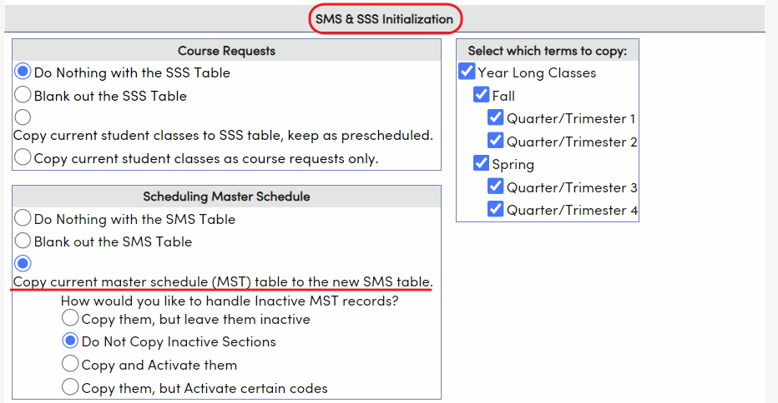
Setup Variation: Copy Existing MST to Use For Next Year’s SMS
Set up (initialize) SMS using one of the Scenarios listed previously. Must start with blanking out SSS and SMS.
Initialize again using the same Scheduling Status and Options, but this time, choose “Copy current master schedule (MST) to the new SMS table” under SMS & SSS Initialization.
Choose how to handle Inactive MST sections
Choose which terms to copy
Press “Initialize Scheduling”.

Slide 14
Thanks for joining us!
Where to Go
Scheduling Setup Flex Scheduling – Scheduling Setup
Aeries Demo Data
Aeries Academy- General

Slide 15
Please take a moment
to complete the survey
https://survey.alchemer.com/s3/6899809/Good-Morning-Aeries-Survey

Slide 16
Watch for more upcoming Good Morning Aeries! and other events
GMA: Jan. 19 – Feb. 2, 2023
Class Link
Grade Reporting Process (GRD)
State Testing – Accommodations, State ID Cards Report
Attendance Dashboard
CALPADS Fall 2 (Q&A)
Physical Fitness Testing
Advanced Query
Updated List of All Events Here

