Slide 1
Good morning, Aeries!
Texas Transcripts Configurations
December 13, 2022

Slide 2
Speaking today:
S
Lori Leal | Training Specialist
loril@aeries.com
M
Athina Firman| Training Specialist
athinaf@aeries.com

Slide 3
Good morning, Aeries!
District Configurations
School Configurations

Slide 4
Who are the stakeholders regarding transcript decisions?
Define different transcript types
What course settings are driving your transcripts?
Need
To
Know

Slide 5
Capability of having multiple transcript types.
How course settings impact transcripts.
Nice
To
Know

Slide 6
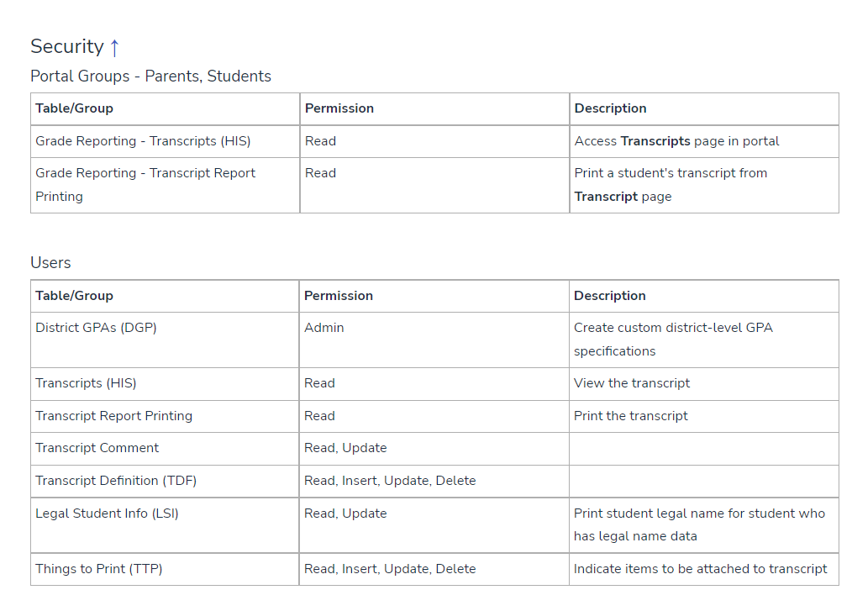
Security Settings

Slide 7
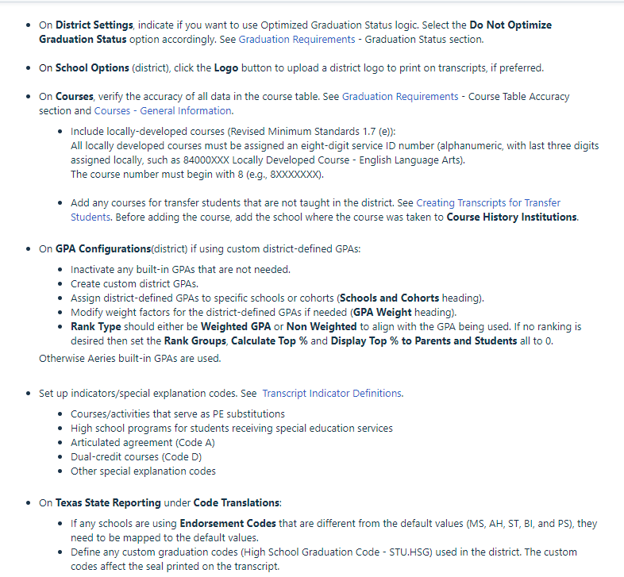
District Configurations

Slide 8
District Configurations

Slide 9
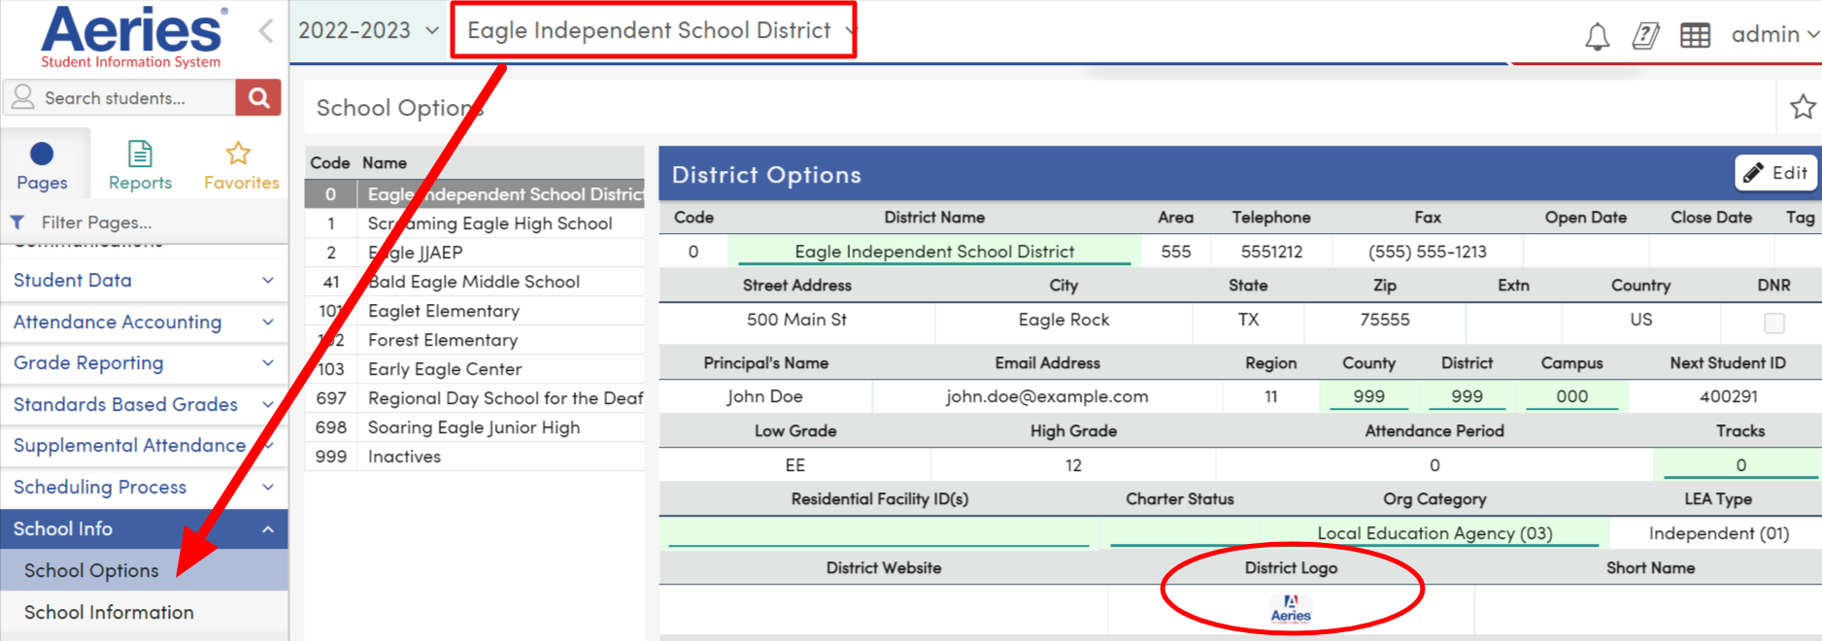
District Configurations

Slide 10
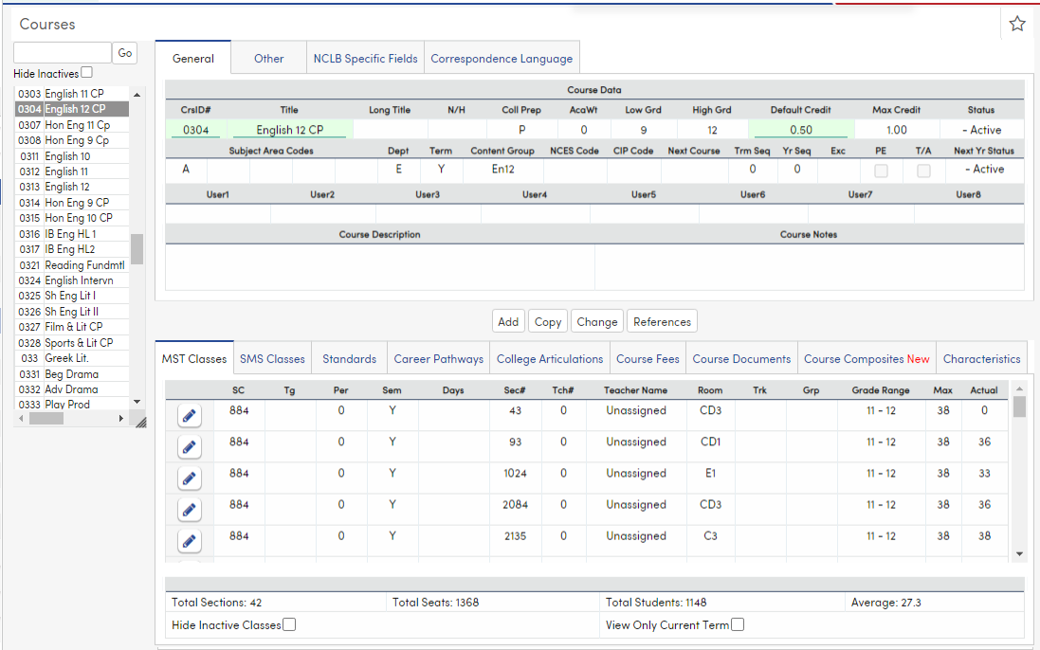
District Configurations

Slide 11
District Configurations

Slide 12
District Configurations

Slide 13
District Configurations

Slide 14
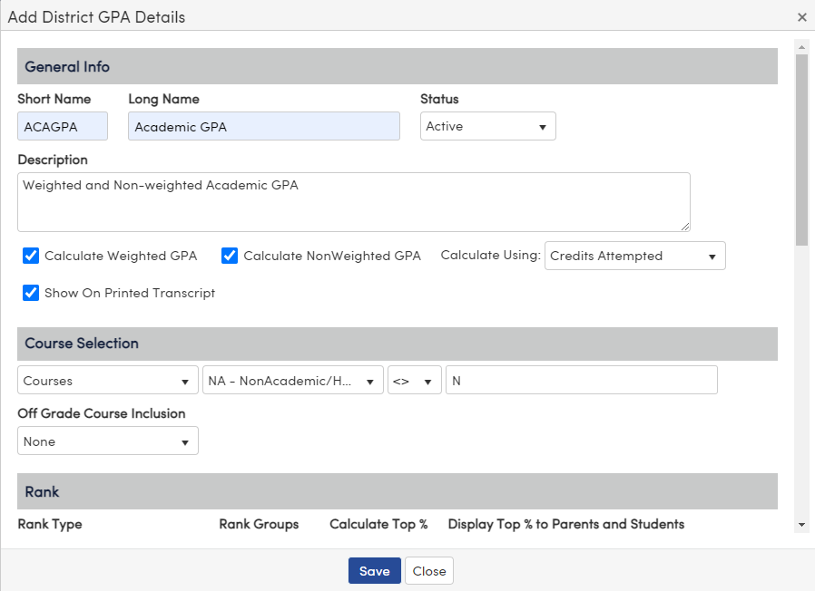
District Configurations

Slide 15
District Configurations

Slide 16
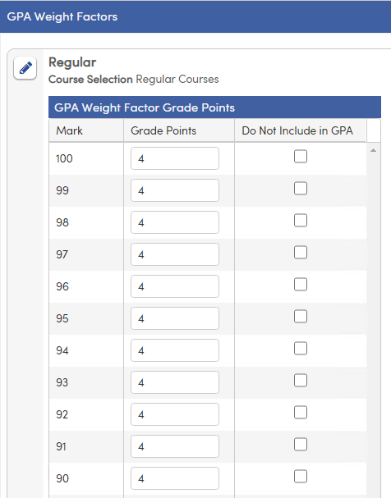
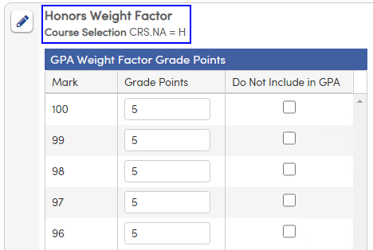
District Configurations

Slide 17
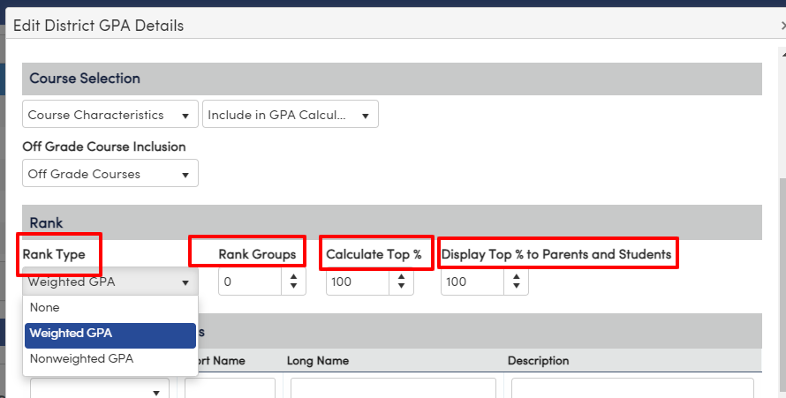
District Configurations

Slide 18
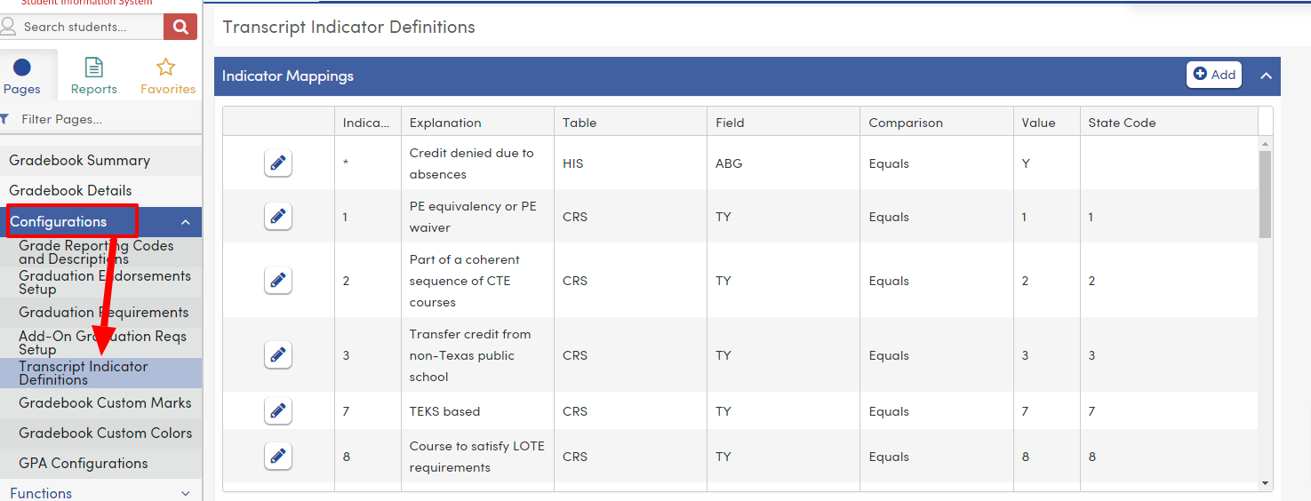
District Configurations

Slide 19
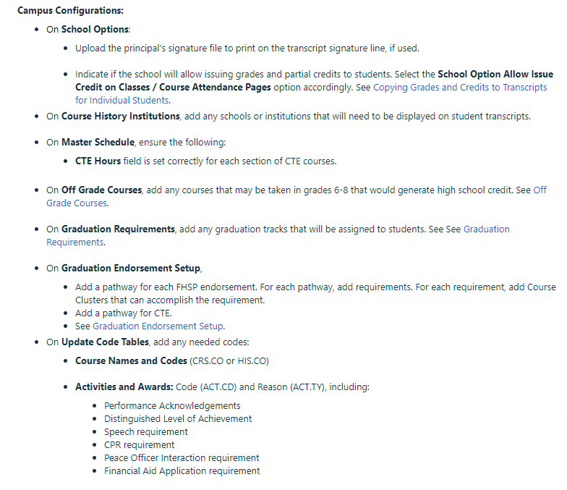
Campus Configurations

Slide 20
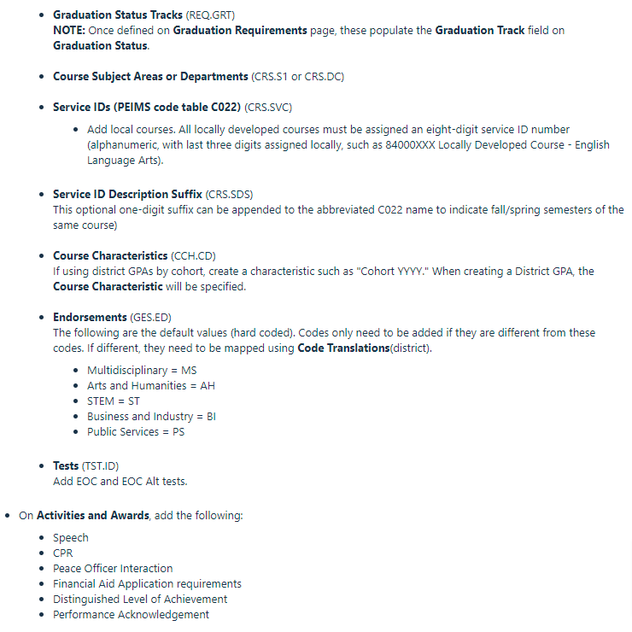
Campus Configurations

Slide 21
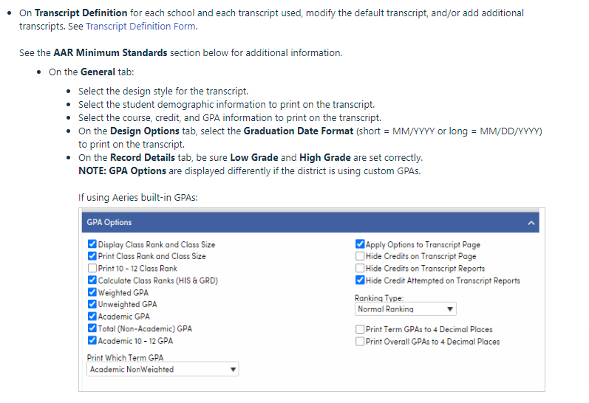
Campus Configurations

Slide 22
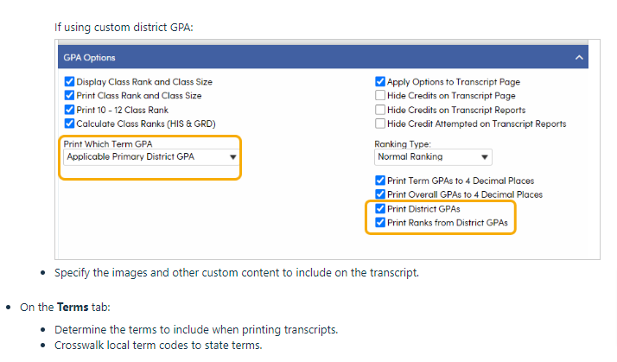
Campus Configurations

Slide 23
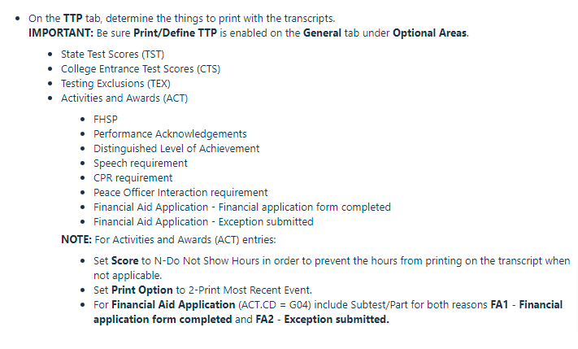
Campus Configurations

Slide 24
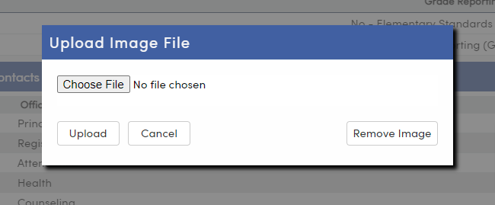
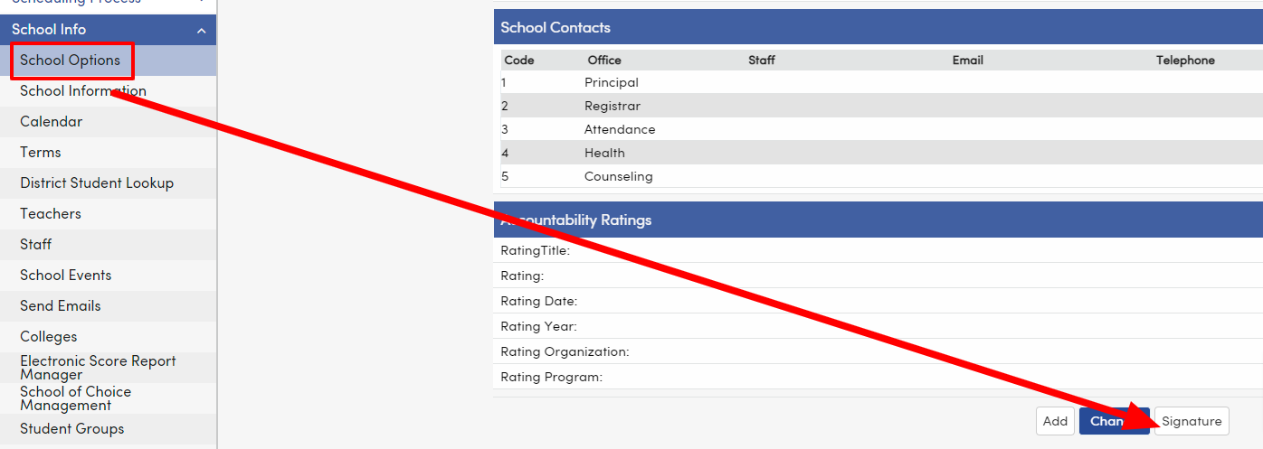
Campus Configurations

Slide 25
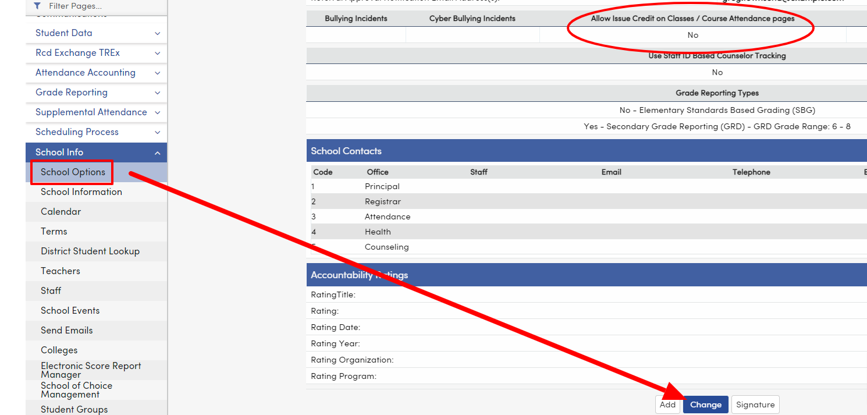
Campus Configurations

Slide 26
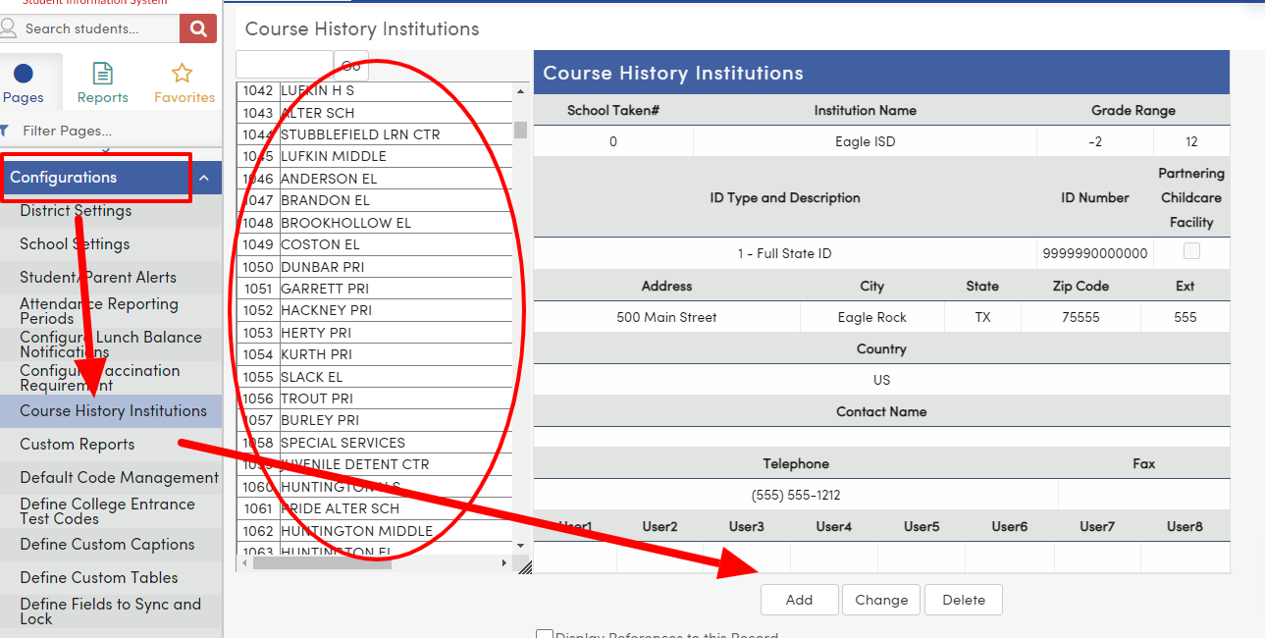
Campus Configurations

Slide 27
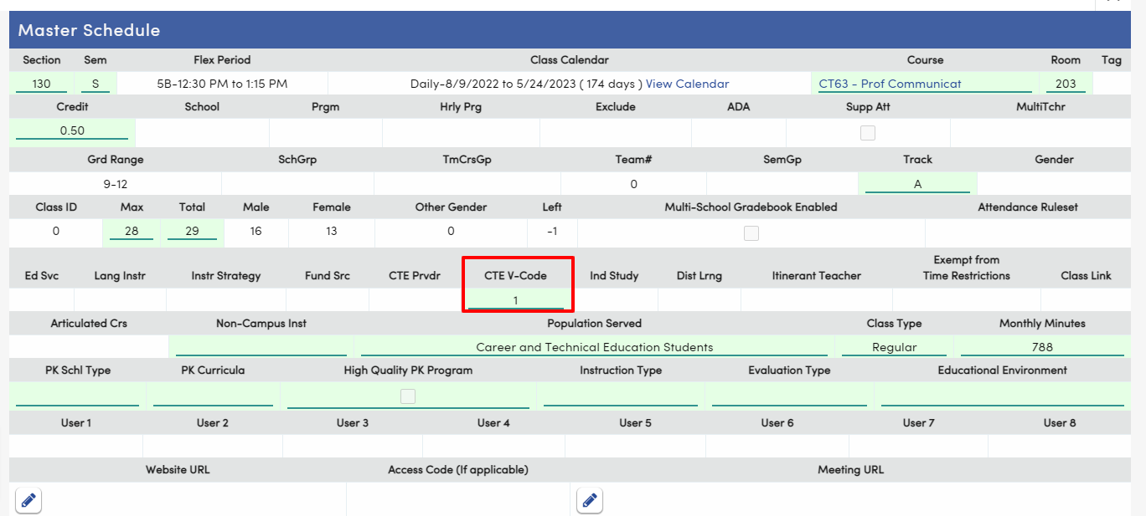
Campus Configurations

Slide 28
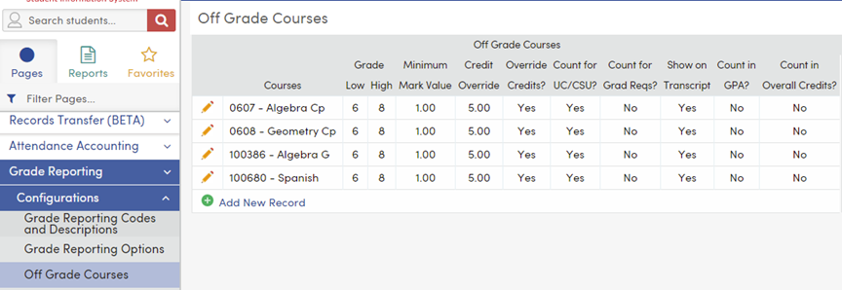
Campus Configurations

Slide 29
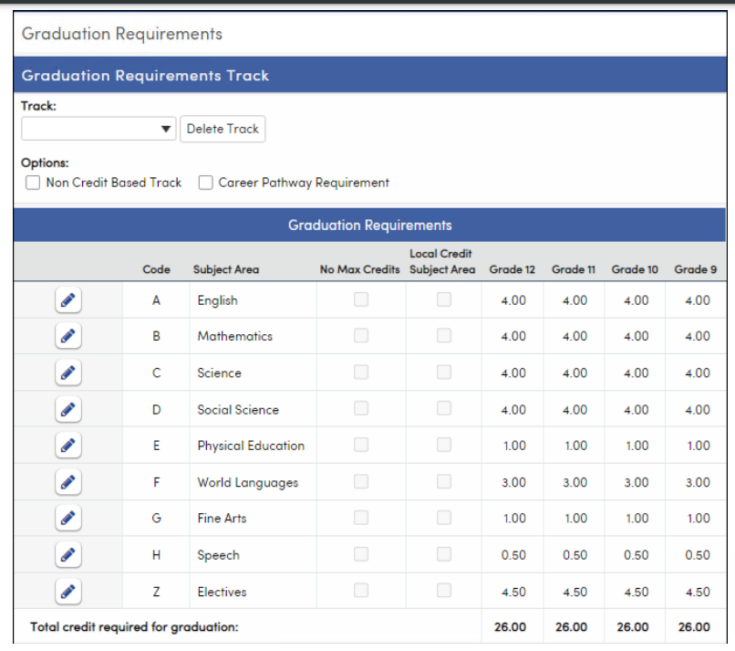
Campus Configurations

Slide 30
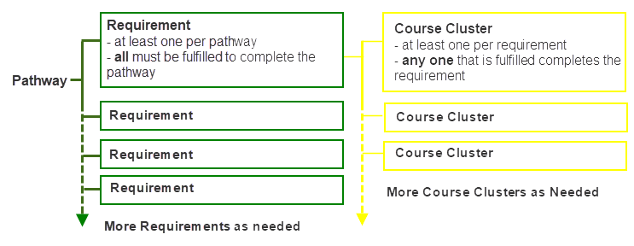
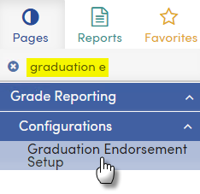
Campus Configurations

Slide 31
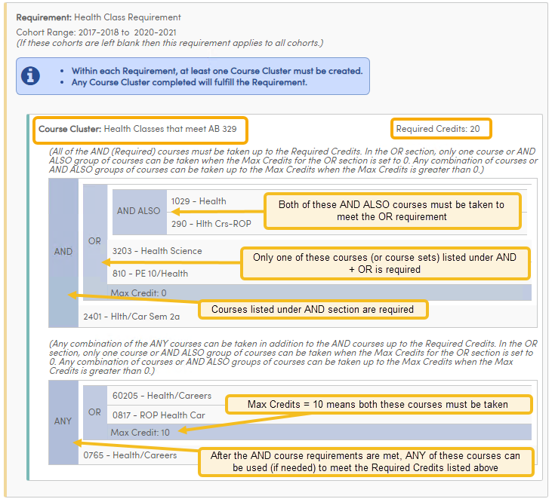
Campus Configurations
Course Cluster

Slide 32
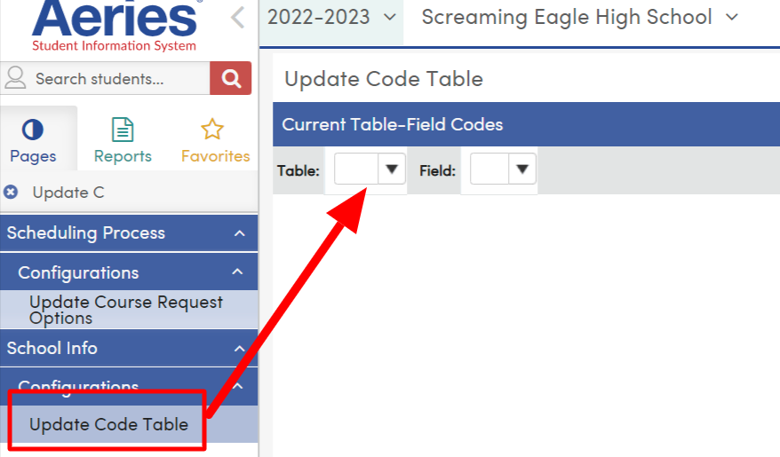
Campus Configurations/Update Code Tables

Slide 33
Campus Configurations/Update Code Tables
Course Names and Codes – CRS.CO, HIS.CO
Activities and Awards – ACT.CD, ACT.TY
Performance Acknowledgements
Distinguished Level of Achievement
Speech requirement
CPR requirement
Peace Officer Interaction requirement
Financial Aid Application requirement

Slide 34
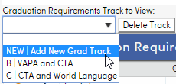
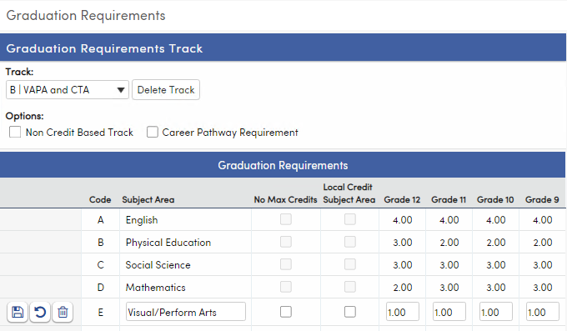
Campus Configurations

Slide 35
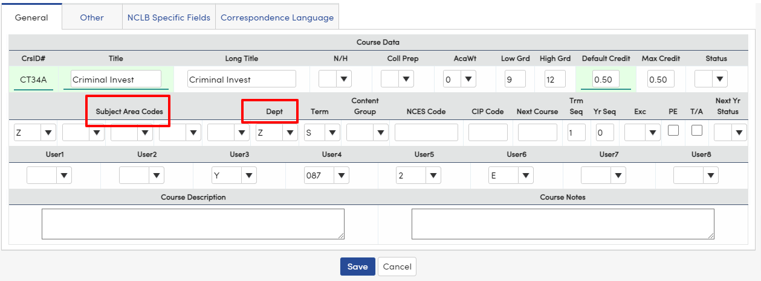
Campus Configurations

Slide 36
Campus Configurations
CO22

Slide 37
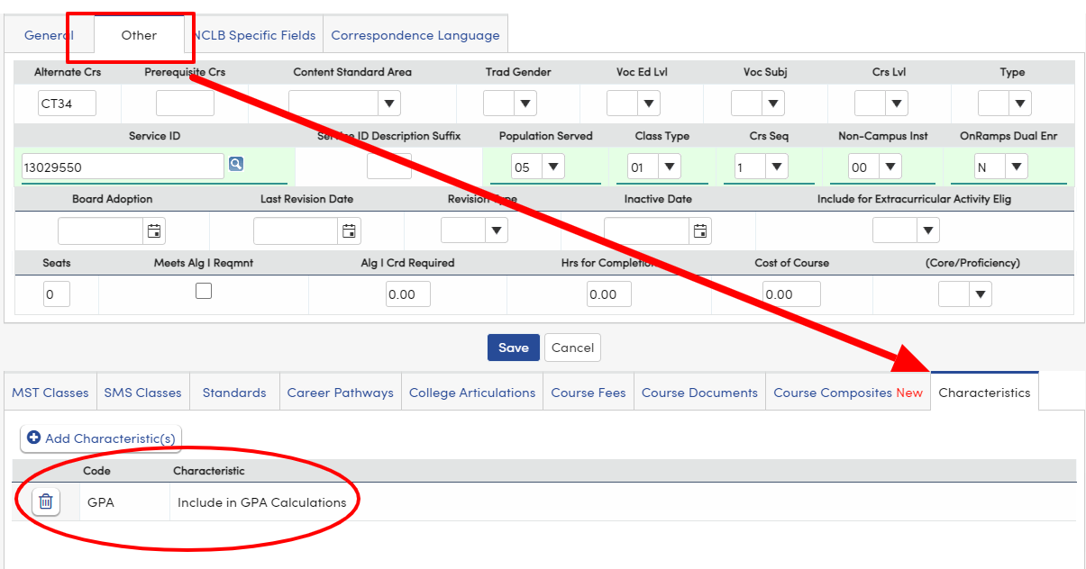
Campus Configurations

Slide 38
Campus Configurations

Slide 39
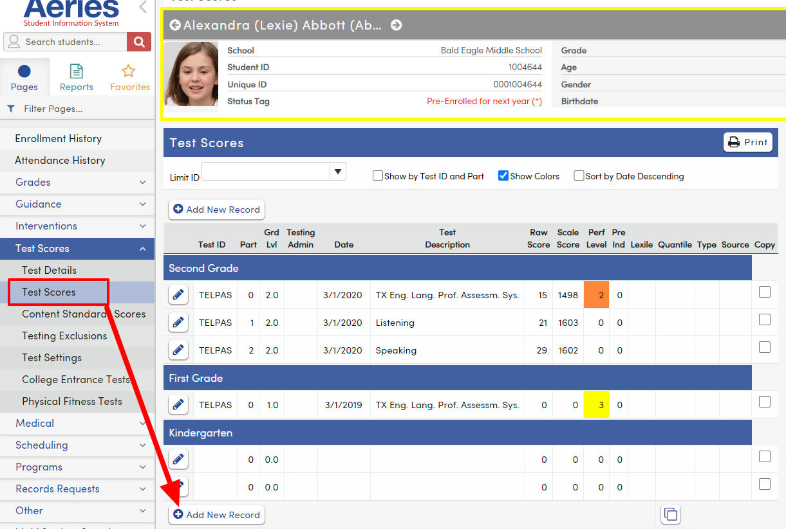
Campus Configurations

Slide 40
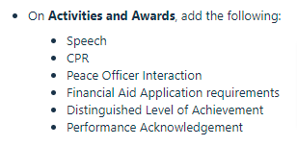
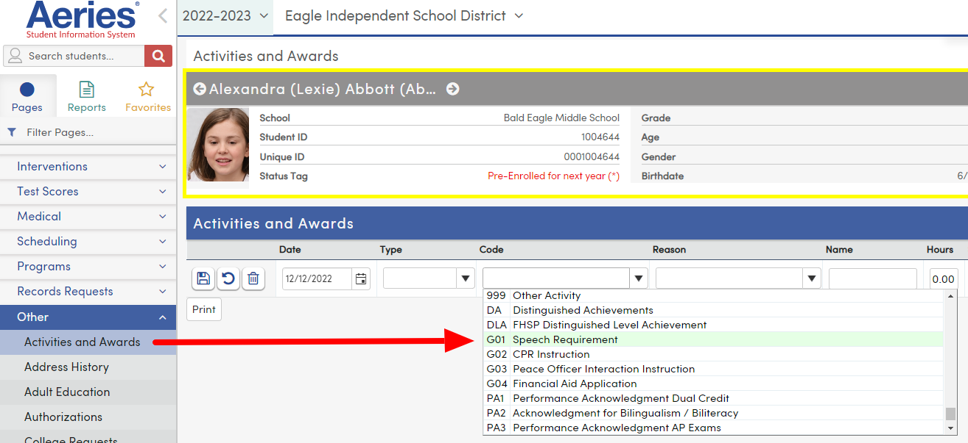
Campus Configurations

Slide 41
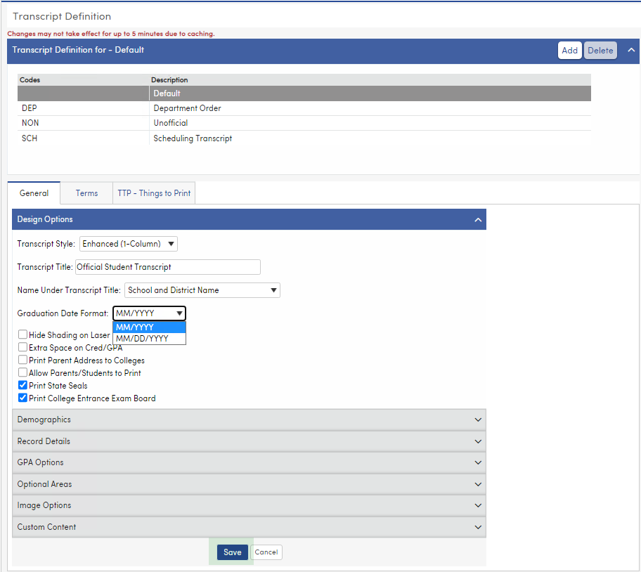
Campus Configurations

Slide 42
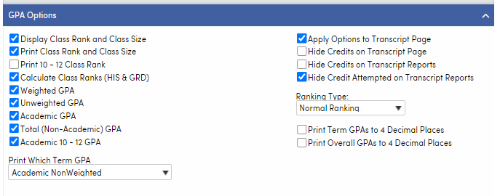
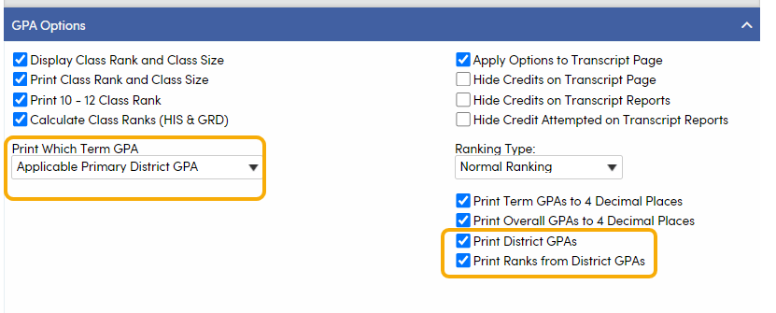
Campus Configurations
If using custom district GPAs
If using Aeries built-in GPAs

Slide 43
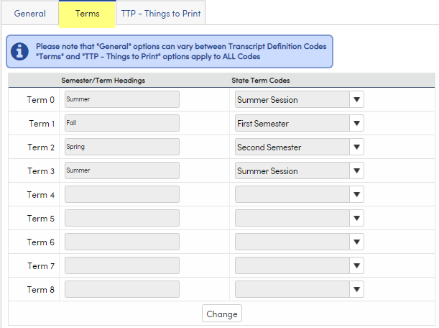
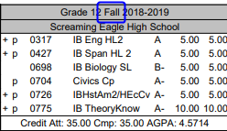
Campus Configurations

Slide 44
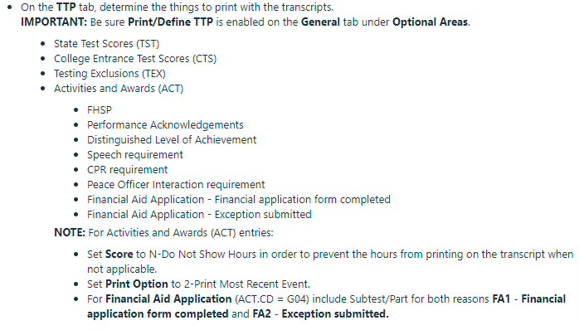
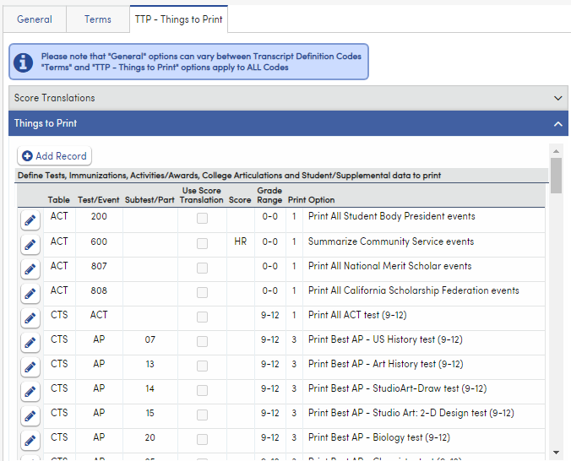
Campus Configurations

Slide 45
Thanks for joining us!
Possible Upcoming GMA
What I wish I knew on day one…………..
Online Enrollment
Custom Reports
If you have any ideas or requests….please let us know!!!
Info and links
TWEDS https://tealprod.tea.state.tx.us/TWEDS/98/0/0/0/Introduction/List/786
Aeries Support
https://support.aeries.com/support/home
Aeries Support Transcript Videos https://support.aeries.com/support/solutions/folders/14000122967

