Slide 1
Good morning, Aeries!
Parent Data Confirmation
Parent Overview Part 2 of 4

Slide 2
Speaking today:
Elena Lohr | Customer Advocate
elena@aeries.com
Moderators | Leslie Stawarz
Carole Willimas

Slide 3
Good morning, Aeries!
Keep topics to 30-45 minutes
Show & Tell
Casual Setting
Time for Q&A
Power Point and Recordings Posted

Slide 4
Portal Account Permissions
Active Portal Accounts will be prompted to complete the PDC process
Income Survey cannot be edited
Request for address change only generates an email, does not actually change within the system
Lock out date – Parents will not be able to access other areas in the portal
Needs to be completed for each student
Need
To
Know

Slide 5
The Parent Data Confirmation may be accessed through the Aeries Mobile App or through a desktop browser
Parent can return at any time to complete process
Parent prompt is located on the bottom right-hand corner (new view) or banner will show on top of page (old view)
Nice
To
Know
Parent can reset
their password

Slide 6
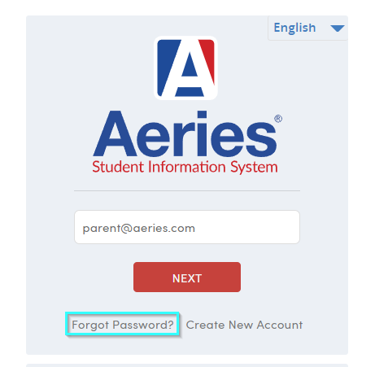
Login Page
The parent may use the forgot password option to reset their password

Slide 7
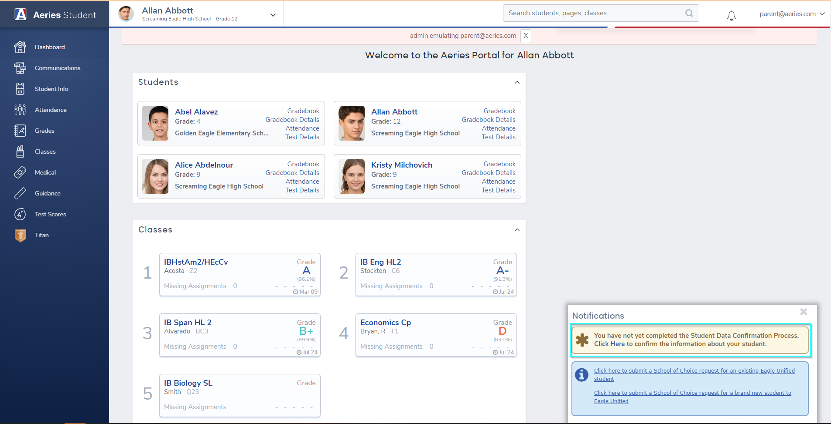
Welcome page
The parent prompt is located on the bottom right-hand corner (new view) or banner will show on the top of the page (old view)

Slide 8
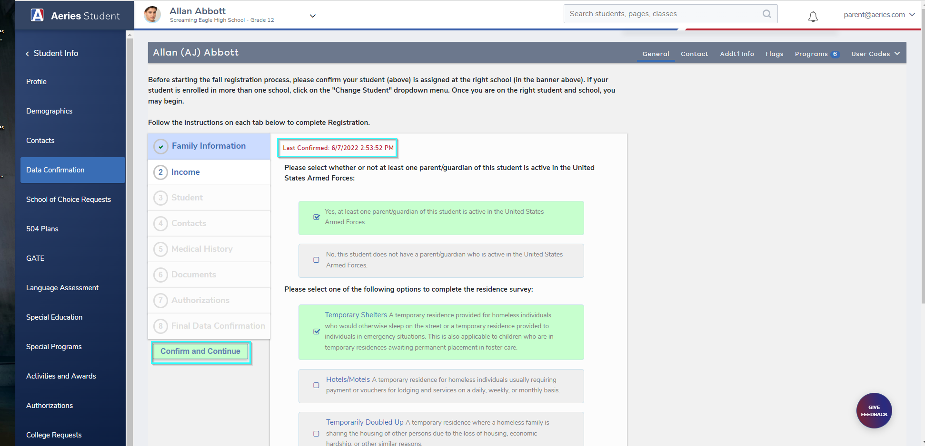
Family Information
The Parent will only see the Surveys that have been enabled

Slide 9
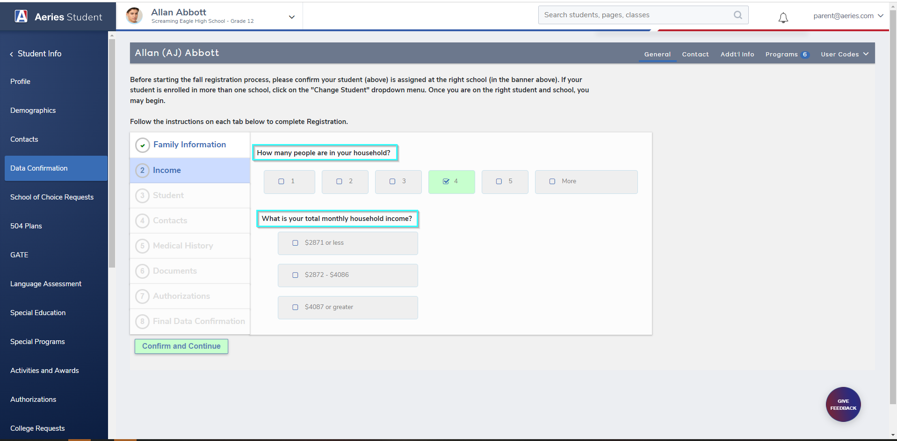
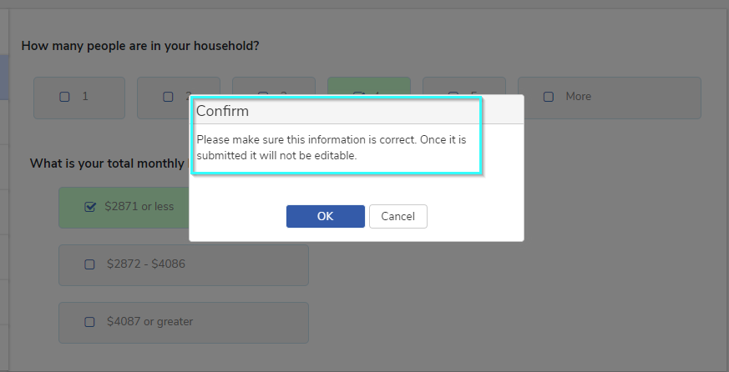
Income Survey
The parent will be prompted they may not edit the record

Slide 10
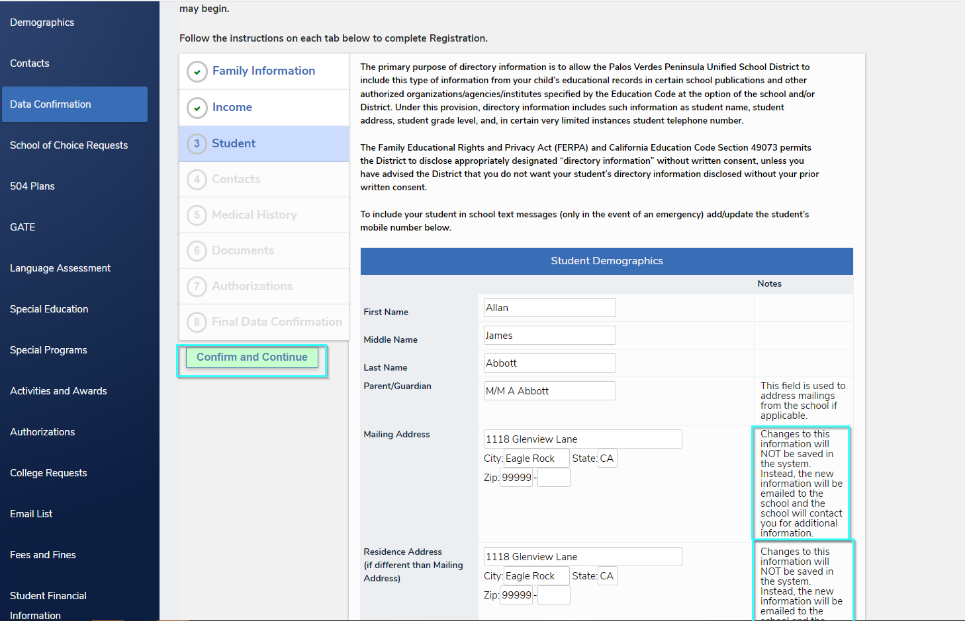
Student Demographics
Address Changes will not automatically be updated in the system

Slide 11
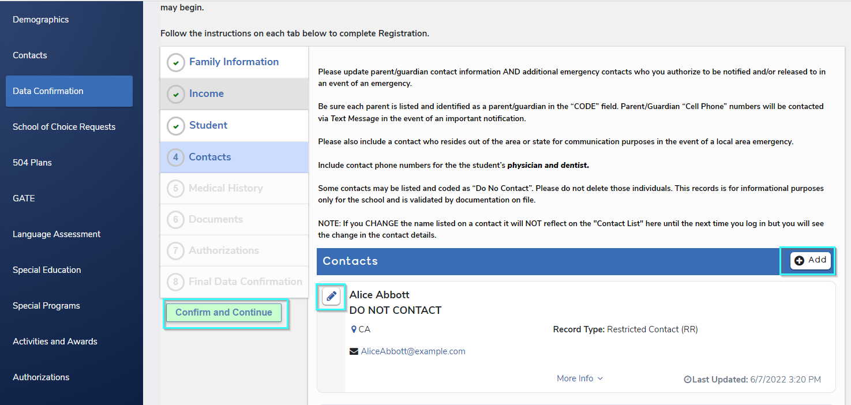
Contacts
Parents may add or edit records

Slide 12
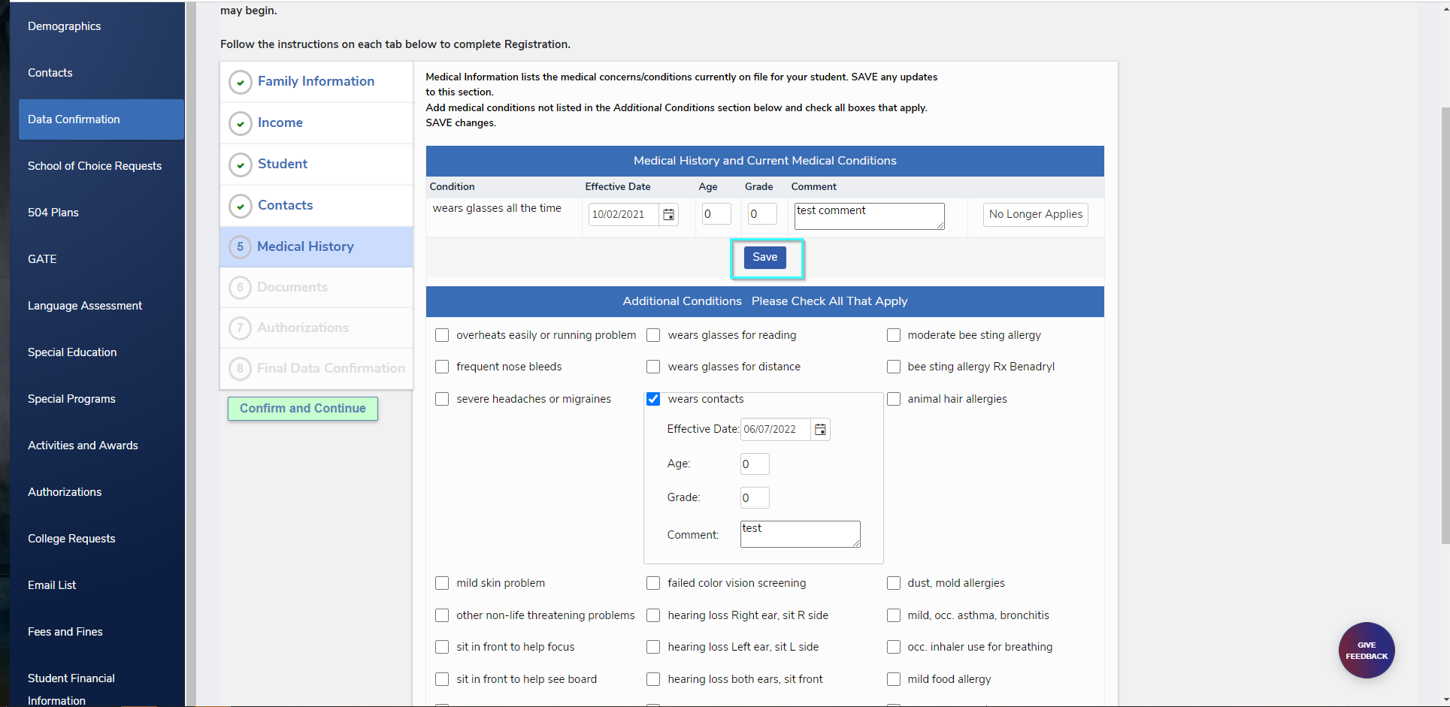
Medical History
Parent may add records and comments
Records that No longer apply maybe removed

Slide 13
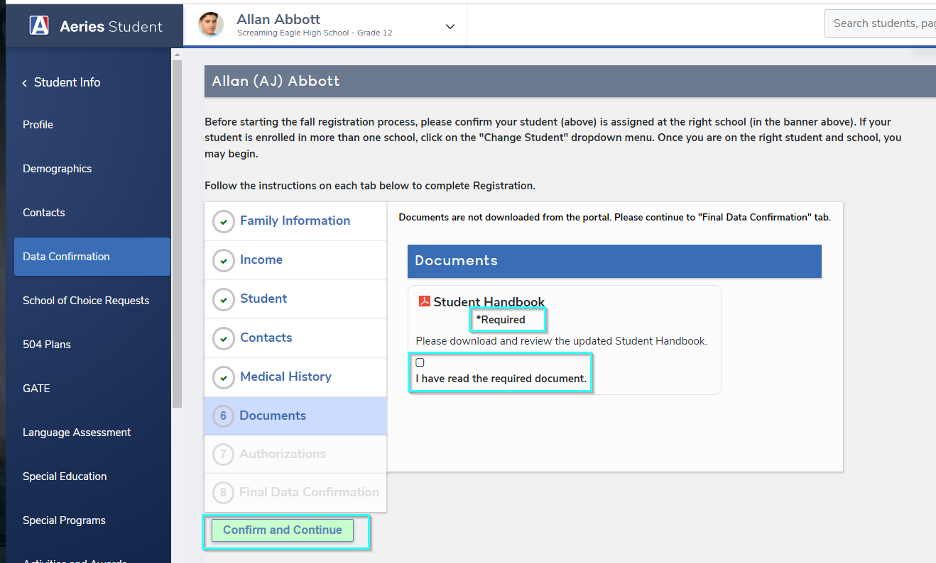
Required Documents
Confirmation Text define the statement in the Code table (DCV.CT)

Slide 14
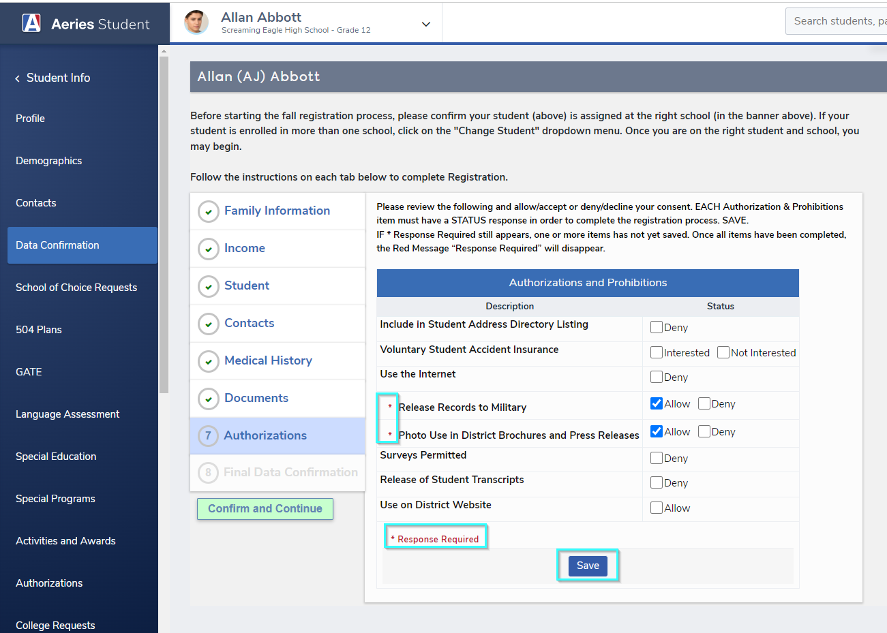
Authorizations
Required questions must be completed before they can move onto the next page

Slide 15
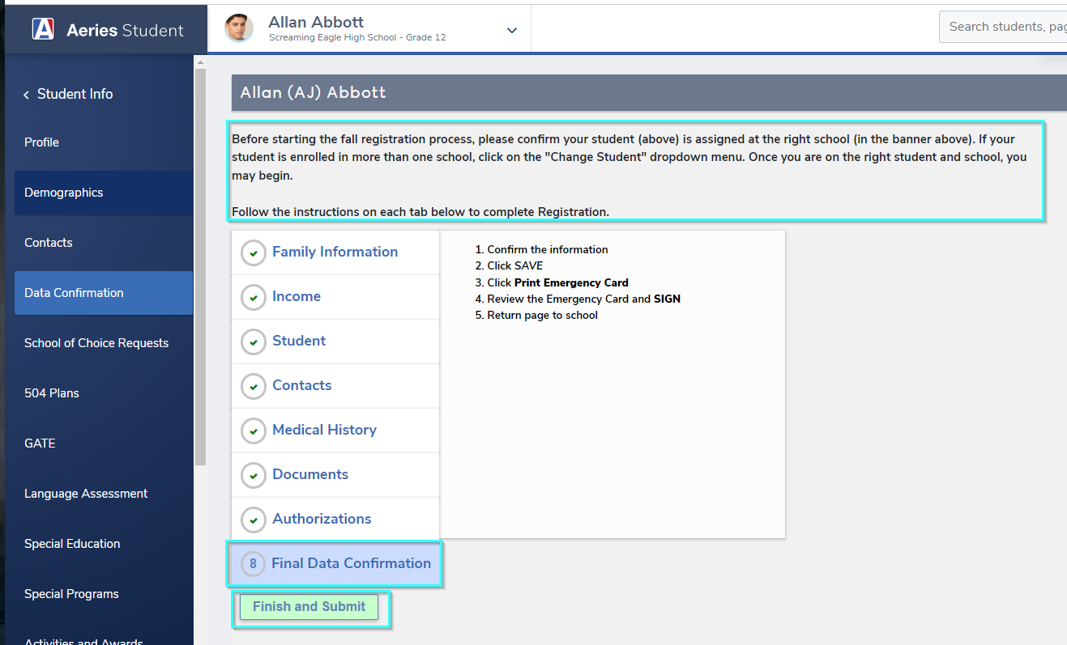
Final Data Confirmation
The Parent must Click Finish and Submit on the page

Slide 16
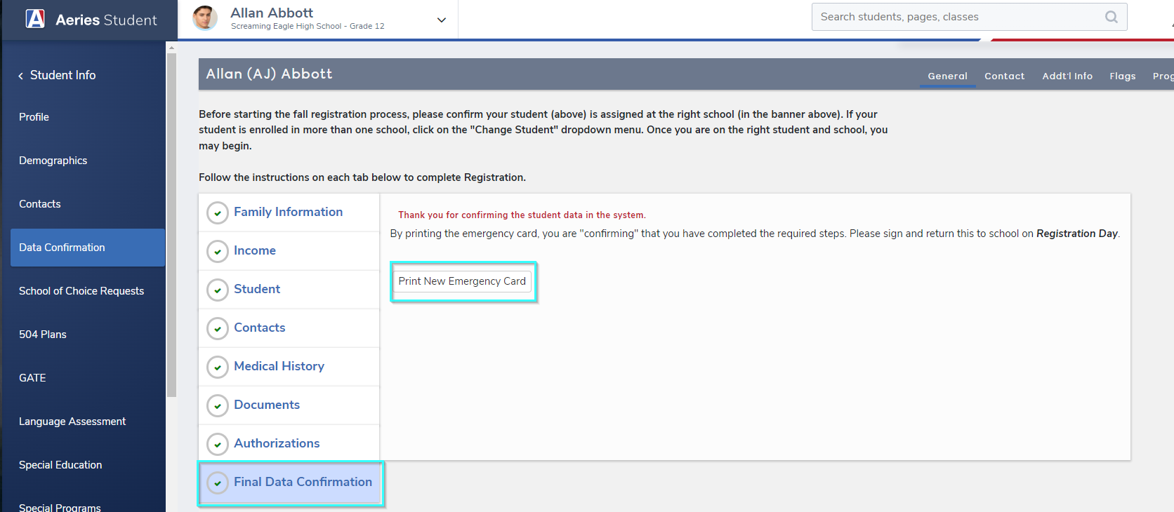
Final Data Confirmation
Based upon your settings parents may print out a New Emergency Card

Slide 17
End of Year Workshop
New Year Kickoff – Pt 1 – EOY Process
New Year Kickoff – Pt 2 – Checklist – Hosted
New Year Kickoff – Pt 3 – Checklist – Non Hosted
What To Do After Rollover
Third Party Integrations
New Student Enrollment
So Many More!!
Watch for more upcoming webinars!

Slide 18
We value your feedback!
Please take a few minutes to complete our survey and let us know how we can better serve you in the future! Have a great rest of your day.
Good-Morning-Aeries-Survey

Slide 19
Thanks for joining us!
Where to Go
Parent Data Confirmation Setup
Aeries Demo Data
Aeries Academy
Parent Data Confirmation Videos

