Slide 1
www.aeries.com

Slide 2
Student Contacts

Slide 3
Internal Team Members
Business Analysts
Minott Opdyke
System Architects & Developers
Matt Ulmer
Internal Advisors
Michele Sullivan, Leslie Stawarz, Deb Cartwright, Susan Prow, Jenifer Johnson, Elena Lohr, Carrie Muchow
External Advisors
Aeries Advisory Group

Slide 4
Overview
The Student Contacts Feature is used to record Parent/Guardian Contact and Emergency Contact information. It provides demographic information about each Contact, their Relationship to the Student, required fields for State Reporting and Communications, and other Customer required or defined fields. The Contact information is also used in defining members of a Students’ household.
Due to the fluid nature of families today, the traditional single-family structure which underlies our current Contacts model does not meet our Customers’ needs for managing Contacts. The new model will allow for greater flexibility to define relationships between Contacts and Students.
We will also work to ensure the data meets all State Reporting and Ed-Fi Standards for interoperability with 3rd parties.

Slide 5
Current Customer Challenges
Contacts
A Contact can be different things for different Students. A Mom, Step-mom, Emergency Contact. Only by having a copy of the record for each Student can there be different relationships.
Contact Information
There are different Contact types related to a Student – Parent/Guardian, Emergency, Restricted, Group Homes – and the information we need for each one can be different, and where to put data might be a challenge or there can be uncertainty about whether certain information needs to be entered for a Contact.
Having a separate Parent/Guardian name, address and email on the Student Information page can conflict with the Parent/Guardian Contact names, address and emails
Contact Updating
Contact records are defined for each student, so Siblings have separate records, and each needs to be updated
Updating a Student address does not update the Contact Address, and vice versa.
Contact Privacy
There is no easy way to hide Contact information such as address and phone in the Portal

Slide 6
Key Expectations for Aeries Next Generation
Contacts
Districts need the ability to define multiple relationships between Contacts and Students.
Contact Information
Districts need a way to capture the information according to the type of Contact.
The Parent/Guardian information that appears on the Student Information page needs to always be the same as the Contact information
Contact Updating
Information for a Contact needs to be synced across all Students related to that Contact.
The Student Address and the Contact address need to be in sync.
Contact Privacy
Schools need the ability to hide Contact information from the Parent/Teacher portals or other Users.

Slide 7
Changes & Differences
Current Aeries
Aeries NextGen
Contacts are currently individual records related to each Student. If the Parent has 3 Students, each one has a Contact record for that Parent. All 3 records have to be managed.
If a Contact has different relationships to Students – Mother for one and Step-mother for another – there is no way to show those relationships other than separate Contact Records.
Schools use different methods for determining which Contacts get reported to the State – Relationship, Record Type, Contact Order – and these can vary between Students of the same Family.
There will be one Contact record per Parent/Guardian or Primary Contact. This will contain the basic demographic information, contact information, and State reporting information.
A Contact can have a different relationship to each associated Student using the same record
Schools can indicate per Student who are the Parent/Guardians, who are Primary Contacts, which Contacts are reported to the State and more

Slide 8
Changes & Differences
Current Aeries
Aeries NextGen
All Contact records are the same no matter what their relationship is to the Student, so data entry can be a little confusing.
Contacts can be sorted for priority, but it’s not always easy to tell at a glance what the relationship to the Student is.
Different Contact Types will display fields according to the Type, so data entry can be more streamlined.
Each Contact Type will display differently and have a default Sort of :
Parent/Guardians
Restricted
Emergency
Other
This order can be overwritten by with drag-and-drop sorting.

Slide 9
Some Visualization
What could Student Contacts look like?

Slide 10
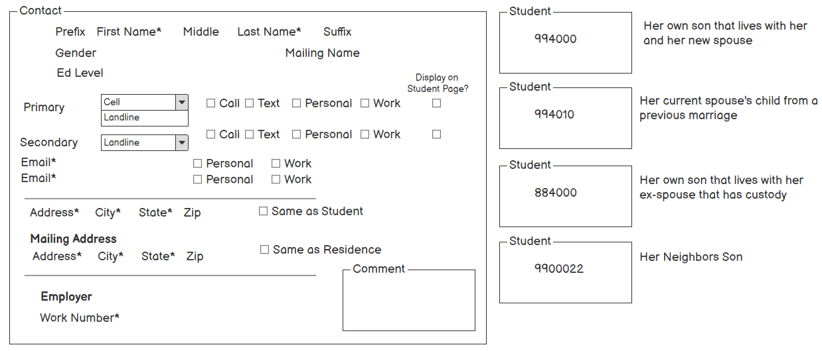
Some Visualization

Slide 11
Some Visualization

Slide 12
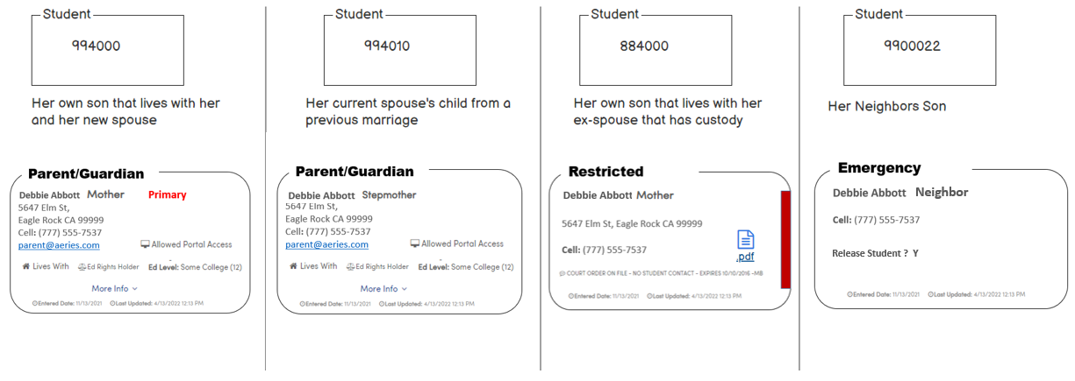
Some Visualization
There is one Contact record presented in different ways according to the Type of Contact for that Student.
So, an update to the address or phone of the Contact record is seen on each of the associated Students’ Contacts.

Slide 13
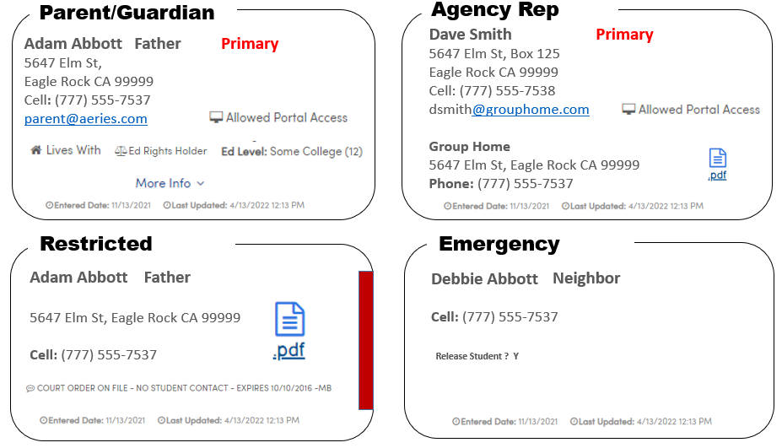
Some Visualization
The color on the Restricted Contact can be customized by the District according to the type of restriction
There will be one other Contact Type available of ‘Other’, maybe for a Doctor or other necessary contact.
Documents can be uploaded

Slide 14
Some Visualization
What might the process look like?

Slide 15
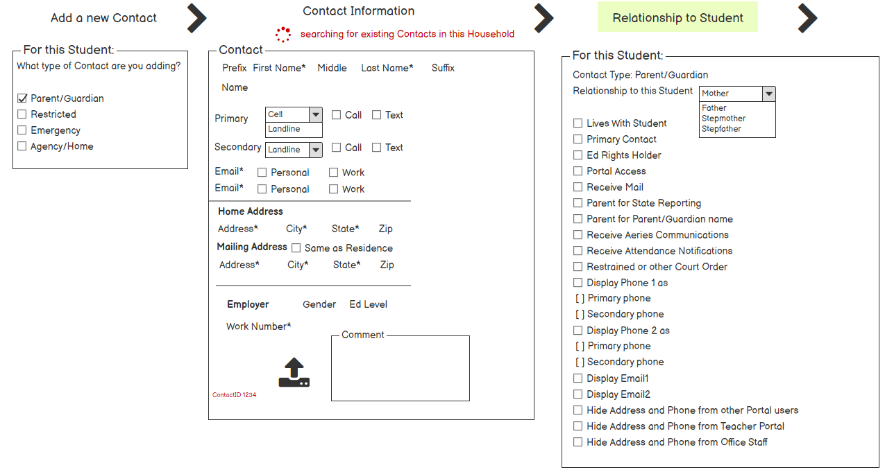
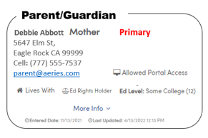
Adding Contacts

Slide 16
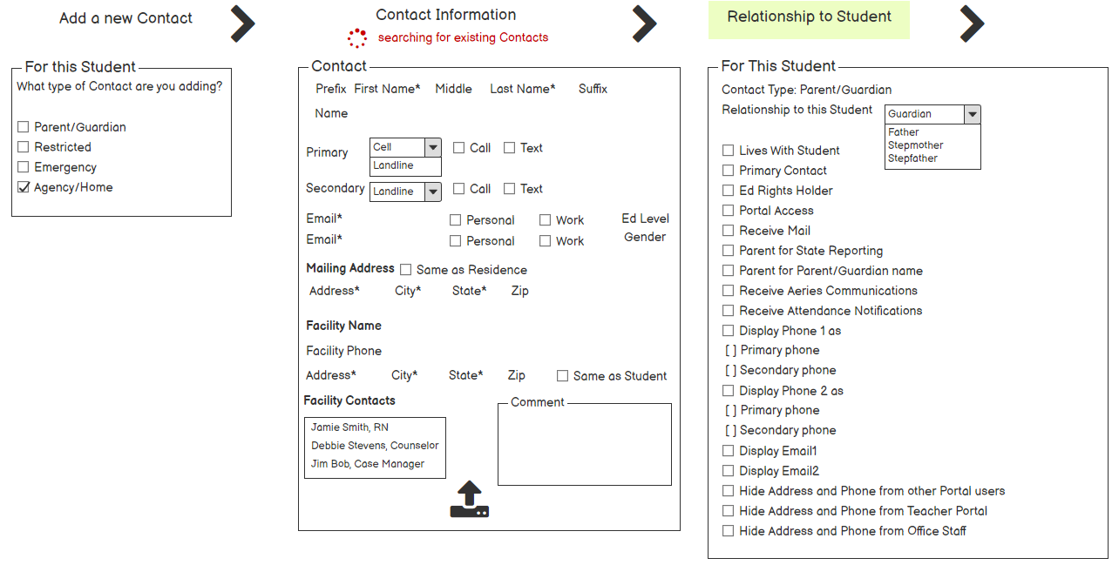
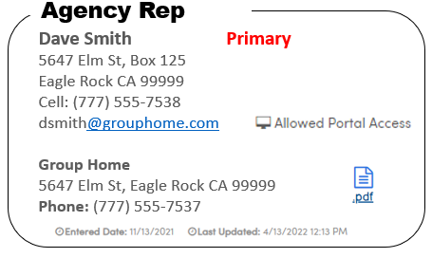
Adding Contacts

Slide 17
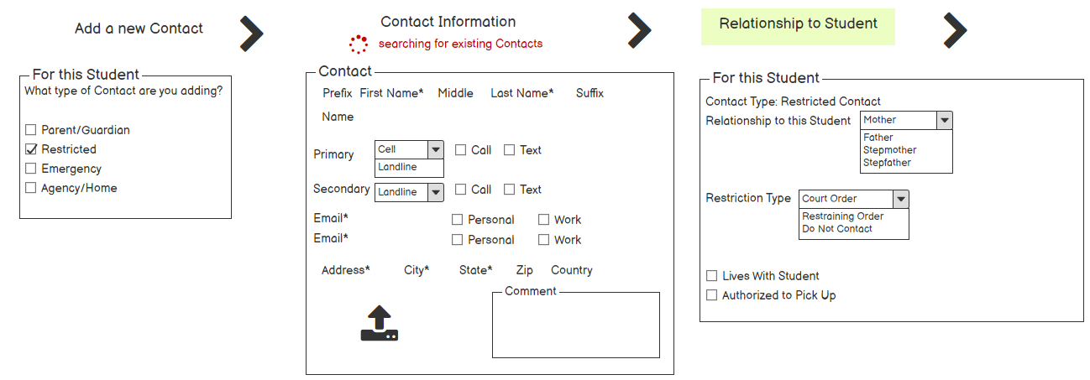
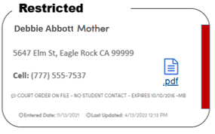
Adding Contacts

Slide 18
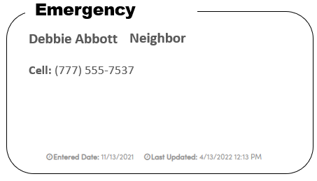
Adding Contacts
Release Student ? Y

Slide 19
Student Contacts
The Relationship codes are customizable as they are currently.
The Contact types will have a default Sort Order of
Parent/Guardians
Restricted
Emergency
Other
The Sort order can be overridden by drag-and-drop sorting.
Emergency Contacts will be different in that they can be duplicate records for different families and each one will be responsible for updating the Contact, unless they are an existing Portal user and have been linked.
Registrars could be notified of potential matches and can merge records

Slide 20
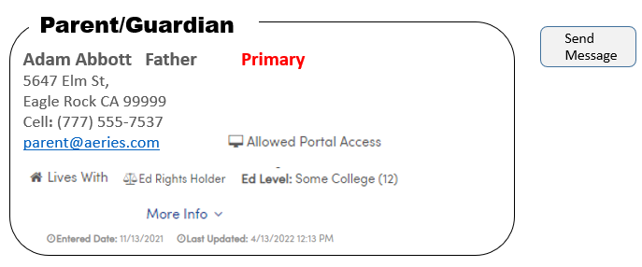
New Features
Messaging:
Can send an email from the Contact page to one or more Contacts
Investigating the ability to Text a Contact through ParentSquare
Send Notifications to Contacts through the Portal
Same function will be available on various Student-related pages

Slide 21
Roadmap
Feature : Data Model
Contact Table
Relationship Table
Emergency Contact Table(?)
Feature: Adding/Editing Contacts
Workflow
Contact Types
Feature: Contact messaging
Email
Text for PS Customers
Aeries Alerts
Feature: Upload Documents for Contacts
Stored in Student Docs but categorized by Contacts
Related to Contact ID

Slide 22
Plan Summary
Provide Districts with a Contacts Management model that allows greater flexibility to adapt to the modern family. It will also grant more granular control of the relationship between a Contact and a specific Student.
When viewing a Students’ Contacts we want to make it visually meaningful, so the user can tell at a glance who is the Contact and how are they related to the Student, along with the ability to order the Contacts they way they prefer.
We want to make communication easier for Districts by letting them customize the priority of Contacts, allowing Contacts to designate how they want to be contacted and providing a quick way to send messages according to the Contact’s preferences.

Slide 23
Questions?

Slide 24
Thank you.
www.aeries.com

