Slide 1
Summer School
Management
Presented by:
Christie Reider, Trainer
Theresa Nicolaou, Moderator

Slide 2
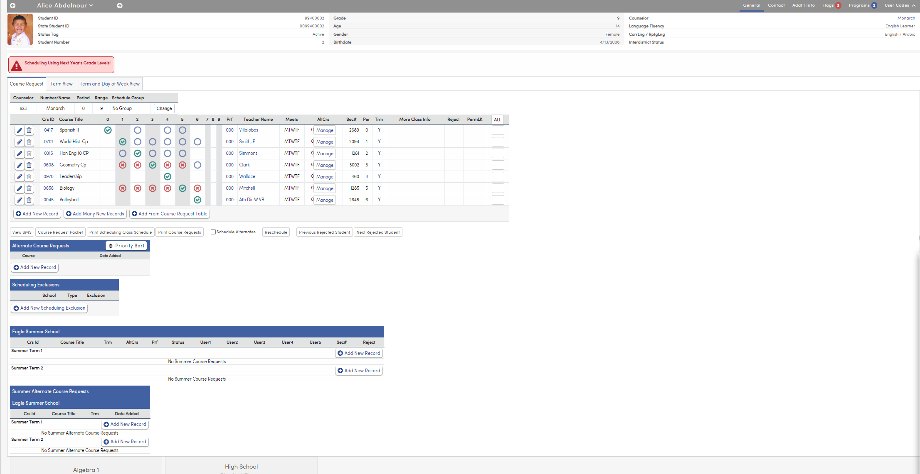
Course Request Page in the home school
NAME OF THE PRESENTATION

Slide 3
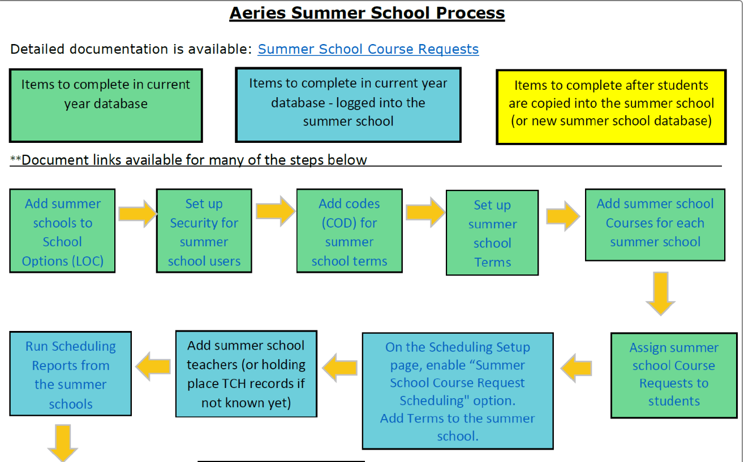
Summer School Flow Chart
NAME OF THE PRESENTATION

Slide 4
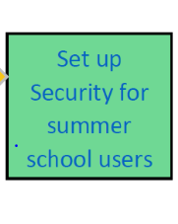
New Summer School Code Tables
• SST – Summer School Terms
• SSA – Summer School Availability
• SSC – Summer School Courses to be offered at each summer school
• SSR – Summer School Course Requests
NAME OF THE PRESENTATION

Slide 5
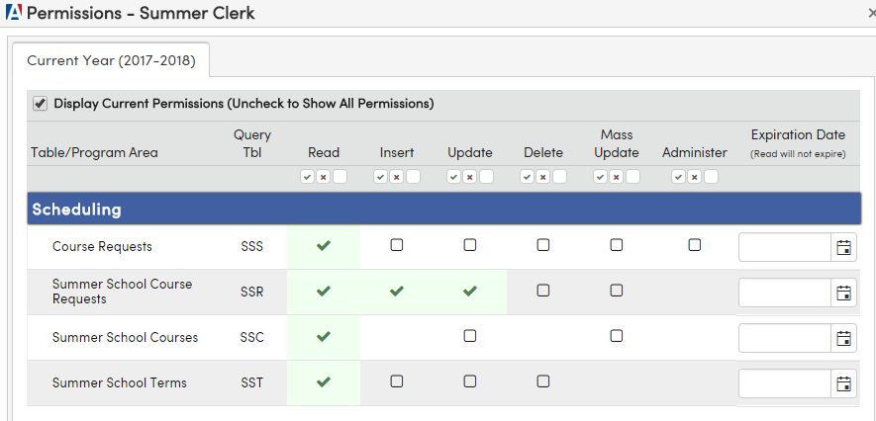
Summer School Permissions
The Clerk who enters the course requests needs permission as shown below:
NAME OF THE PRESENTATION

Slide 6
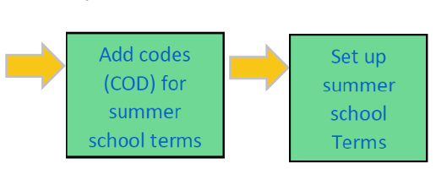

Flow Chart
NAME OF THE PRESENTATION

Slide 7
Questions????
NAME OF THE PRESENTATION

Slide 8
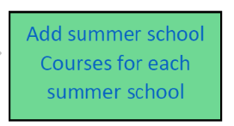
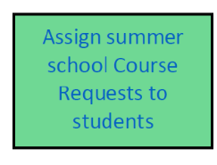

Flow Chart
NAME OF THE PRESENTATION

Slide 9
Scheduling Students
Students are scheduled into summer school courses while staying in their regular school (SSR Table). This eliminates the need to pre-enroll students in Summer Schools until closer to the end of the regular academic year.
NAME OF THE PRESENTATION

Slide 10
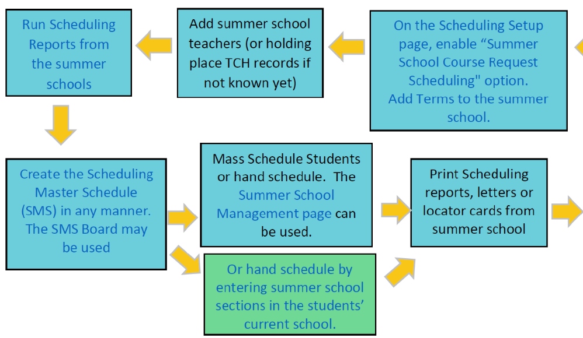
Flow Chart logged into Summer School

Slide 11
Scheduling Reports when in Summer School
All Scheduling reports are available when logged into the summer school:
Print Scheduling Course Request Tally
Print Scheduling Course Request Listing
Students With More or Less Than N Course Requests
Print Scheduling Course Request Letter to Parent
Preschedule Edit Listing
Scheduling Course Request Analysis
Scheduling Class Load Analysis
Scheduling Class Load Averages
Scheduling Reject Analysis Listing
Students With Double Periods
Students With Incomplete Class Schedules
Students With More or Less Than N Periods
Students With Unbalanced Academic Weight
Scheduling Letter to Parent
Summary of Students by Teacher and Period
Student Locator Cards
NAME OF THE PRESENTATION

Slide 12
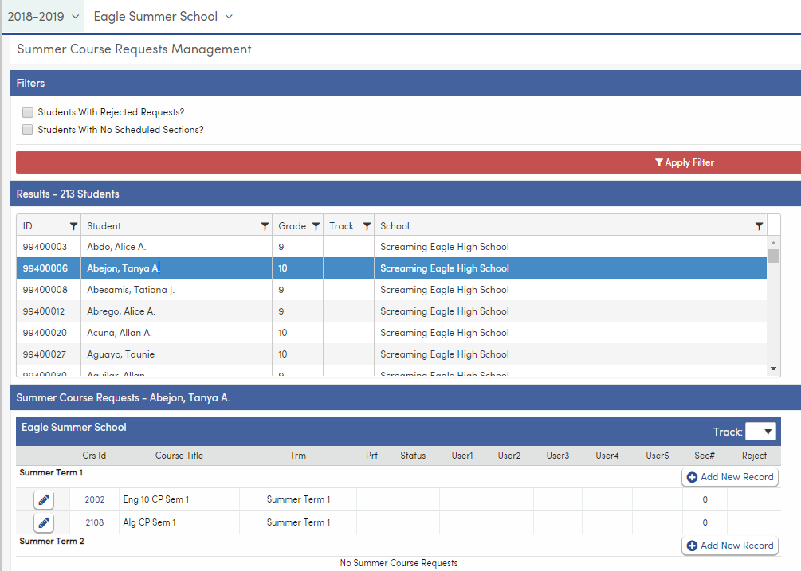
Summer Course Request Management
NAME OF THE PRESENTATION

Slide 13
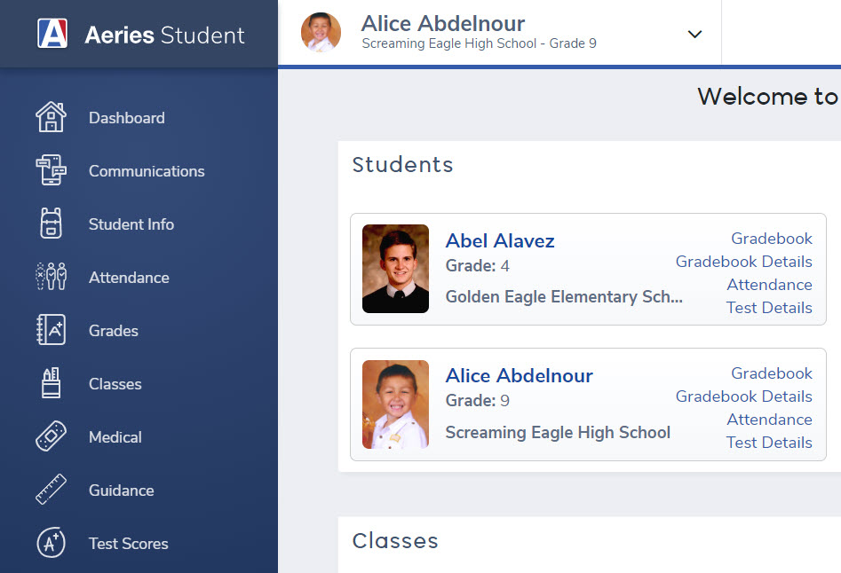
Student/Parent Portal
Summer School Course Requests can be viewed or entered by parents or students through the Aeries Portal.
NAME OF THE PRESENTATION

Slide 14
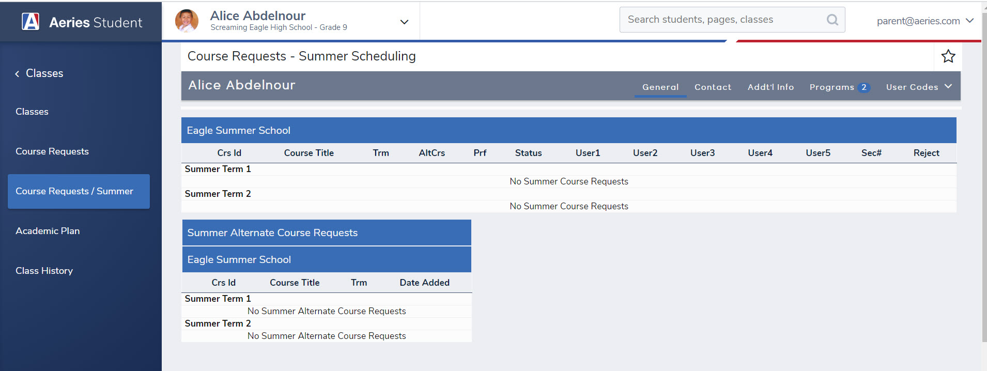
Parent/Student Portal
The Summer School Course Requests appear under classes
NAME OF THE PRESENTATION

Slide 15
Questions????
NAME OF THE PRESENTATION

Slide 16
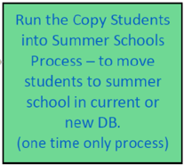
Flow Chart Copy Students into Summer School
NAME OF THE PRESENTATION

Slide 17
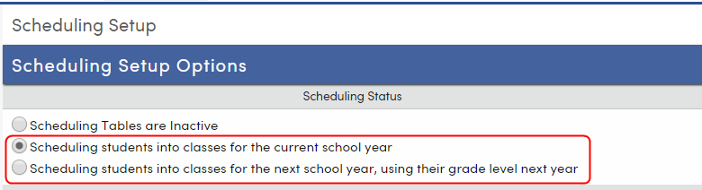
The student’s grade level in the summer school will be populated based on the Scheduling Setup options in the summer school in the regular database.
NAME OF THE PRESENTATION

Slide 18
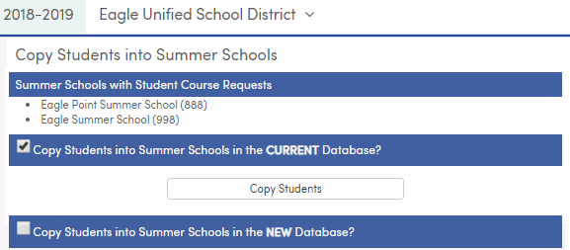
Copy Students into SS in the Current Database
NAME OF THE PRESENTATION

Slide 19
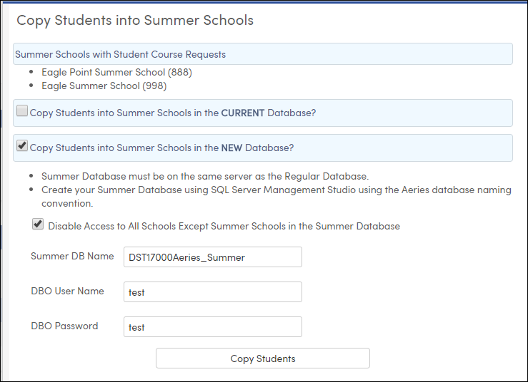
Copy Students into SS in a New Database
NAME OF THE PRESENTATION

Slide 20
SS New Database Options/Requirements
The administrator performing the Copy Students into Summer School in the New Database will also need to enter the DBO User Name and DBO password to the copy process
Note: This elevated SQL login is necessary because this process entails copying more than just data (e.g., security and some table definitions). At minimum, the login must be a member of the db owner database role on both the current and new summer databases and have the ALTER ANY LOGIN server-level permission. Using a login that is a member of the sysadmin fixed server role is one way to guarantee that permissions are adequate.
Custom tables that have been configured using the Define Custom Tables feature in Aeries will automatically be created and copied during the Copy Students into Summer Schools process.
NOTE: Non-student-related custom tables will NOT be copied to the new summer database at all.
NAME OF THE PRESENTATION

Slide 21
Prior to running the Copy Students into Summer School process, the new summer database needs to be created in SQL Server Management Studio.
The year of the new summer database must be the same as the current year or increased by one (for example DST17000EagleUSD_Summer)
The SQLModel from the most recent Aeries Client Version update needs to be run against it to create the table structure.
Note: There is no need to connect to the new summer database in AdminCS prior to running in Web as long as the latest SQLModel is used.
The new summer database must reside on the same server as the regular database
The new summer database connection must be configured in a different database group than the current database
The District Rule (LOC.R2) to “Assign new student Id numbers from the district, not school” will be honored. Verify the next perm ID in the regular database from School Options is set correctly for new student adds.
Disable Access to All Schools Except Summer Schools in the Summer Database – this option, when selected, will delete tag all USR records (User School Permissions) table to limit the access of users to only the summer schools.
SS New Database Options/Requirements
NAME OF THE PRESENTATION

Slide 22
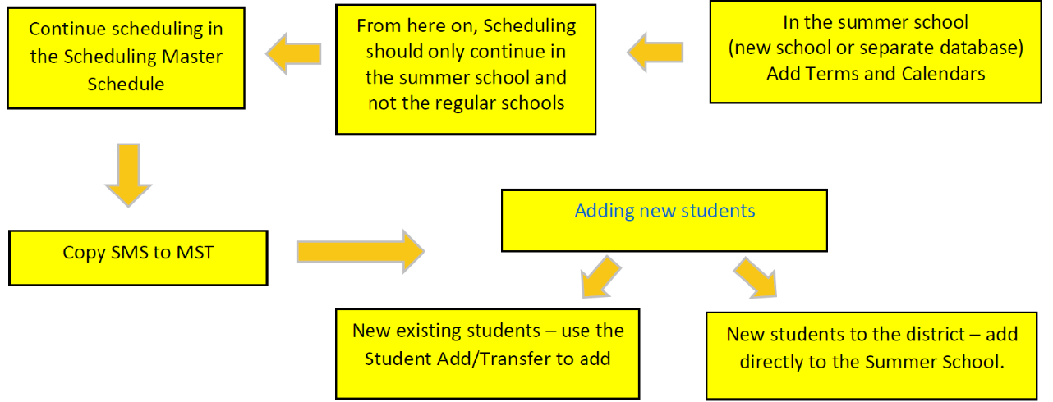
Flow Chart
NAME OF THE PRESENTATION

Slide 23
Troubleshooting – Things to Check
Confirm School Options.
Confirm Terms.
If using Tracks, must build track related information in Summer School.
Confirm Bell Schedule.
Confirm Scheduling:
  SMS scheduler should remain linked to the SSR table at the student's school.
  Confirm SMS sections are correct.
  Confirm all students have been scheduled.
  Copy students to Summer School.
  In Scheduling Process | Configurations | Scheduling Setup remove the checkmark from Summer School Course Request Scheduling.
  Make a backup.
  Roll to MST.
Teachers don't have access to Summer School:
  Copy teacher permissions from another school.
  Confirm teacher record is linked to Staff ID.
  Confirm Attendance in Portal Options is configured.
  Confirm App Settings | Appsettings.config is set for Summer School.
Users don't have access to Summer School:
  Confirm Summer School access on user accounts.
Portal Accounts cannot see data in Summer School:
  In Security | Portal Groups push permissions to Parents and Students
NAME OF THE PRESENTATION

Slide 24
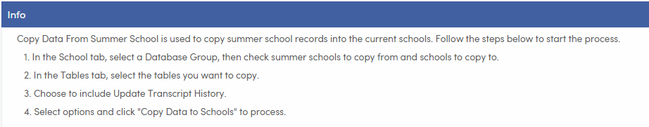
Copy Data from Summer School (District)
NAME OF THE PRESENTATION

Slide 25
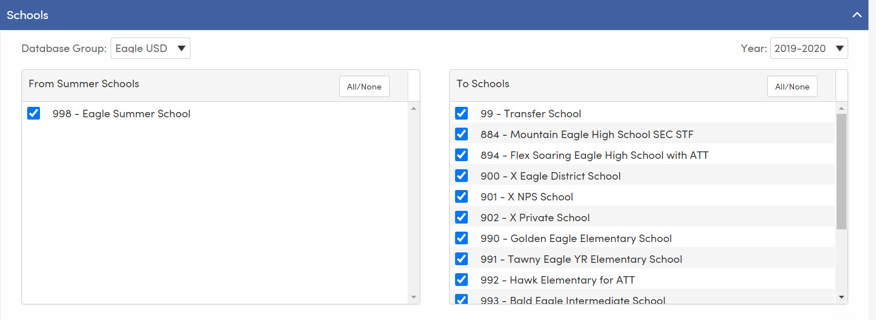
Copy Data from SS (School Options)
NAME OF THE PRESENTATION

Slide 26
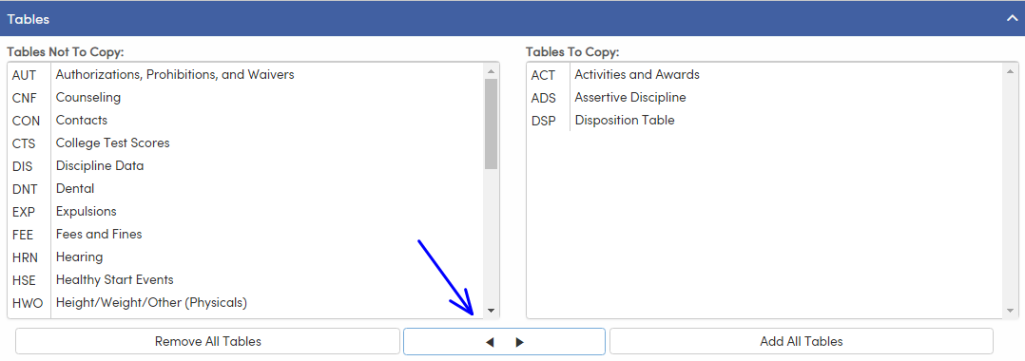
Copy Data from SS (Table Option)
NAME OF THE PRESENTATION

Slide 27
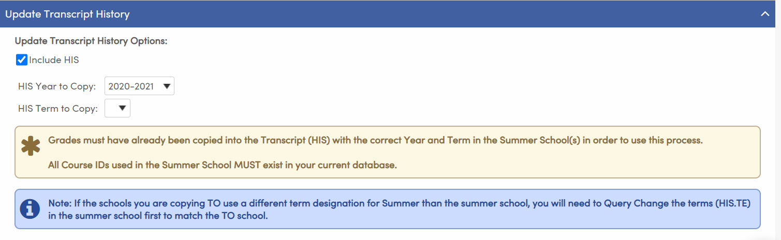
Copy Data from SS (Update Transcript History)
NAME OF THE PRESENTATION

Slide 28
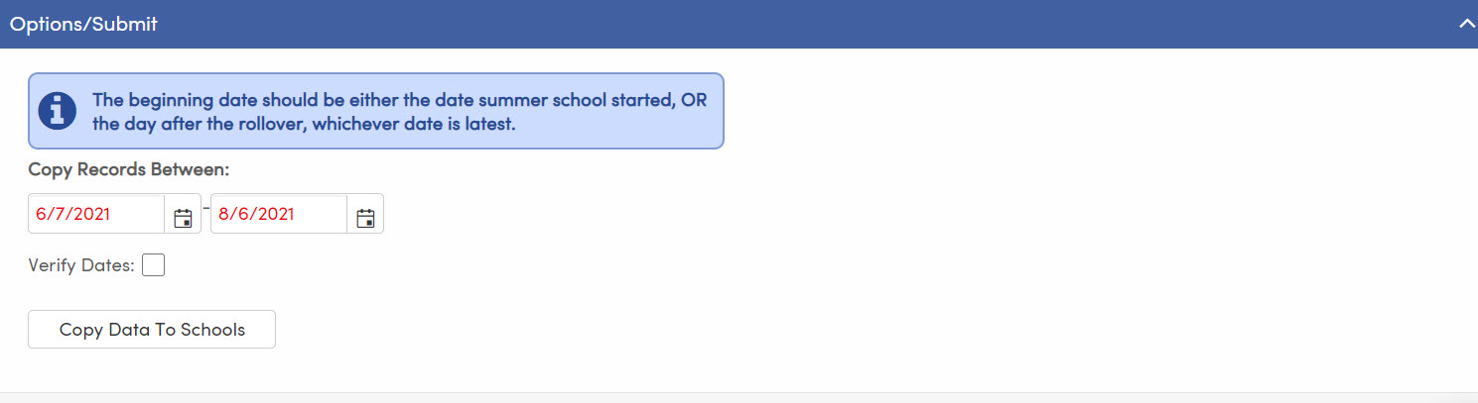
Copy Data from SS (Options/Submit)
NAME OF THE PRESENTATION

Slide 29
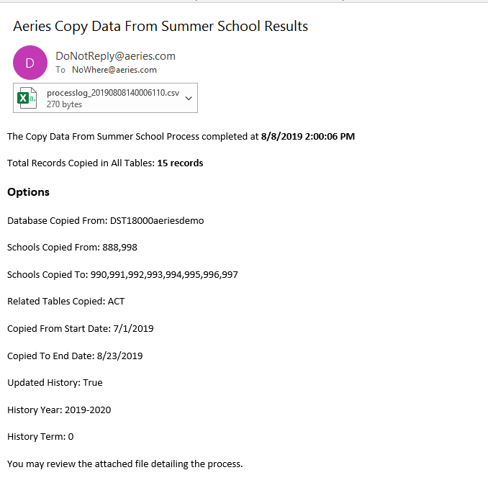
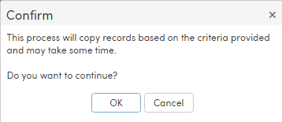
Copy Data from SS (Confirmation)
NAME OF THE PRESENTATION

Slide 30
Questions????
NAME OF THE PRESENTATION

